Slide 1
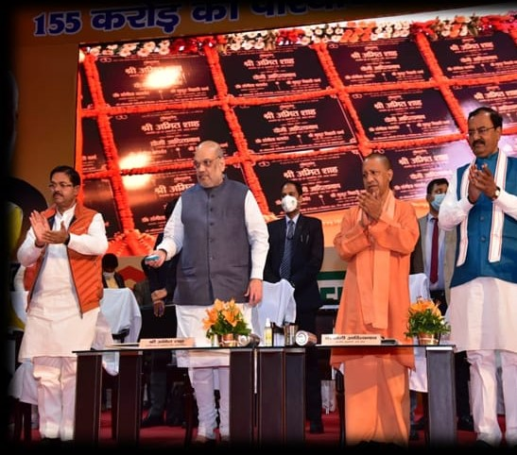
State Cooperation Secretaries and RCSs Conference, Ministry of Cooperation, Govt. of India
Under the chairmanship of Secretary, Department of Cooperation, Govt. of India
Hall no 2 and 3, Vigyan Bhawan, New Delhi, Date- 9th Sept 2022

Slide 2
Multidimensional Works
U P Cooperative Societies Act 1965 & Rules 1968
Societies functional since 1903
More than 2 crore members
40000 employees
Economic upliftment
Mitigating Rural Migration
Freedom from money lenders
10 Departments 46000 Societies
Housing-2547
Cane/Sugar- 199
Silk- 197
Dairy- 20792
Industrial- 902
Khadi & Gramodyog- 2685
Handloom- 2840
Fisheries- 1012
Horticulture- 992

Slide 3
Cooperation through Coordination
State/UT governments
R.B.I (Licence/
Regulation)
NABARD (5000 Cr Financing)
Agriculture/Chemical
Fertiliser / Finance Service / Cooperation/ Civil Supplies
Ministries (GoI)
IFFCO/ KRIBHCO (10000 Cr Business on Credit)
FCI
(14000 Cr MSP)
Finance
Business worth Rs. 75000 Cr with Budgetary Support of Rs 500 Cr
Target of increasing business to
Rs 1 lakh Cr
NAFED
(74Cr)
Pulse/Tilhan
Agriculture
Departments of State
TRIFED
(MoU)
(5Cr Business)
Food & Civil Supply
Cane/Horticulture
Nagaland Cooperative Federation
BIRD/ IGCM
Training
Patanjali Products (5 Cr Business)
NCDC
(45Cr)
NCUI (Training)
Sikkim Federation (MoU)
(5Cr Business)
NBCFDC/
NSCFDC
(500 Cr)

Slide 4
Agriculture, Consumer, and Construction
Price Support
Wheat/Paddy/Pulse
70 % Share
Agri Inputs
Seeds/ Fertilisers/ Nano/ Micro Nutrients
40% Share in state
Construction
800 Cr Turnover
Consumer
250 Cr turnover
IFFCO, KRIBHCO
80 LMT
Provincial Cooperative Federation
1450
Staff
Turnover 12000 Cr
Provincial Cooperative Union
579 Personnel Turnover
3154 Cr
Uttar Pradesh Upbhogta/
Consumer
Sahkari Sangh
176 Employees Turnover
1665 Cr
Pradeshik Cooperative Federation
(Warehousing and Transportation)
Uttar Pradesh Rajya Nirman Sahkari Sangh
Strength 483 Turnover
600 Cr
Uttar Pradesh Cooperative Labour Development Federation
117 Personnel Turnover
200 Cr
Uttar Pradesh Sahakari Sangh
171 Staff
Turnover 250 cr
PACS 7400
Marketing Societies=258
71 Lakh MT procurement under MSP
Disbursement of Rs. 14000 Cr
to 15 lakh Farmers
8500
Sale Points
344 Construction Member Societies
265 Labour Member Societies
118
centres

Slide 5
Banking and Warehousing
Banking
Warehousing
U P Cooperative Bank
Branches 40
Strength 639
Turnover Rs 20594 Cr
Uttar Pradesh Sahkari Gram Vikas Bank
Branches 323
Personnel 2590
Turnover 2614 Cr
Urban Cooperative Bank (58)
Branches 245
Strength 1802
Turnover
7850 Cr
State Warehousing Corporation
Staff 2477
Turnover 567 Cr
District Cooperative Banks 50
Branches 1260
Personnel 5076
Turnover Rs 35170 Cr
7400 PACS
Rs 20000cr ST loan
18 lakh members
120 Sugar Mills funded with 20 Lakh Cane Societies Members
Linkage of 84 lakh members of PACS with NABARD
Employment Oriented/ Farm Equipment Financing
3.5 lakh Members
Banking Services to
2 lakh Deprived Customers
110 lakh MT storage capacity
Growth upto 150 lakh MT by
March 2023
PDS / PMJKY in State for Warehousing and Transportation under FCI

Slide 6
Administrative Structure
Training and Resource Development
PCU
ICCMRT
ACSTI
IGCM
BIRD
State Cooperative Election Commission
1 Chief Election Commissioner
2 Election Commissioners
112 personnel
Judicial Tribunal
1 Chairman (Ex. District Judge)
2 Members
13 personnel
Investigation
Special Investigation Branch
1 DGP
1 DIG
Strength 261
Sewa Mandal
(Recruitment Agency)
Personnel 15
Currently recruitment through IBPS
Commissioner and Registrar
23 Additional Registrars
04 Joint Registrars
14 Deputy Registrars
111 Assistant Registrars
152 officers
Training to 5000 Office Bearers Personnel
MBA Curriculum
Elections to 46000 Societies Ensuring Democratic Functioning
Appellate Authority Under the ACT
(110 Appeals Disposed)
Investigation of Embezzlement Exceeding
Rs. 1 Lakh
Service Related Matters
(233 Cases Disposed)
Powers vested under UP Cooperative Societies Act 1965 and Rules 1968

Slide 7
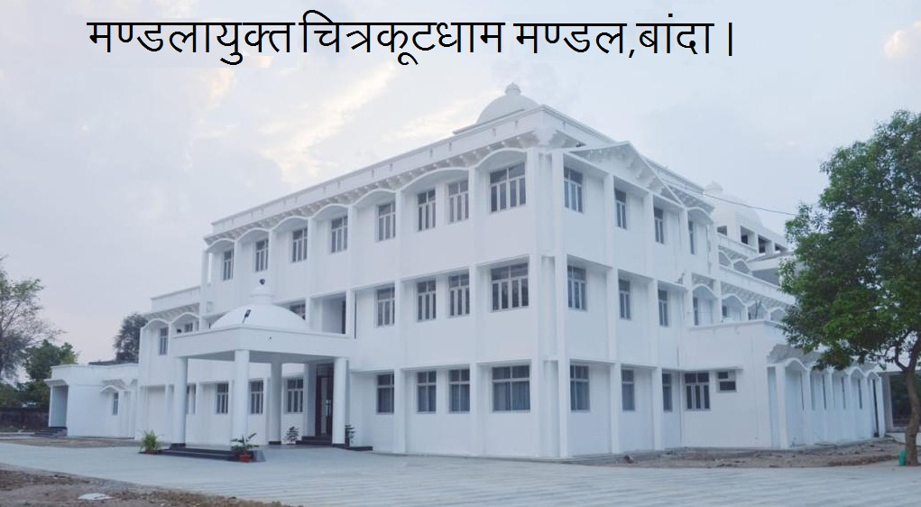
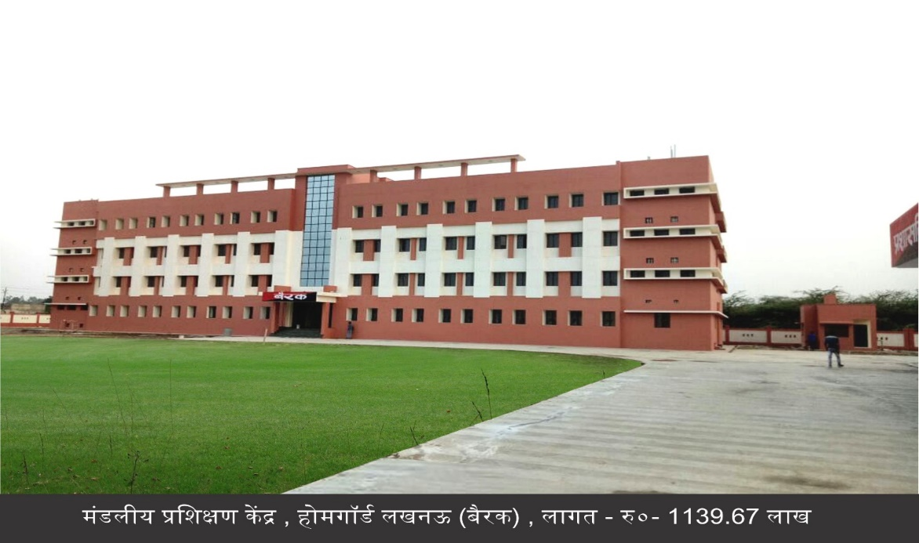
Apex Bodies: Infrastructure Creation
Uttar Pradesh Rajay Nirman Sahkari Sangh (UPRNSS)
(Turn Over- Rs 600 Cr.) (Projects- 2600)
2. Uttar Pradesh Construction and Labour Development Federation Limited (UPCLDF)
(Total Turn Over- Rs 200 Cr.) (Projects- 1400)
First State of the Nation with two cooperative construction agencies being run in Uttar Pradesh
26000 Workers Covered under Social Security Scheme of the Labour Department
For the first time since inception, 10 Apex Cooperative Institutions are in profit of Rs 400 Cr
Construction Cost= Rs 854.6 lakhs
Mandaliya Prashikshan Kendra, Homeguards
Cost= Rs 1139.67 lakhs

Slide 8
Agri Infrastructure Fund (AIF) Atma Nirbhar Bharat Initiative
6% Interest Subvention (3 % GoI + 3% GoUP)
Total:
3403 Applications
1140 Projects Sanctioned
Project cost-Rs 510 Cr
PACS:
1249 Applications (amt. 166.03 Cr)
707 Projects Sanctioned(amt. 112.15 Cr) (UP ranks 3rd)
559 Projects for which loan disbursed (amt.40.02Cr)
(UP ranks 2nd)
Non PACS:
857 Applications (amt. 911.37 Cr)
433 Projects Sanctioned (amt.399.00 Cr)
327 Projects for which loan disbursed (amt. 272.14 Cr)
Number Of Applications
Applicants
First state to provide Rs 22 lakh additional interest subvention to beneficiaries.

Slide 9
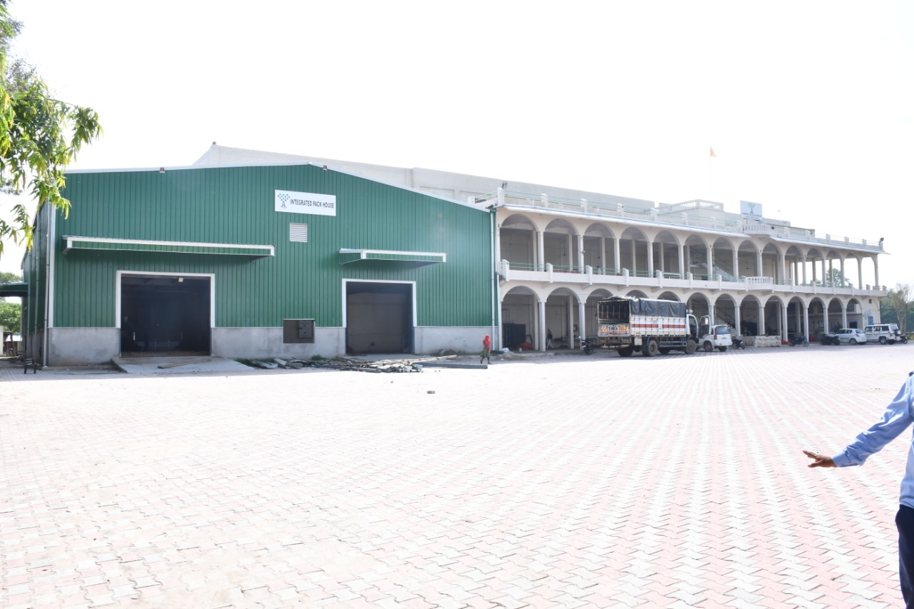
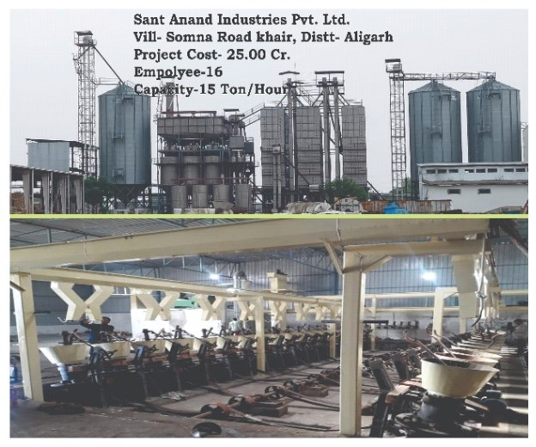
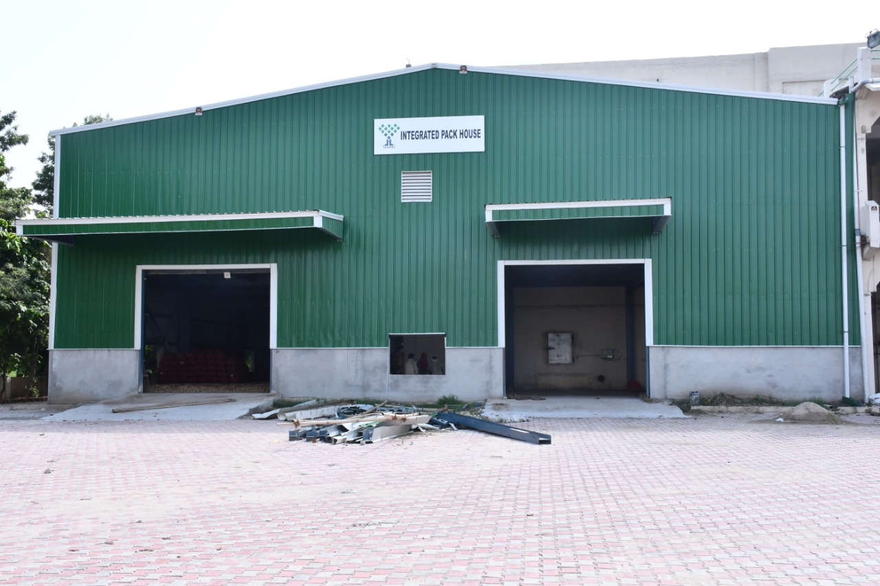
Yashpal Agri Product and Cold storage Pvt Ltd., Aligarh
Capital Cost = Rs 2.76 Cr

Slide 10
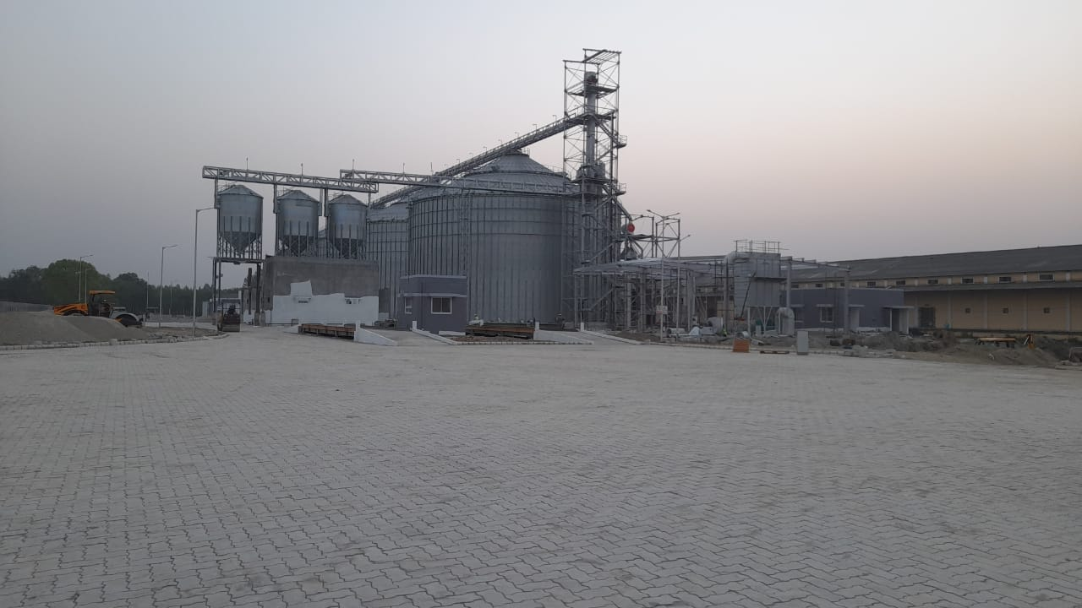
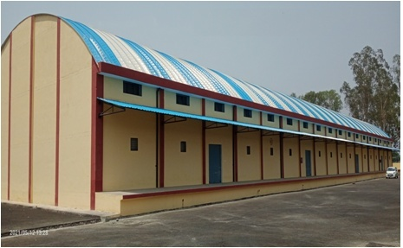
Innovations in Warehousing
Awarding of WDRA Certification to State Warehouse Corporation- 40 lakh MT.
1st in logistics under PM Gati Shakti Scheme with geo-mapping of 140 warehouses
Additional WDRA certification of PACS warehouses capacity 250 MT or above
Steel Silos of 50,000 MT each constructed under PPP mode at 10 locations: 7 locations (FCI) and 3 locations (UPSWC)- Rampur and Kannauj functional
A total of 6.85 lakh MT capacity enhancement and modernization under Private Entrepreneurs Guarantee Program.
State Warehousing capacity in 2017 was 70 lakh MT which grew to 110 lakh MT in 2022
M/s Adani Group
50000 MT Kannauj
SWC
5000 MT Amroha

Slide 11
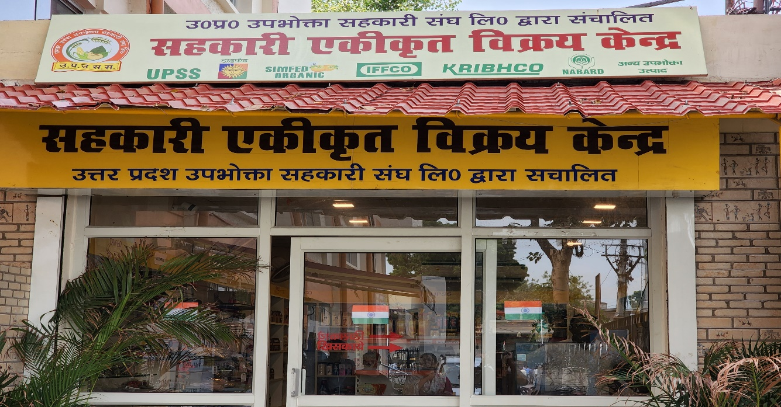
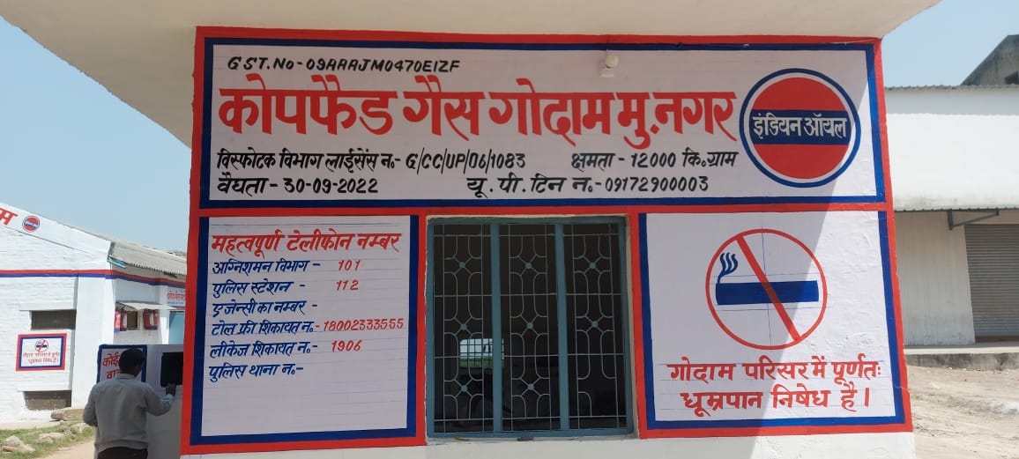
Business Diversification
MoUs to enhance profit and to provide pan-India outlook:
    UPSGVB (Sahkari Gram Vikas Bank) and LIC- Expected business Rs 100 Cr
    UPSGVB MoU with IFFCO Tokio and ICCI Lombard- Business Rs 22 Cr
    UPSS and Sikkim State Cooperative Supply and Marketing Federation Limited (SIMFED)- Business Rs 10 Cr
    UPSS and Tribal Cooperative Supply and Marketing Federation Limited (TRIFED)- Business Rs 20 Cr
    UPSS and Nagaland Cooperative Federation Limited
Sale of Patanjali products through PACS

Slide 12
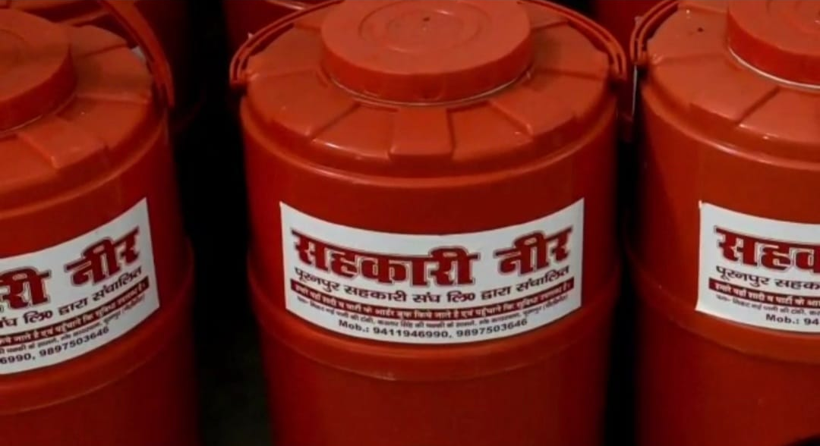
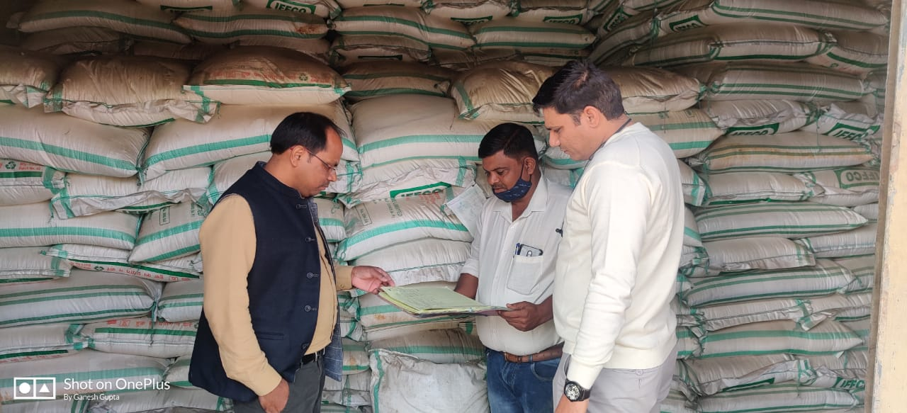
Employment Generation
4 Cr. man- days created through cooperative societies during a year.
Target of Rs 3500 Cr. Investment and employment to 1 Lakh individuals under AIF in a year.
Long term Credit by Uttar Pradesh Sahkari Gram Vikas Bank Ltd. of Rs 588 Cr to 38000 farmers (80% Growth), providing employment to One Lakh individuals
Creation of 163 lakh man-days by PCF through business in fertiliser distribution, transportation and procurement under MSP.
UPRNSS and UPCLDF generating 50 lakh man-days
RO Water Plant, Sahakari Snagh, Pilibhit
Fertiliser Distribution through PACS

Slide 13
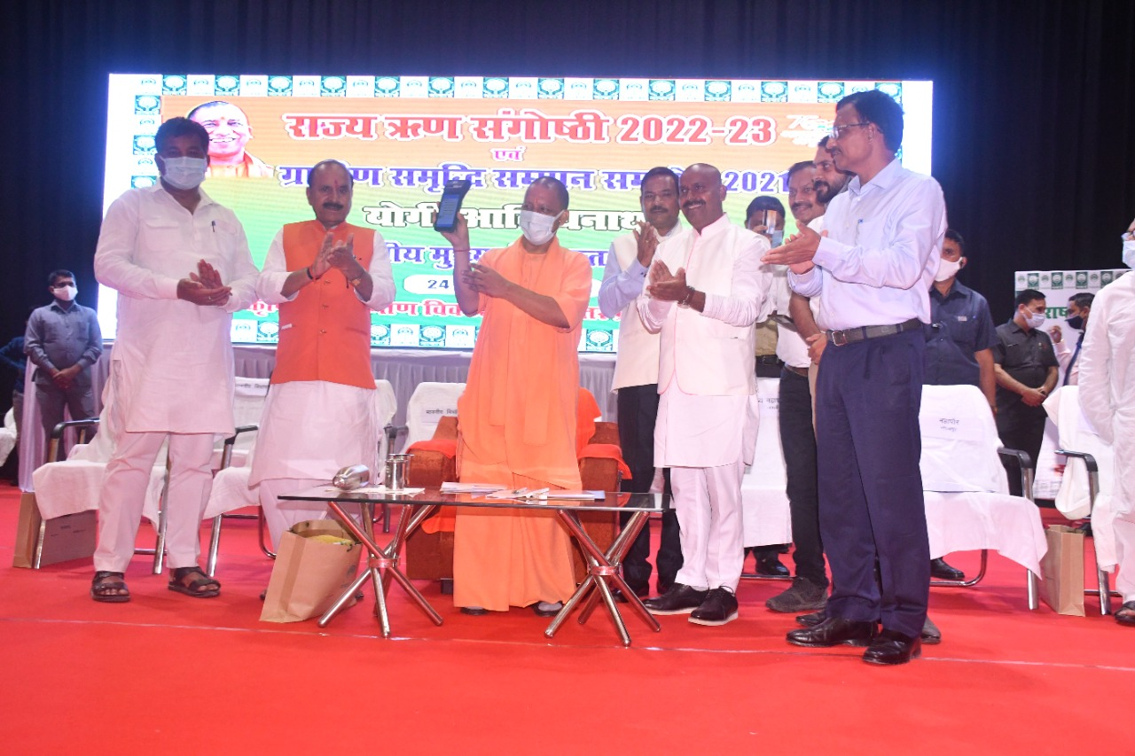
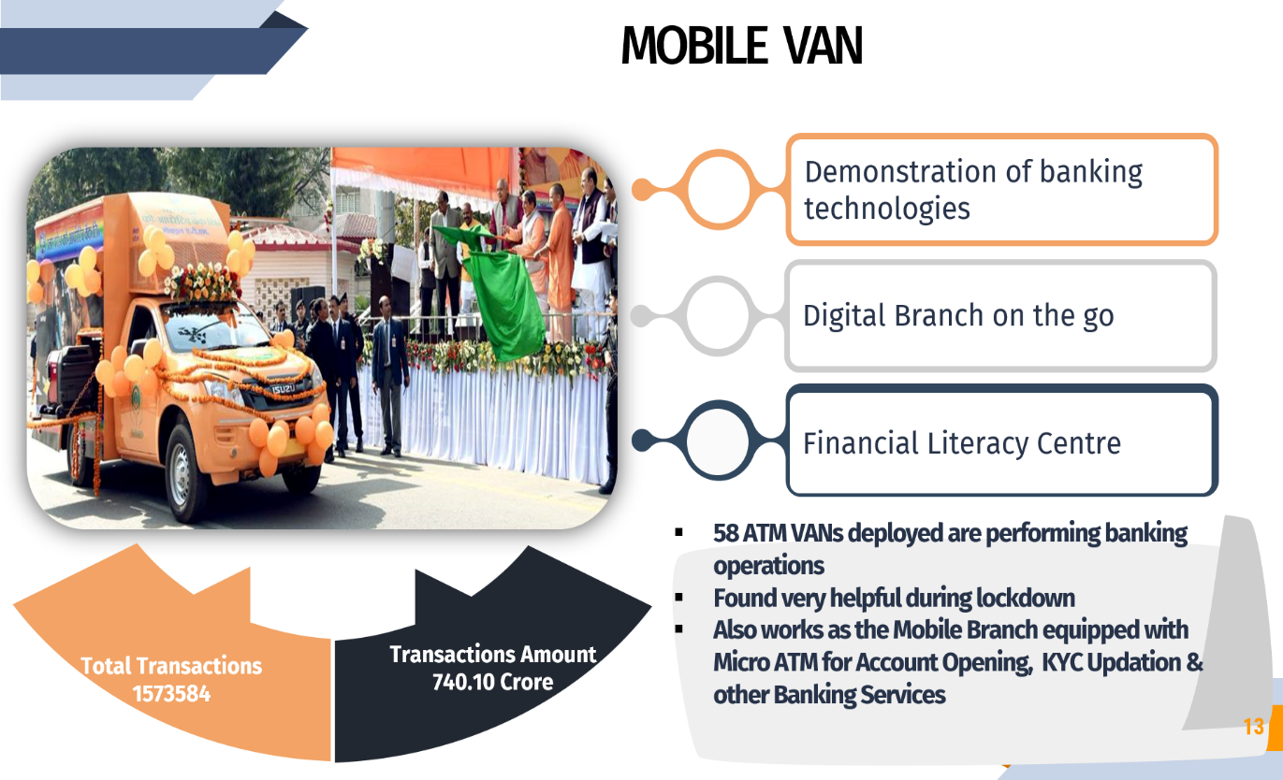
Digitalization for Transparency and Efficiency
Micro ATMs (7600) - Micro ATMs in PACS for facilitating banking activities in Rural India
Mobile ATM Vans operational in 75 Districts
    Total transactions 19.85 lakh of amount 928.17 Cr
Details of 13000 immovable properties computerised and GPS enabled
Monetization of 385 Hectares of land
MoU of DCCBs and PACS with UPPCL for collection of electricity bills
Internet Banking active in Uttar Pradesh Cooperative Bank and 08 DCCBs
Inauguration of Micro ATM by Hon CM Yogi ji at Gorakhpur
Inauguration of Mobile ATM van

Slide 14
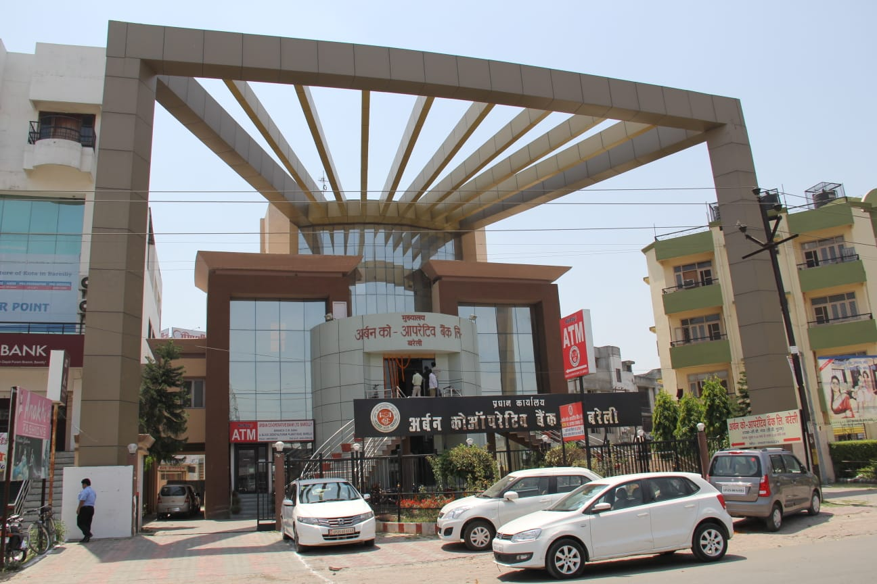
Business Growth of Cooperative Banks
  License for 13 new branches of UP Cooperative Bank (UPCB) by RBI- Branches functional
  Disbursement of short term crop loan amounting to 20,000 crores to 18 lakh farmers
  Financing of Ethanol and Sugar sector of Rs. 7000 Cr through Cooperative Banks- Ethanol policy of UP worth imitating by other states
  Financing of Rs 320 Cr to 7 sugar mills by UPCB and Rs. 110 Cr to 6 sugar mills by DCBs for ethanol sector
  Deposit growth to the tune of 25% in UPCB
Urban Cooperative Bank, Bareilly

Slide 15
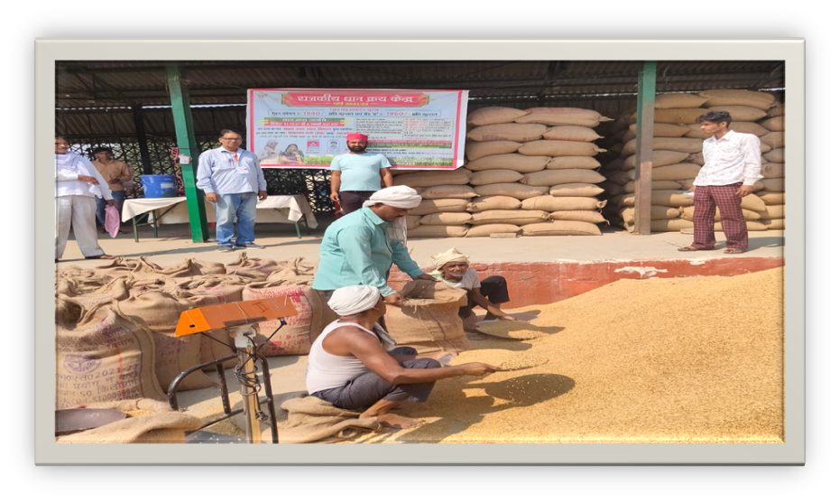
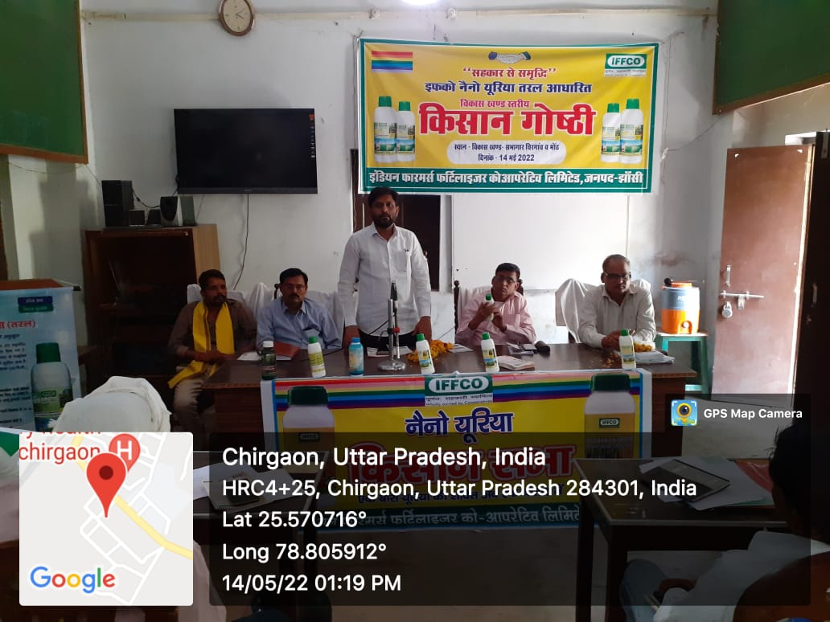
Minimum Support Price/ Nano Urea
MSP-
    70 % of total procurement under MSP through Cooperative Societies
    Payment of Rs. 14000 Cr for procurement of 71.43 Lakh MT from 15 Lakh farmers for their produce in year 2021-22
Nano Urea-
    Organization of Kisan Goshthis in all 823 Development Blocks for promoting use of Nano Urea
    Distribution of 64 Lakh Nano Urea bottles, reduction in consumption of conventional urea by 25 % till 2024
    Production of Nano Urea to begin from month of October from Phulpur and Aonla plant of IFFCO
Wheat purchase under MSP in Shahjahanpur
Kisan Goshthi
for encouraging Nano Urea

Slide 16
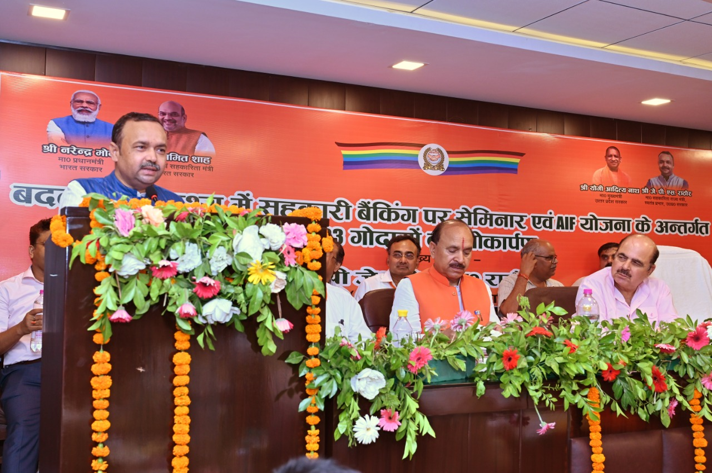
Governance Reforms/ Inputs On Agenda
1. Online registration of the Cooperative Societies/FPO-100
Registration
2. Completion of audit of 6400 PACS
3. Recruitment through IBPS
4. Linkage with NPCI for UPI services initiated- customer
onboarding and app downloading from 12th Sep, 2022.
5. Proposal of setting up of Petrol pump in 78 Cooperative
Societies
6. Rs 25 cr budget outlined for renovating PACS godowns.
7. For establishing PACS in every panchayat, the state act has
authorised the RcS
PACS bylaws of U.P. 2011 has authorised RCS to adapt innovations of other states. As soon as GoI finalises the model bylaws for PCAS, the same will be adopted in the state.
NBCFDC/ NSCFDC and UPLDB initiative to provide subsidized loans@ 6% for SC/ OBC beneficiaries

Slide 17
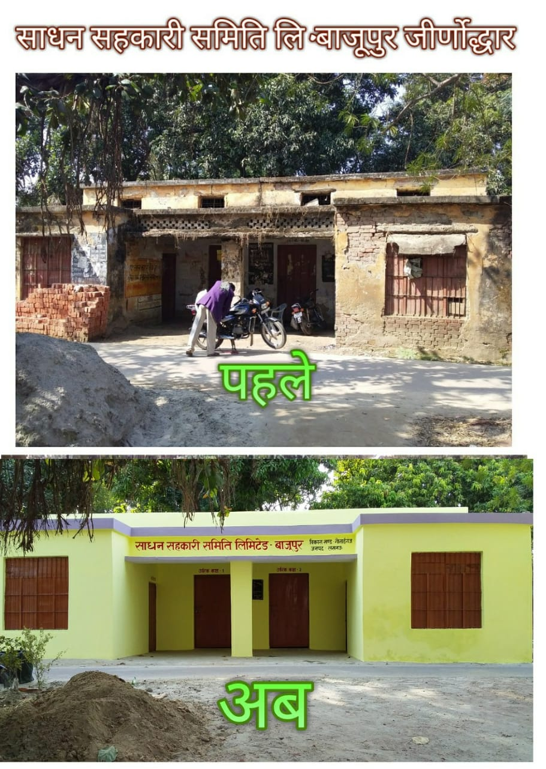
Renovation of 500 PACS under Kayakalp Scheme of the State

Slide 18
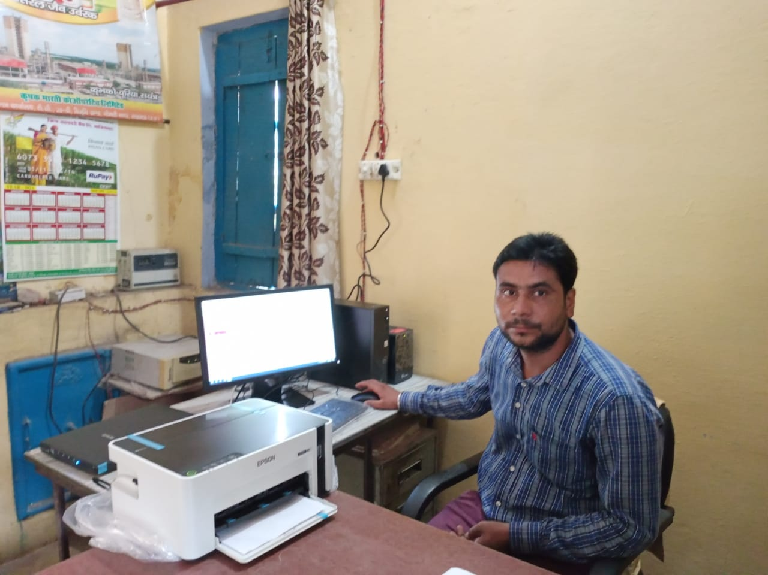
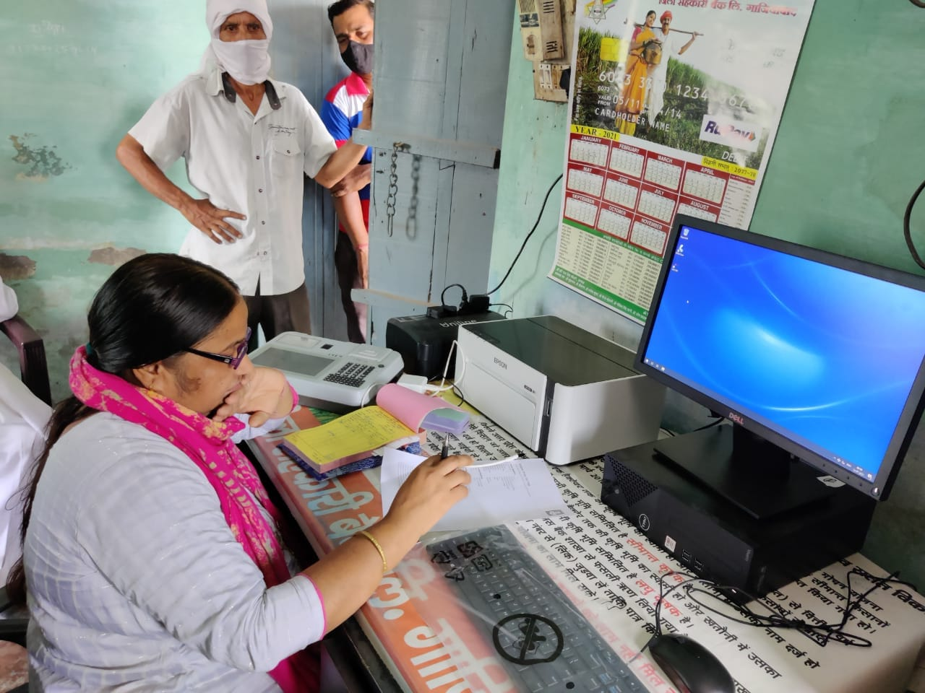
Inputs on Agenda Points
Computerisation of PACS
  Allotment of State share of Rs 17 Cr.
  Setting up of DLMIC and SLMIC
  Proposal of computerisation of 1500 PACS in the first phase, selected/approved by DLMIC and SLMIC sent to NABARD
“Prosperity through Cooperative” scheme, budget head opened and budget provision in advance
Constitution of 8 FPOs under Cooperative Societies Act and process of formation of 100 FPOs through Societies
Suggestions sent for National Cooperative Policy, Collateral Free Credit Guarantee Scheme, National Database and National level Cooperative University
S.S.S. Ravikala, Ghaziabad
S.S.S. Sarna, Ghaziabad

Slide 19
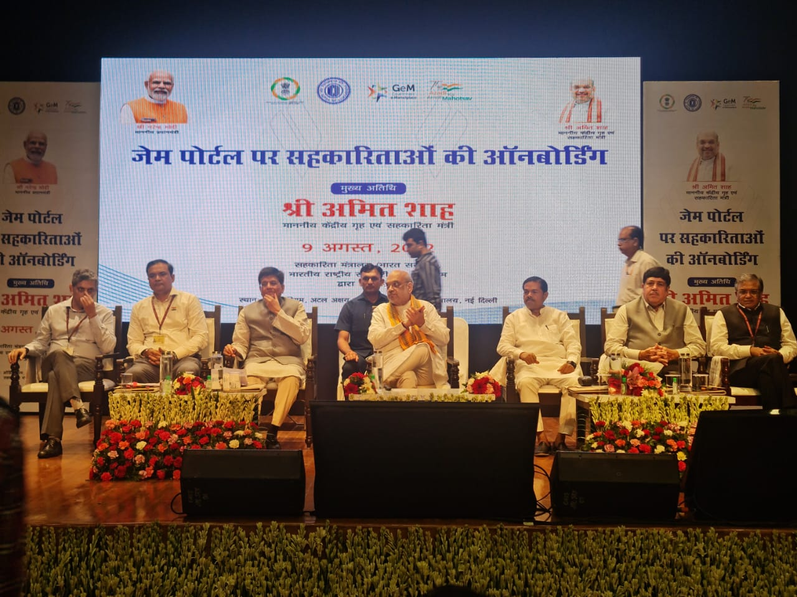
Inputs on Agenda Points
The proposed National Policy on cooperative may promote various think tanks for the advancement of cooperative societies and DICGC coverage for cooperative societies including the PACS.
For the proposed National Cooperative Database Policy, in order to get authentic data, it is suggested to create a mechanism for online verification at various levels.
52 Societies of the State registered on GeM portal
First in the country in onboarding on GeM portal
Procurement of about Rs 500 Cr through GeM portal
Standardisation of Syllabus, Eligibility Criterion, and Selection procedure in recruitment all across the country.

Slide 20
Inputs on Agenda Points
National Cooperative Development Scheme on the lines of Rastriya Krishi Vikas Yojana (RKVY) of the Agriculture Department
Artificial Intelligence and IT courses in proposed Cooperative University
Determination of rating standards at the national level for the societies to promote marketing agro based and organic products and their exports.
For Export promotion for cooperative products, a national level mechanism, like DGFT may be created
Apex Cooperative society to undertake marketing and branding of produce of coops.
For Milk and Fisheries Societies: the State Land Development Bank, Urban Cooperative Banks and District Cooperative Banks can dovetail their financing structure with the National Fisheries Development Board, National Dairy Development Board and Central and State Ministries/Departments of Animal Husbandry, Dairy, Fisheries, Food Processing, Agriculture, Horticulture and Agriculture Produce Marketing Committees (mandis)
U.P. fisheries ranks 3rd in India in inland fish production, and their Matsya Jeevi Sahkari Sangh Ltd, U.P. awarded by NFDB, GoI as Best Quasi Organisation (2021)

Slide 21
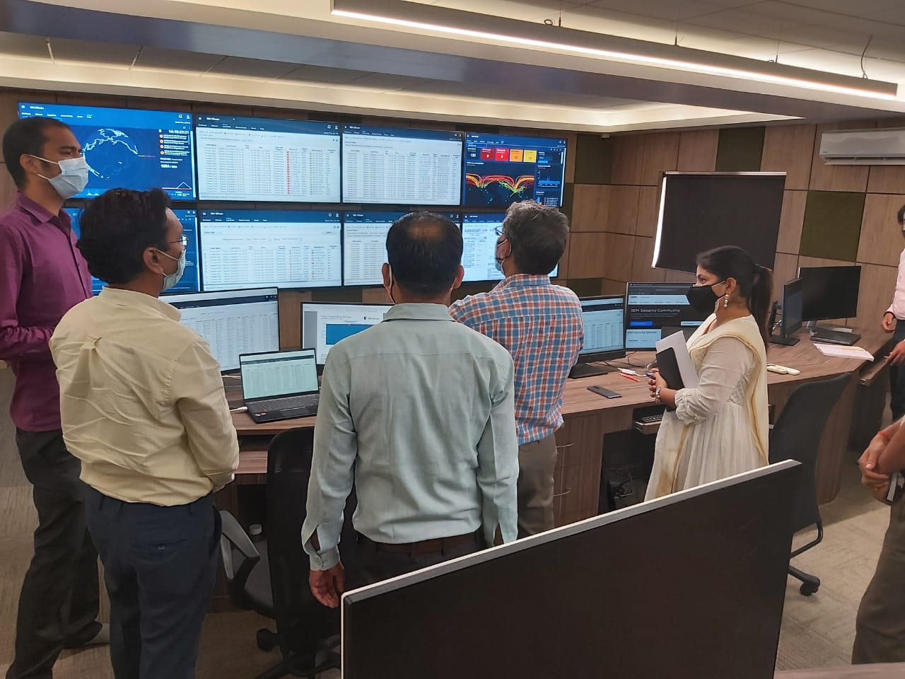
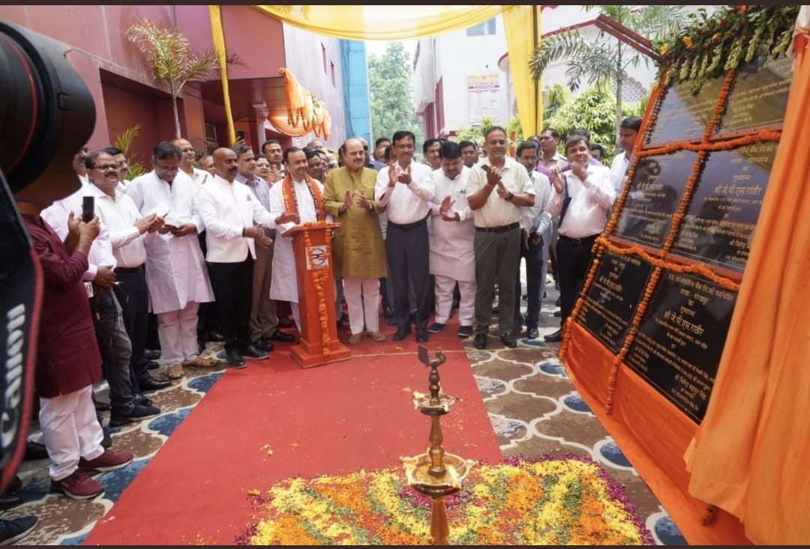
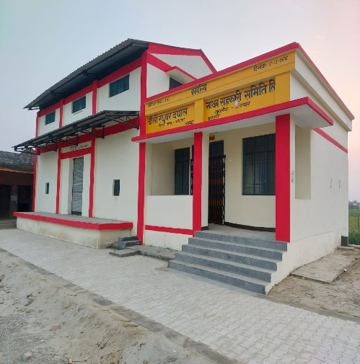
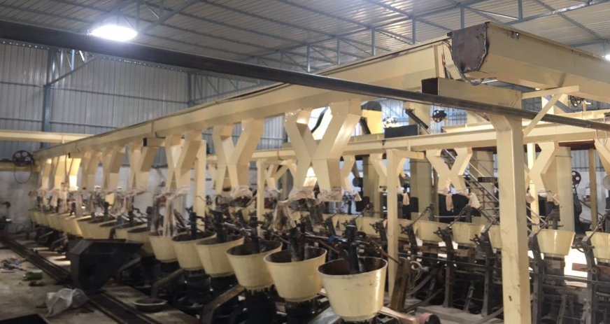
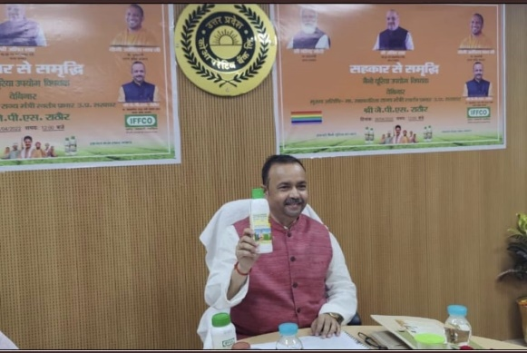
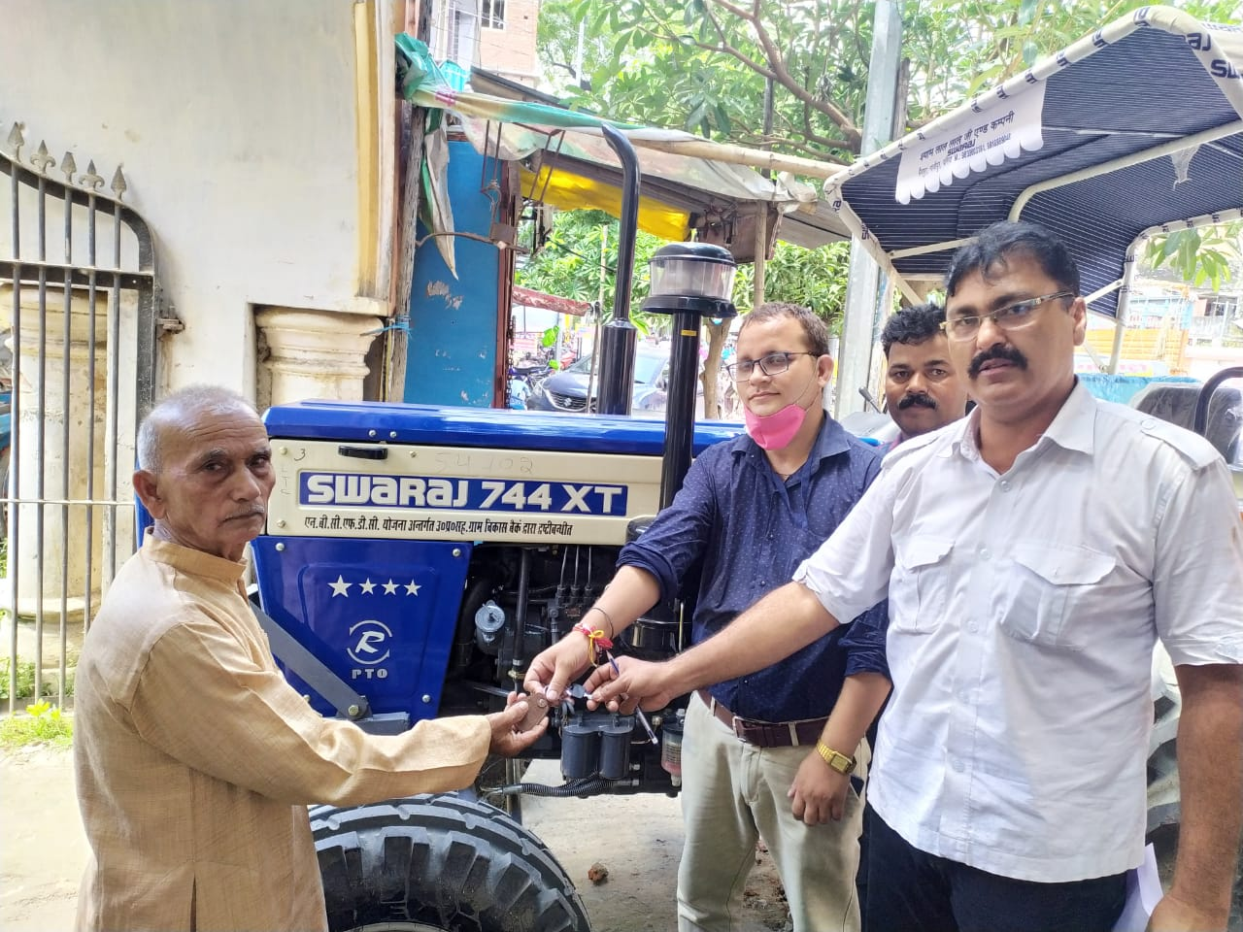
Cyber Security Cell, UPCB
Inauguration of 13 DCB Branches
Dauli Samiti Godam, Bareilly
Capacity= 100 MT
Yug Food Industries,Mainpuri
Capital Cost=
Rs 3.86 Cr
Hon Shri J.P.S. Rathore ji Cooperative Minister Of State (Independent Charge)
Shri Parmatma, Ballia given Tractor via UPGSVB via loaning
“If cooperation fails, there will fail the best hope of rural India”
Royal Commission 1915
Thank You

