Slide 1

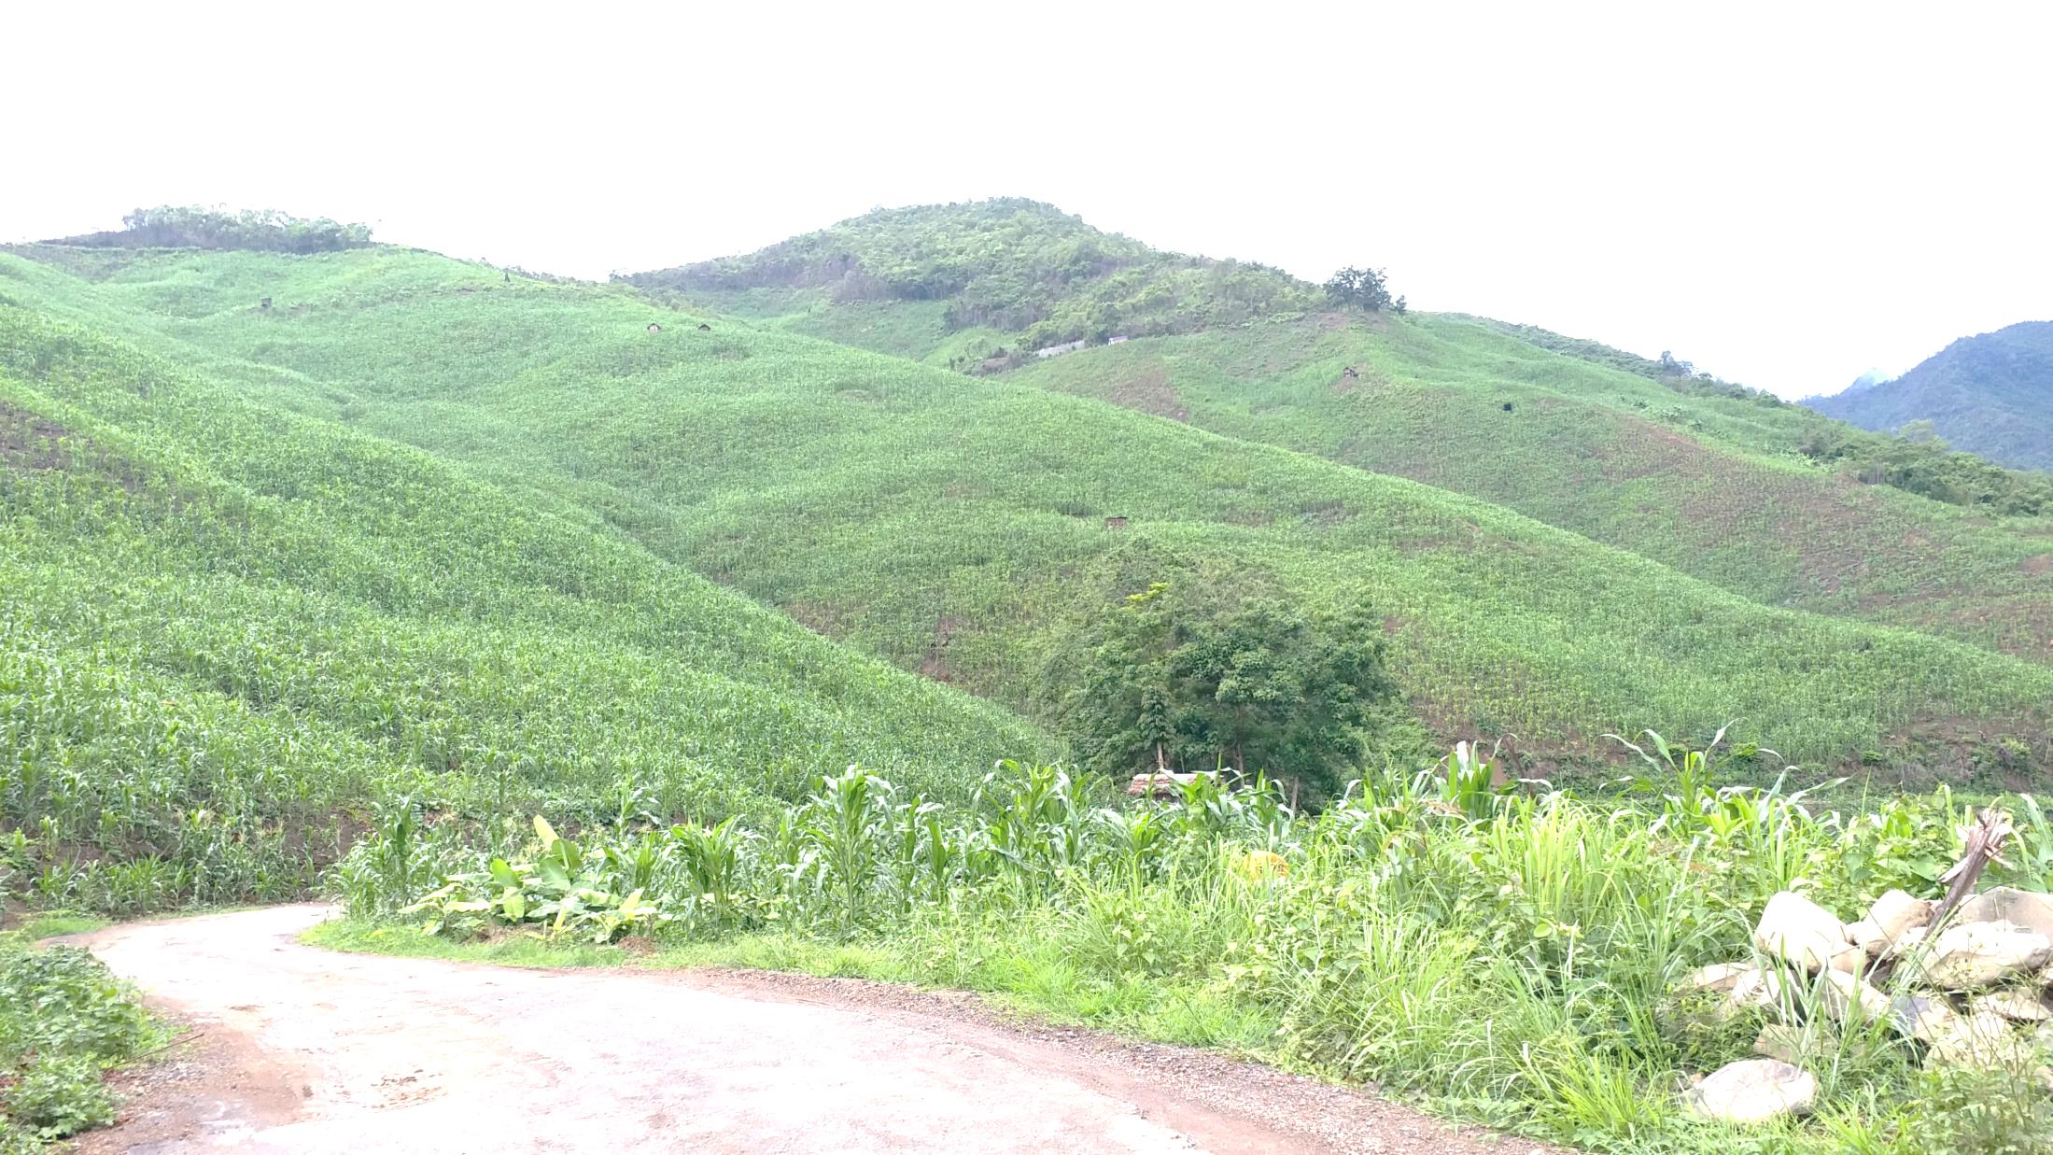
WELCOME TO NAGALAND
Cooperation Department

Slide 2
Cooperation Department, Nagaland
Cooperation department was formed in 1965.
The mandate, duties and functions are provided by the Nagaland Cooperative Societies Act 2017.
There are around 8000 registered cooperatives. Out of which only around 25-30% are functioning cooperatives.
There are 6 state level cooperative federations.
The only state government sponsored cooperative training institute- the Cooperative Training Centre.

Slide 3
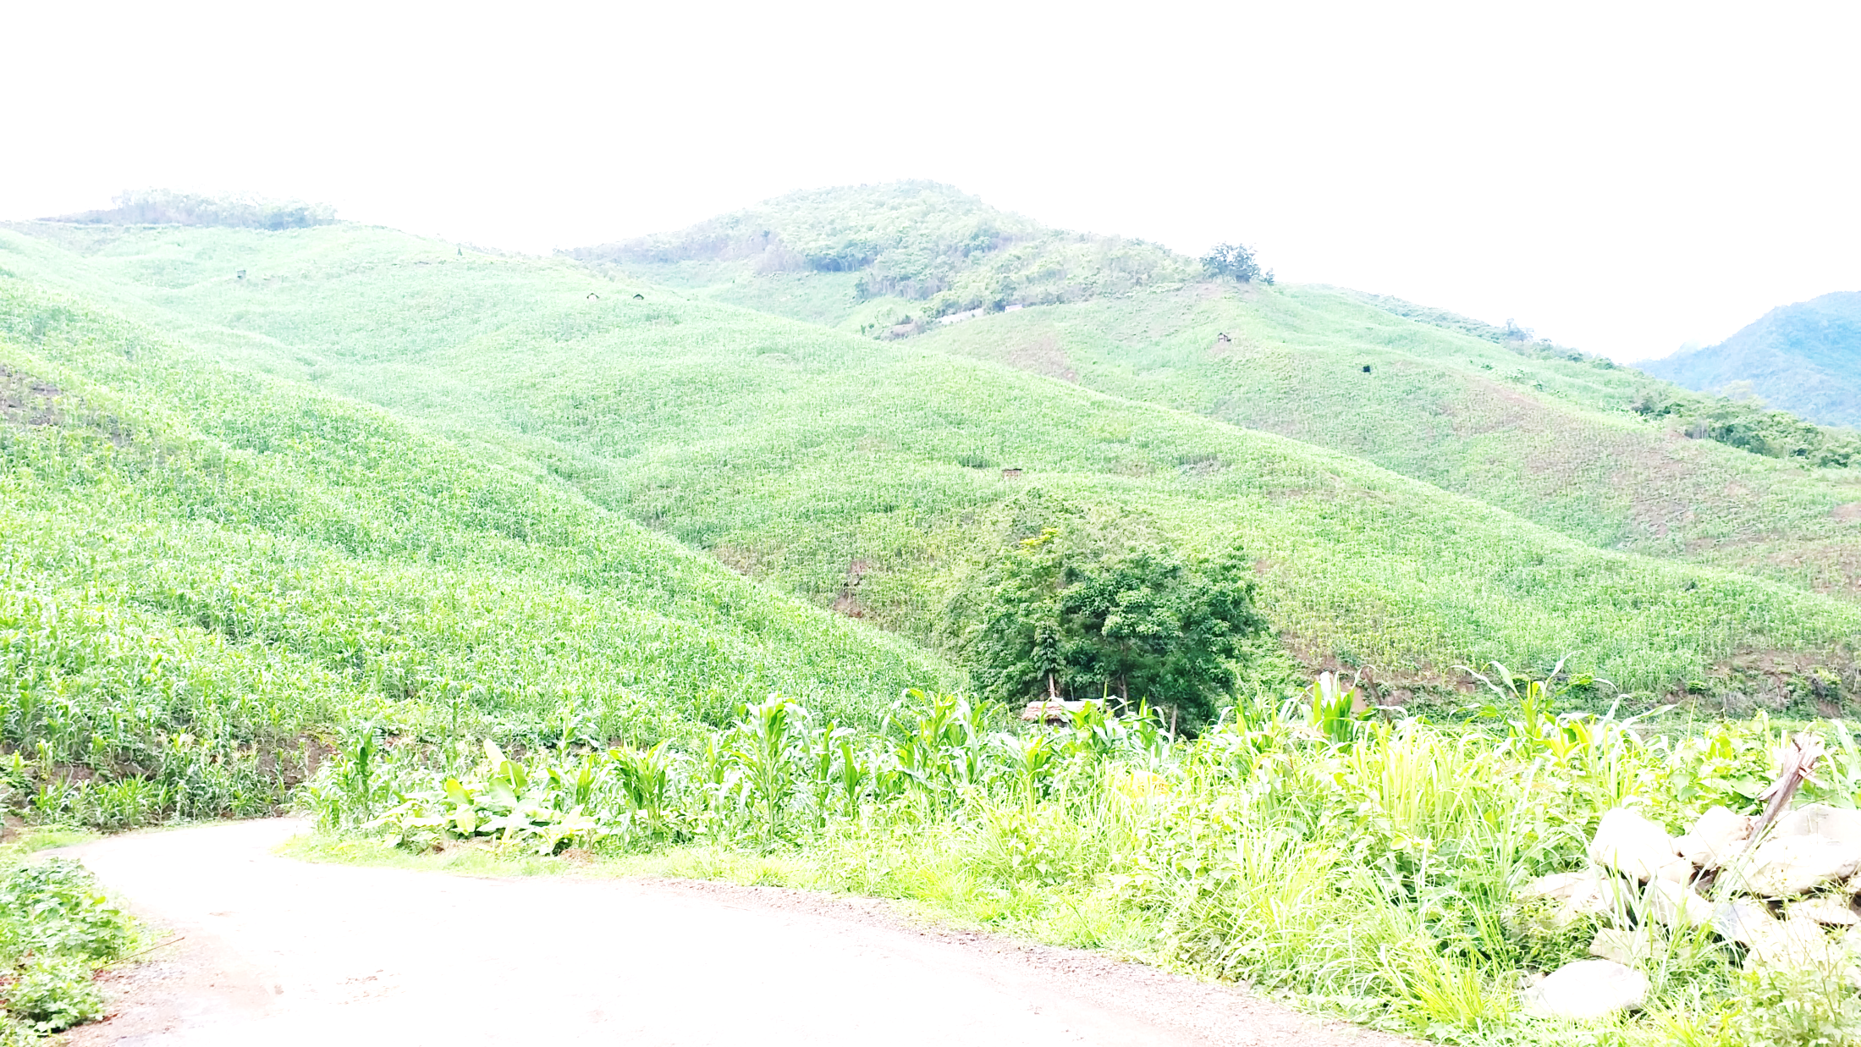
Economic Activities
One of the two Biodiversity Hotspots under Eastern Himalayas
Predominantly agrarian state – economy dependent on agri & allied.
70% of population engaged in agriculture
Potential areas
- Agro & Forest based industries,
- Livestock
- Horticulture,
- Food processing,
- Tourism,
- Handloom & Handicraft

Slide 4

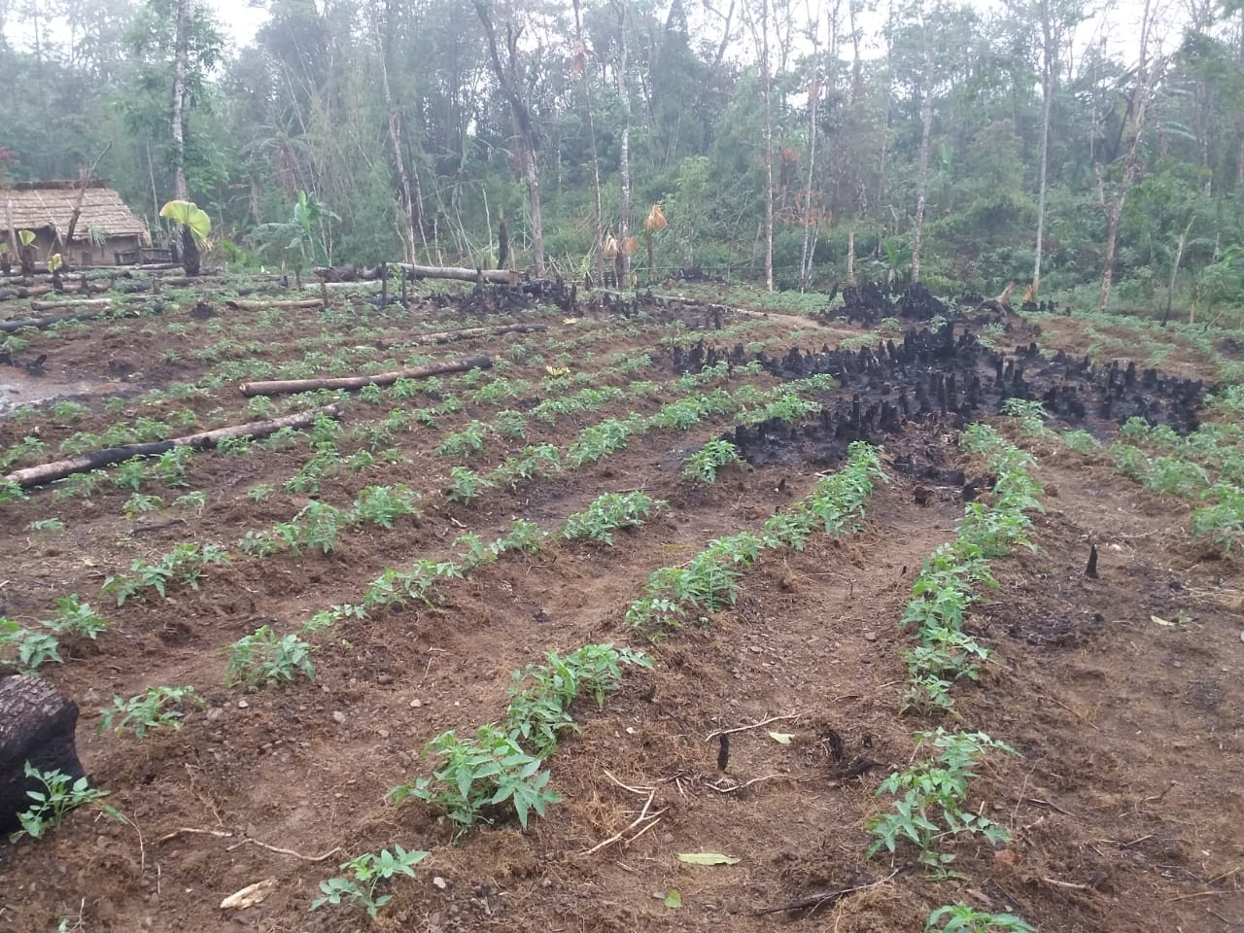
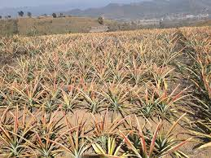
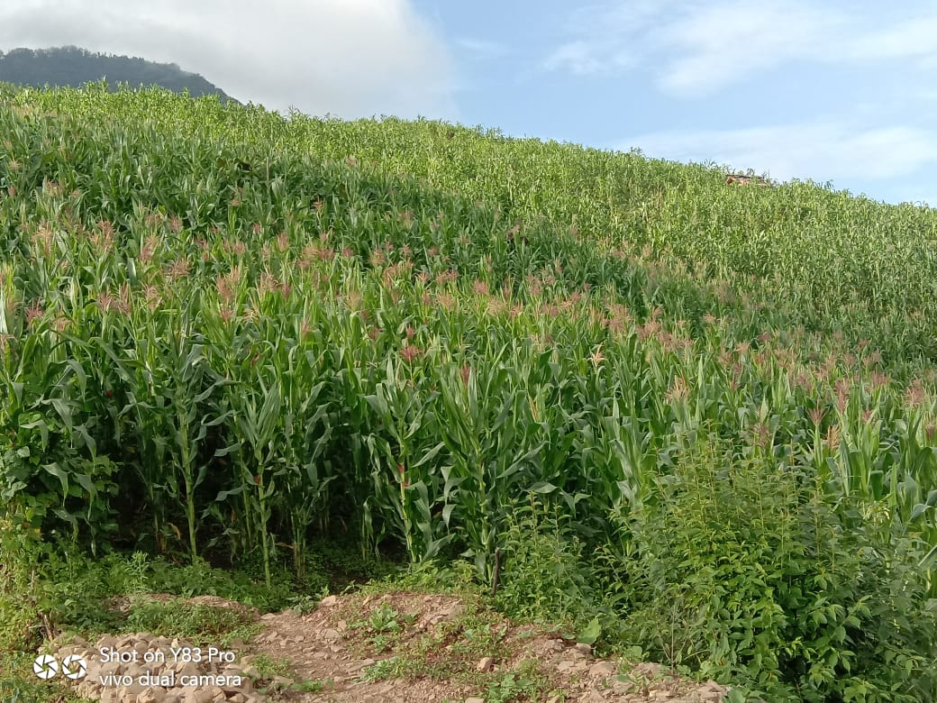
SYSTEMS OF AGRICULTURE
Terrace cultivation
Jhum cultivation
Settled agriculture
(Pineapple farm)

Slide 5
CHALLENGES
Small Membership: Cooperatives in the State and in the region are usually small in membership, depending on the size of the village, which are scattered due to the topography of the state. This has resulted in less working capital, scattered activities, etc.
The main economic activity is Agriculture, and yet most of it is subsistence farming. The leap to commercial and contract farming is yet to take-off.
Thrift and credit habits are comparatively new and is yet to be embraced by the population.

Slide 6
CHALLENGES (cont)
The different CSS projects targeting the farmers, viz., Agriculture Infrastructure Fund (AIF), PM Kisan, Computerization of PACS, etc. are not being able to implement in Nagaland due to various technical roadblocks. The only cooperative Bank (the Nagaland State Cooperative Bank Ltd) is a non-scheduled bank, making it ineligible to access A.I.F. and other similar schemes. Non attainment of RBI criteria, has stopped the NSCB to even provide Net banking services.

Slide 7
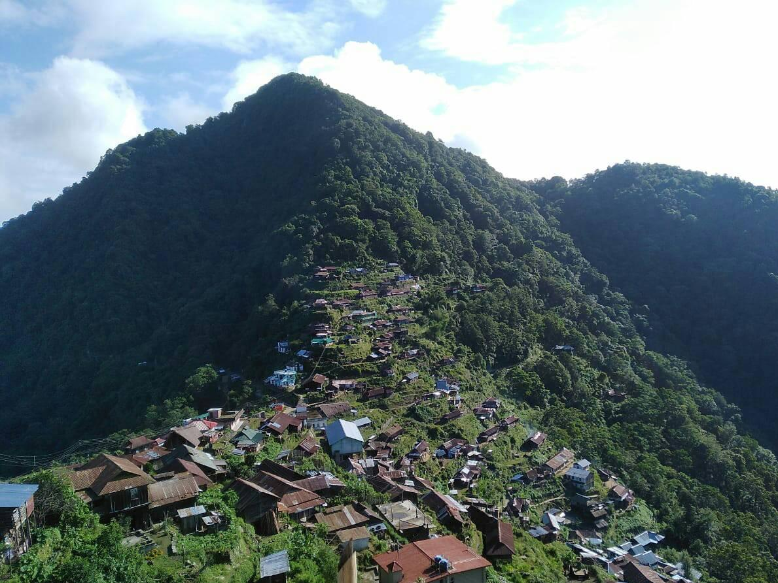
RECENT INITIATIVES
1. One Village One Coop. Society (Integrated)
One member from each household
Provides Thrift & Credit and other financial services
Provides other non-credit services
Economic counterpart of village panchayat

Slide 8
RECENT INITIATIVES
2. Cancellation of Non-functioning Cooperatives
To weed-out non-functioning & defunct cooperatives.
So far registration of 566 cooperatives have been cancelled.
The target is to cancel all the remaining non-functioning cooperatives within the next couple of years.

Slide 9
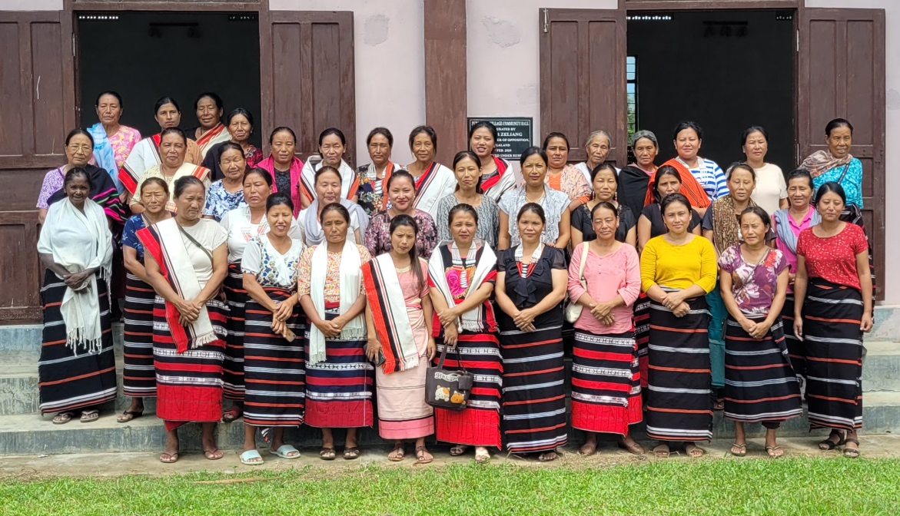
3. Convergence Program
Initiated convergence program with other Departments.
Rural Dev. (World Bank) - SHG facilitated to form Cooperatives – assisted by ICDP
Bee & Honey Mission - Village Bee Committee converted to Cooperatives
Land Resource Deptt. - Watershed Management Committee converted to Cooperatives
Punglwa ‘B’ Women Livelihood CS Ltd

Slide 10
RECENT INITIATIVES
4. OTS & Recovery of outstanding Govt. debts.
‘Fast Track Loan Recovery Drive’ has resulted in recovery of significant amount during the last few years.
One Time Settlement (OTS) of outstanding CSS loans issued on or before 31.12.2007, has also resulted in settling and recovering significant outstanding loans.

Slide 11
RECENT INITIATIVES
5. NCDC sponsored ICDP
The recent ICDP ending 2022-23
Districts | Financial achievements (lakh) | Physical achievements
 |  | No. of assisted societies | No. of member benefitted
Kohima | 1287.60 | 205 | 9,430
Tuensang | 1419.30 | 235 | 10,575
Kiphire | 726.97 | 181 | 8,326
Longleng | 428.10 | 99 | 4,752
Peren | 603.41 | 66 | 3,234
Total | 4465.38 | 786 | 36,317

Slide 12
RECENT INITIATIVES
5. NCDC sponsored ICDP (last 4 years)
Key Features of the present ICDP:
6 Collection Centres
300 Micro ATMs for PACS at unbanked areas
42 nos. of Pick-Up vans
18 nos of Marketing Go-downs
3 nos of customized vehicles
304 units of piggery units
2 Marketing Complex
Fruit Preservation Units in Tuensang & Kiphire dists.
1,230 Hectares of Agri & horti activities.
- host of other activities viz., Poultry, Dairy, Mithun rearing, Bee Keeping, Fishery, Handicrafts, Weaving, Consumer shops, etc.

Slide 13
6. Banking And Financing
RECENT INITIATIVES
Major areas of the state is still unbanked.
Poor infrastructure
Low connectivity (non fulfillment of RBI Criteria)
Only cooperative bank i.e., The Nagaland State Cooperative Bank Ltd. cannot provide Net Banking facilities, resulting in low deposits from the customers.

Slide 14
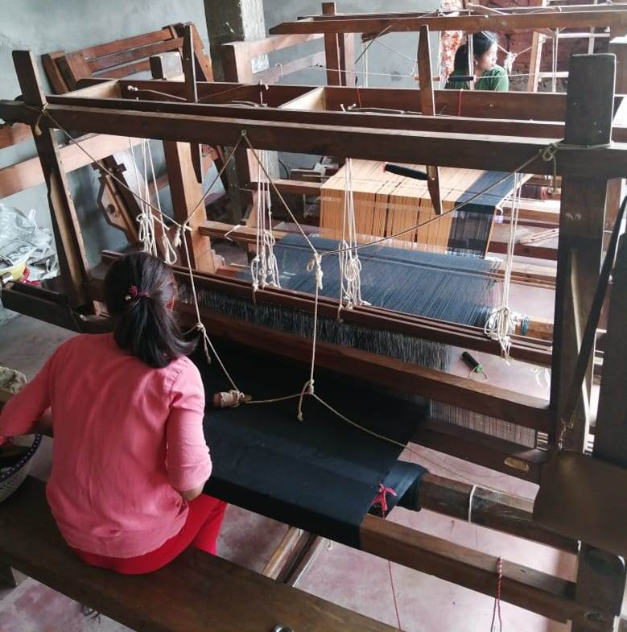

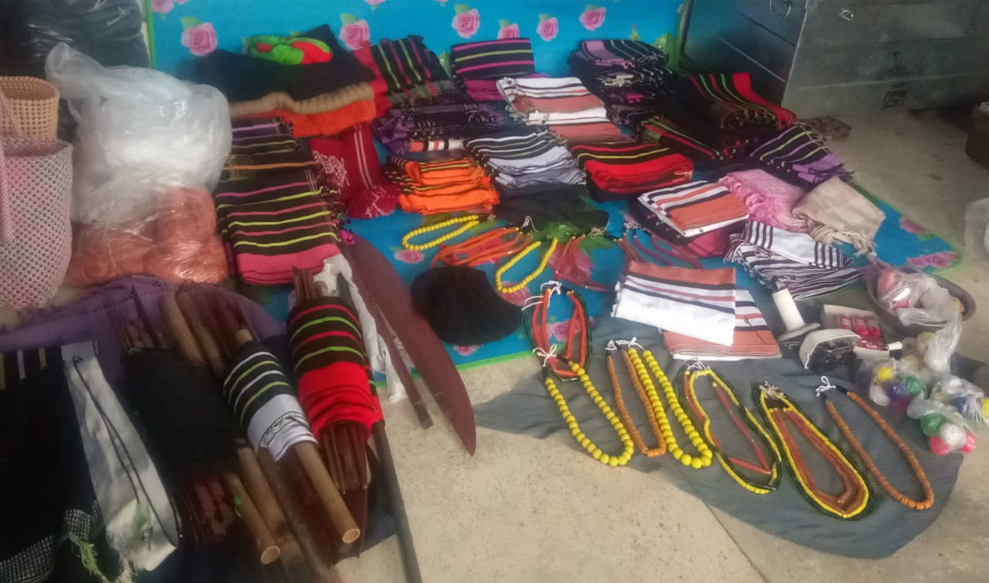
Some activities: Handloom & Weaving
Tsiepfhe Weaving CS Ltd. represented
India in France - 2022

Slide 15
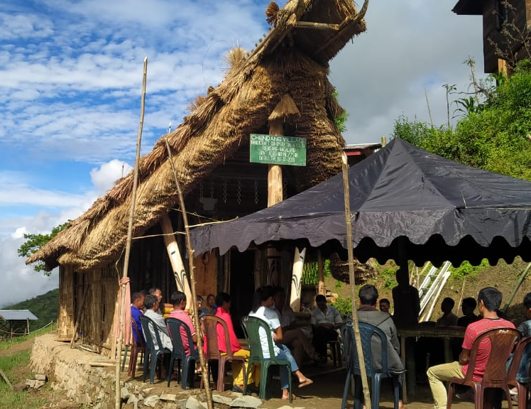
Handicrafts
Common Facility Centre
Community training &
skill development
Gallery
Tourism attraction
Meeting in Progress: Chendang Village Handicraft CS Ltd
Tuensang, Nagaland

Slide 16
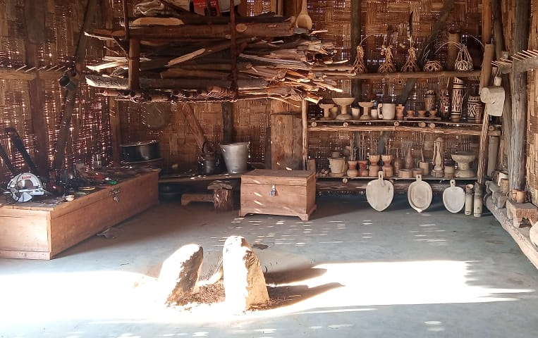
Handicrafts
Chendang Village Handicraft CS Ltd Tuensang, Nagaland

Slide 17
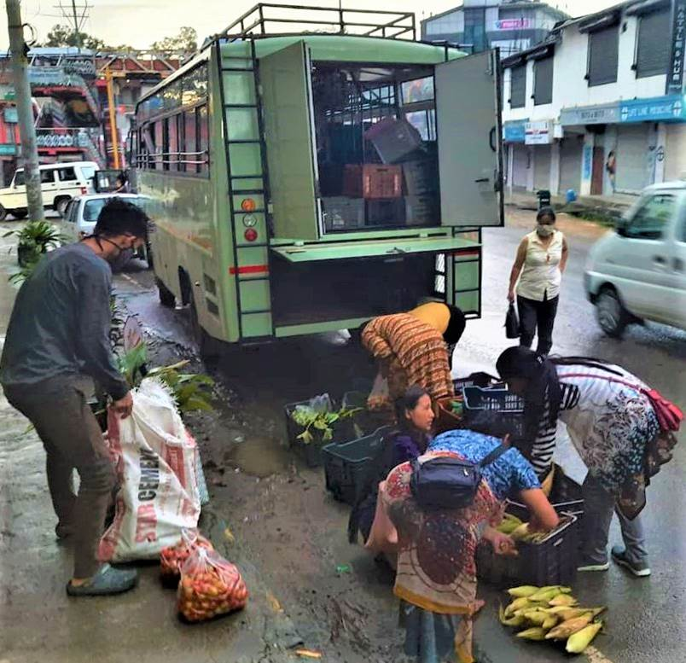
MARKET ACCESS
Cooperative
Marketing Bus
Mobile market
Passengers
Fruit & vegetables
Livestock & feeds

Slide 18
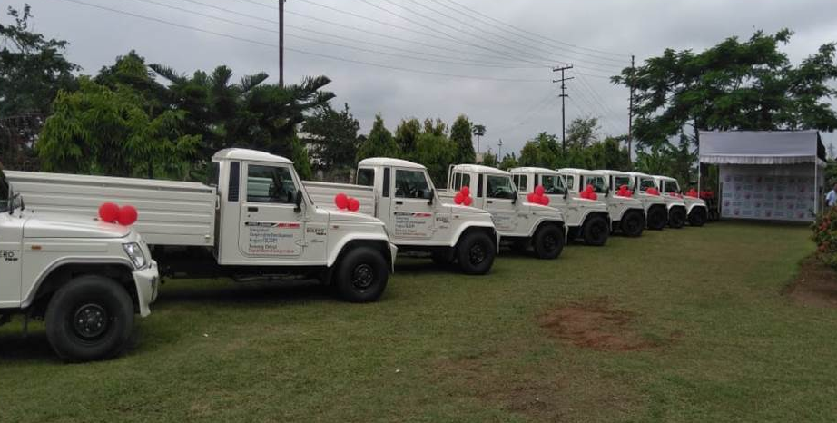
MARKET ACCESS
Distribution of transport vehicles to primary Cooperatives for marketing rural products

Slide 19
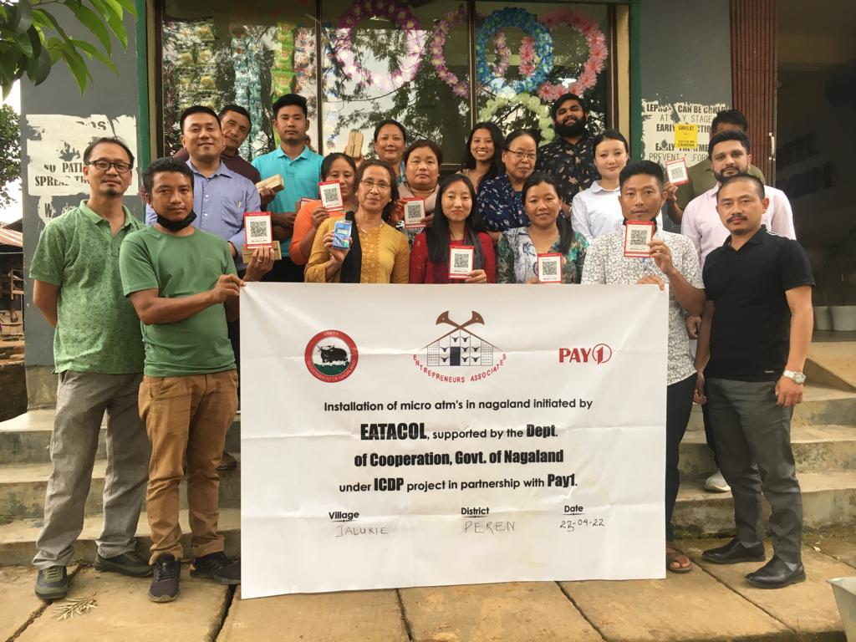

BANKING AND FINANCING
Way Out: Introduction of Micro ATM in the Blocks & villages, through Pay1

Slide 20
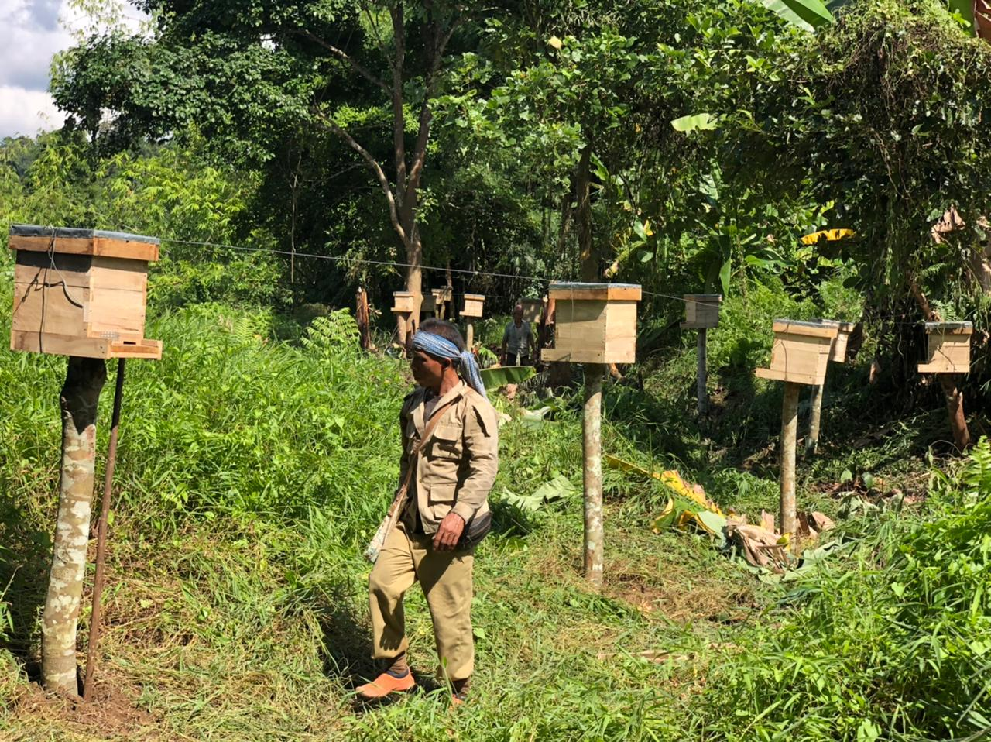
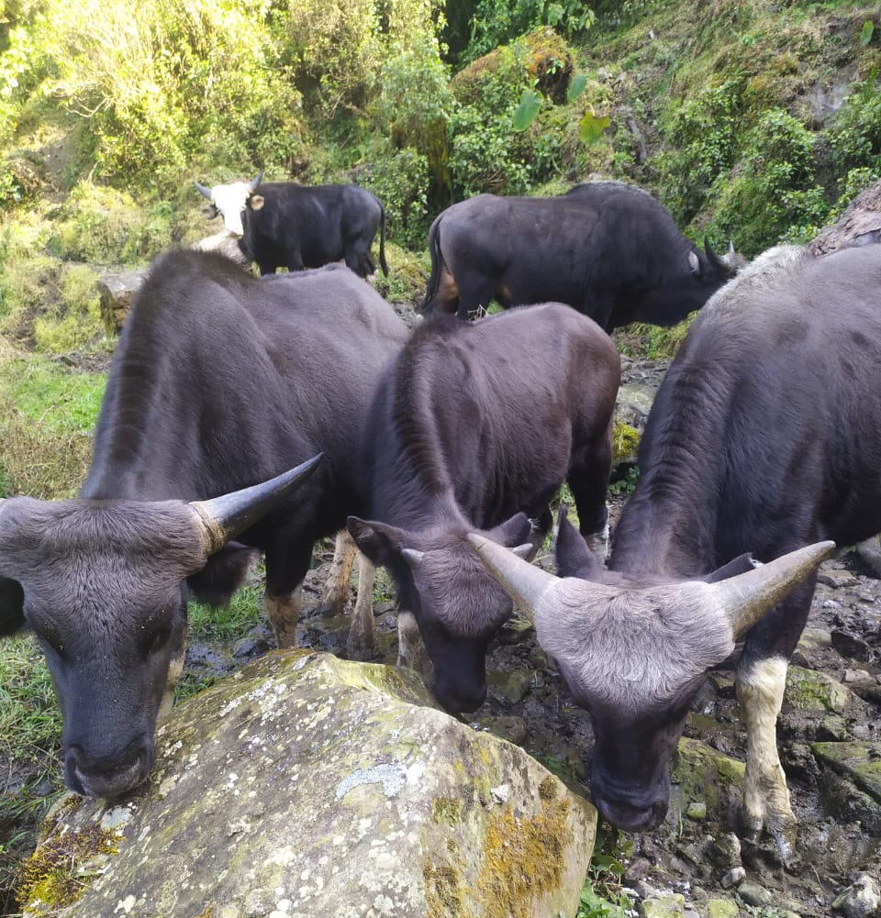
6. ENVIRONMENT & CONSERVATION
BEE, HONEY & MITHUN ETC
Village Apiary & Bee Keeping Cooperatives
Mithun rearing Cooperatives
Cooperatives rooted in the communities
They serve as guardian of environment and conservation of ecosystem.

Slide 21
WAY FORWARD
Ongoing Promotion of One Village – One Cooperative.
Taking Cooperative Education to the grassroot levels.
Promotion of Piggery Value Chain.
Organic Value Chain for Agri & Horti crops.
Up gradation of CTC into a Centre of Excellence (Regional or National Institute)
Promotion of tourism cooperatives as NE is becoming a tourism hub.

Slide 22
Thank You

