Slide 1
STATUS OF COOPERATIVE SECTOR IN ASSAM,
GOVERNMENT OF ASSAM

Slide 2

OVERVIEW OF COOPERATIVE MOVEMENT OF ASSAM
Atma Nirbhar Bharat is a Vision and dream of our Hon’ble Prime Minister, Sri Narendra Modiji. The Hon’ble Prime Minister believes that Cooperative Movement can help in fulfilling it and bring a revolutionary change in self sufficiency in Rural India.
A separate Ministry of Cooperation is created to strengthen the Cooperative movement under the leadership of Shri Amit Shah, Hon’ble Union Minister of Cooperation.
Assam has been part of the Cooperative movement since the enactment of the Cooperative Act 1904 by adhering to the principles of Voluntary participation, democratic functioning, mutual cooperation, transparency etc. for social and economic up-liftment of rural Assam.
Cooperation Department, Government of Assam is making best efforts for sustainable development and strengthening of Cooperative Movement as follows :
  To bring awareness of various Government Schemes to Cooperative societies
  Creating Market linkages
  Professional management and expert participation
  Fair and transparent practices
  Economies of scale
  Training
The Primary Agricultural Credit Societies were formed in the early 70s in every Gaon Panchayat.

Slide 3
Current status of Cooperatives in State of Assam
* There is a need to revamp/ revitalize the Panchayat level women multi purpose cooperative societies.
Way Ahead :
Government of Assam has initiated to form constituency level cooperative societies in all 126 legislative Assemblies.
Current status of societies in State of Assam
Sr | Type of Societies | Numbers as on Date
1 | Cooperative Societies | 13636
2 | Primary Agriculture Credit Societies (PACS) (Gaon Panchayat Coop: Societies(GPSS) =714 + Large Area Multi Purpose Coop: Societies=94 (LAMPS) | 808
3 | Panchayat level women multi purpose cooperative societies | 2265

Slide 4
COMPUTERIZATION OF PACS
In line with Digital India vision of Hon’ble Prime Minister of India, Government of India (GOI) has undertaken a drive to computerize/Digitise the Primary Agriculture Credit Societies across the country.
Approach of Government of Assam (GOA) for Computerisation/Digitisation of Cooperatives :
  Initially 808 nos of functional PACS (Gaon Panchayat Coop: Societies =714 + Large Area Multi Purpose Coop: Societies=94) will be taken for computerization in a phased manner.
  Funding : The total cost of the project will be jointly borne by GOI and GOA to address the aspects of “e-Governance" and “Business Enablement”
  Implementing Agency : The Assam Cooperative Apex Bank & Assam Gramin Vikash Bank Ltd.
  Beneficiaries : 543 PACS affiliated to Apex Bank
  Others : 265 PACS to be computerized through Assam Gramin Vikash Bank Ltd.
    NABARD has already initiated the project for Assam
    Five PACS have been selected for pilot projects for computerization.

Slide 5
LIST OF TYPEWISE STATE/PRIMARY /DISTRICT LEVEL COOP SOCIETIES
Sl No | Types of Cooperative Societies | Number of Societies |  | Sl No | Types of Cooperative Societies | Number of Societies
1 | GPSS /LAMPS | 808 |  | 15 | Other Coops: | 799
2 | GPSS (NEW) | 1437 |  | 16 | State Level Coop: | 48
3 | Village Council Multipurpose Coop: Societies (VCMCS) (Bodoland Territorial Region) | 97
 |  |  |  | 17 | Urban Banks | 8
4 | Consumer Societies | 372 |  | 18 | Livestock | 872
5 | Women Multipurpose (GPBMSS) | 2265 |  | 19 | Area Level Federations (ALF) | 452
6 | Dairy | 880 |  | 20 | Trading | 350
7 | Thrift and Credit | 849 |  | 21 | Village Organization (VO) | 680
8 | Poultry & Duckery | 285 |  | 22 | Agro Producers’ Coop: | 551
9 | Farming/ KPSS | 603 |  | 23 | Horticulture | 20
10 | Pisciculture/ Fishery | 650 |  | 24 | Sericulture & Weaving | 19
11 | Housing | 231 |  | 25 | State Coop: Union | 1
12 | Industrial | 369 |  | 26 | Dist. Coop: Unions | 18
13 | Processing Coop: | 90 |  | 27 | Multipurpose | 157
14 | Transport/ Labour/ Contract | 283 |  | 28 | Piggery | 442
TOTAL |  |  |  | 13636

Slide 6
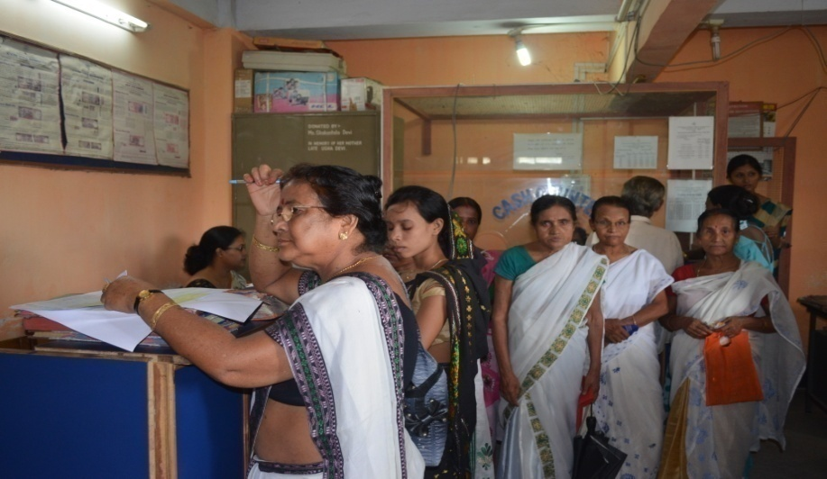
WOMEN CO-OPERATIVES
There are 2265 nos. of Women Multipurpose Cooperative Societies (WMPCS) in the State.
These Societies are playing a pivotal role in channelizing the efforts of the rural women in their string towards economic empowerment.
However, they have not been able to achieve the desired goals in the absence of required financial and logistical support.

Slide 7
ASSAM CO-OPERATIVE APEX BANK LTD. (ACAB)
Established in the year 1948, Licensed by RBI
Two Tier system of operations. PACS (543 affiliated) ←---→ BANK
As on date there are 67 branches across the state of Assam and 6 Zonal Offices with its H.O. at Panbazar, Guwahati.
Financial Position as on 31/03/2022
Total paid up share capital | Rs.17.08 Crores
Total Deposits | Rs.3406.84 Crores
Total Loans & Advances | Rs.1419.88 Crores
Net worth | Rs.103.74 Crores
Net profit for the FY2021-22 | Rs.11.51 Crores
Products:
Deposits : Savings & Current Accounts, Fixed Deposits, Recurring Deposits, Apex Bank Small Deposits etc.
Loans & Advances : Agricultural & Allied Agril., Non- Agril. loans and Retail loans. etc. Also participating in various Govt. Schemes.
Services : Core Banking Solutions (CBS), Cheque book and SMS facilities, ATMs & Debit Cards, POS machines, Locker facilities at selected branches, PMJJBY, PMSBY, APY, PMFBY, Demo ATM Mobile Vans etc.
Ongoing/Future Initiatives:
Expansion of Branch Networks, Expansion of ATM Networks Immediate Payment Services (IMPS) Quick Response (QR) Code Banking Unified Payments Interface (UPI) Mobile banking Loan Originating System(LOS) Internet Banking etc.

Slide 8
ASSAM DAIRY DEVELOPMENT PLAN
  Plan period: 7 years Outlay: INR 1939 Crores Funding Source: Various Central/ State sector schemes
  Host of activities to be simultaneously implemented across the State by the New JV through Cluster Milk Unions.
  Dairy processing Infrastructure - 6 Plants with a combined processing capacity of about 10 Lakh Litres per Day
  Productivity enhancement in animal stock: Through Artificial Insemination - using sexed & conventional semen, Induction of cattle - targeted 15000+ cattle, Ration Balancing Programme – reduce cost of production & improve quality
  Scientific nutrition : Setup 2 Cattle feed plants, 2 Mineral Mixture plants, and 3 Silage manufacturing plants in the State. Popularise Green Fodder Production and Silage making, Usage of Chaff cutter, Crop residue Management Technologies
  Adequate health support : Through State AHVD Network – supplemented with popularization of Mastitis control & infertility camps, Ethno Veterinary Medicine
  Institutional building and support to farmers : Organise 1.75 lakh producers to form 4155 village level institutions (Dairy Cooperative Societies). Robust Milk Procurement system (Automatic Milk Collection System) with direct payment to producers’ bank accounts, State Incentive to milk producers.
  Marketing and cold chain infrastructure development: Network of Milk booths on public spaces and support in terms of cold chain infrastructure creation. Achieve sales target of 10 lakh litres per day.

Slide 9
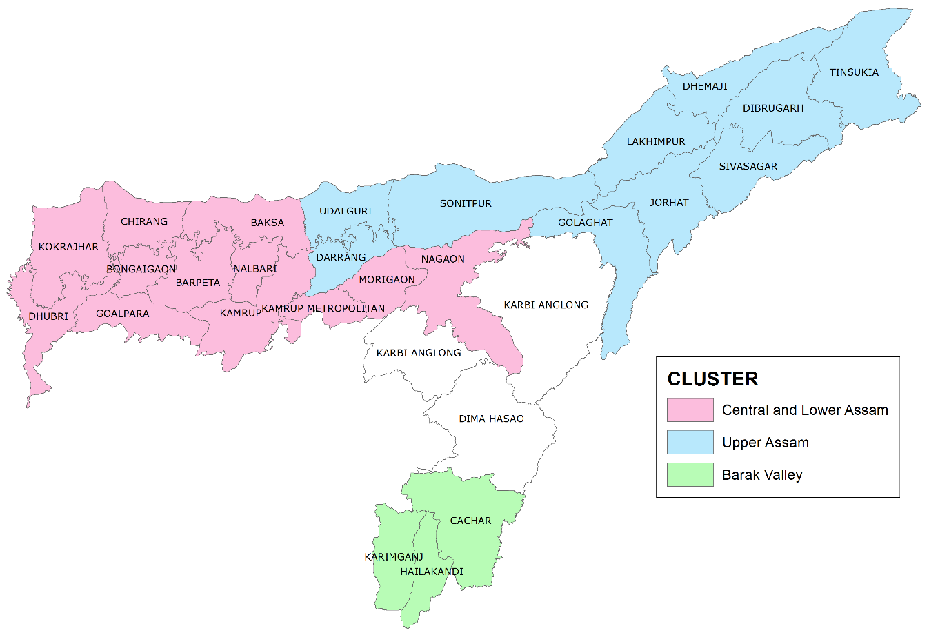
UNLISTED PUBLIC JOINT VENTURE COMPANY TO BE INCORPORATED UNDER COMPANIES ACT 2013
Unlisted Public Joint venture (JV) company between Government of Assam (GOA) and National Dairy Development Board (NDDB) with Registered office at Guwahati, Assam.
To implement Assam Dairy Development Plan and take forward Cooperative Dairying in a big way
Objectives
To enhance productivity of bovines for increasing milk production
To provide better service and returns to the dairy farmers
To increase share of cooperatives in milk supply and demand
To provide quality and safe milk and milk products to consumers
With equal share holding and initial equity contribution of Rs. 5 crore each by GOA & NDDB
Hon. Minister of Cooperation, Government of Assam will be chairman of the New JV company
Initially there will be 8 directors in board (4 each from GOA and NDDB)
All the field activities/ dairy development actions will be undertaken
through three (3) Cluster Cooperative Milk Unions at
1. Central and Lower Assam,
2. Upper Assam, and
3. Barak Valley
All these cluster Unions will be initially managed by NDDB

Slide 10
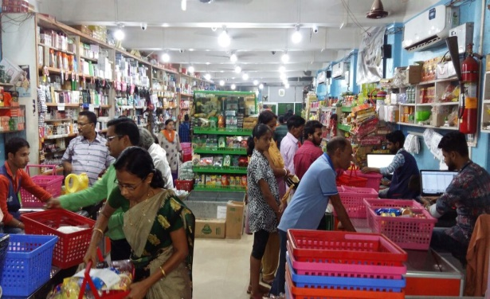
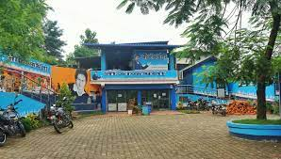
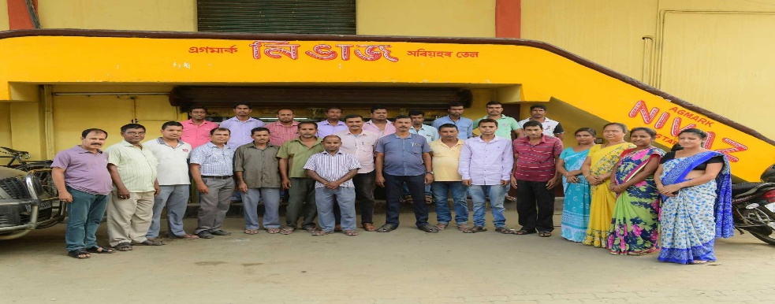
KARIMGANJ WHOLESALE COOPERATIVE SOCIETY LTD.
Sales Turn Over & Net Profit for last 3years Year
Year | Sales | Net Profit
2019-20 | 19,52,39,782.00 | 2,57,334.87
2020-21 | 15,96,15,471.00 | 57,932.54
2021-22 | 14,65,74,790.00 | 48,757.73
Established in = 10-May-1974
No of Members = 3450
No of Employees = 47
No of Branches = 02
SITAJOKHOLA DUGDHA UTPADAK SS LTD, AMLIGHAT
Registered on = 11/06/1959
Date of Last AGM = 02/03/2022
No of Share holders = 620
No of Farmers = 526+
No of Cows = 5000+
Qty of Milk Production = Around 18,000 to 20,000 litres a day
EASTERN AGRO PROCESSING & TEA WAREHOUSING COOP: LTD, GHY
Registered on = 10/06/1971
Date of Last AGM = 26/09/2021
No of Share holders = 515
Auth. Share Capital = Rs.100.00 Lakh
Paid Up Share Capital = Rs.98.00 Lakh
Profit (as on 31/03/22) = Rs.184.81 Lakh
No of Employee = 82
Notes:
10

Slide 11
CONSTRAINTS AND FUTURE PROSPECTS
The constraints in the Cooperative sector are:-
Lack of cooperative education and training,
Absence of professionalism in management,
Lack of members’ awareness.
Constrain of fund.
To overcome, the State Govt. is taking the following steps:
To formulate policy for inclusion of Cooperatives as a subject in the syllabus of educational curriculum.
To give financial support to newly registered and needy cooperatives for nurturing and handholding.
Training of all the Cooperative officers & societies’ members in State level Institutes/ National Institutes.
Activate Publicity Cell across the State.

