Slide 1



Registrar Co-operative Societies, GNCTD
Mandates, Best Practices Implemented in o/o Registrar Cooperative Societies, GNCTD

Slide 2

Mandate of the Department
Registration of Cooperative societies.
Approval for amendment in Bye-Laws of Cooperative societies.
Clearance of membership in housing society and recommendation to DDA under Rule 90 for conducting draw of lots.
Arbitration – Any dispute other than recovery cases – Deputy Registrar (Housing Cases) and Assistant Registrar (other than housing cases) decides whether dispute exists or not, then appointment of Arbitrator under Section 71 is ordered.
Recovery / Collection of outstanding dues on behalf of societies
Audit of Society – The Department approves the audit report of the societies and in case of delay, penalty up to Rs. 1,500/- can be imposed. Audit is compulsory for all cooperative societies.

Slide 3
Mandate of the Department
7. Conduct of election of the Managing Committee of the society.
8. Enforcement/execution of orders, awards and decrees of various courts.
9. Winding up, dissolution and cancellation of registration of defunct/non-functional societies and liquidation there of.
10. Confirmation of expulsion of members.
11 Supersession of Management Committee of societies and appointment of administrators

Slide 4






Best Practices Implemented in o/o Registrar Cooperative Societies, GNCTD

Slide 5

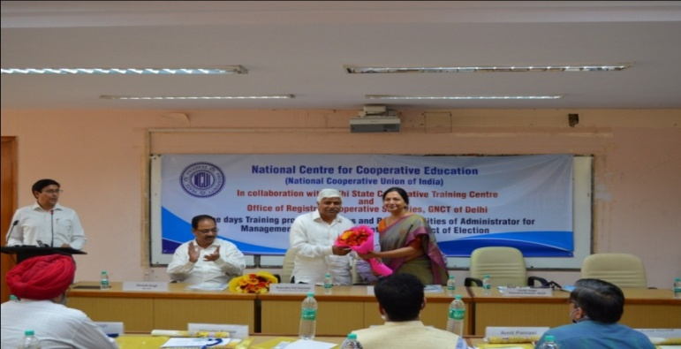
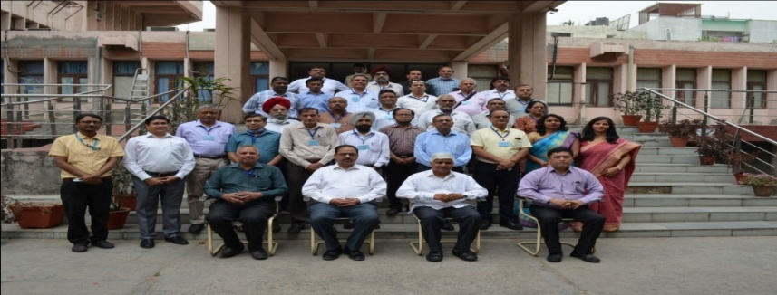
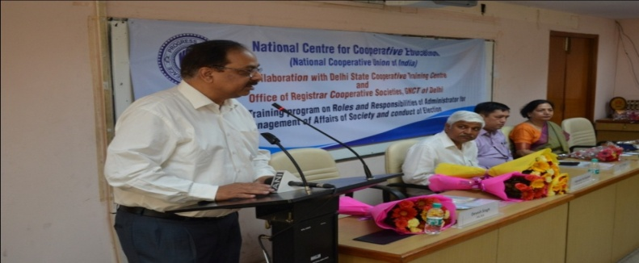
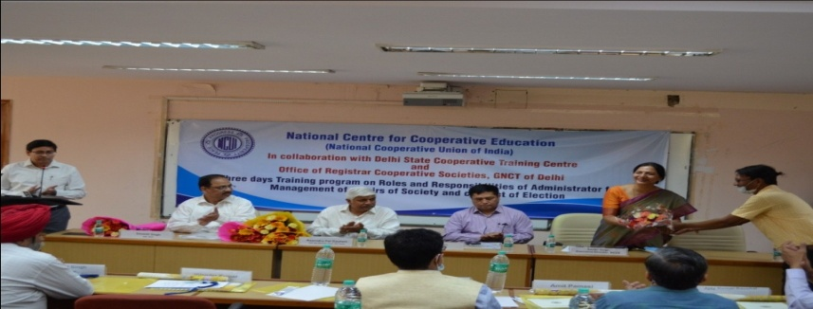
1. Training of RCS Staff
A Training Program was conducted on Delhi Cooperative Societies Act 2003 and Rules 2007 for the Officers and Officials of the office of Registrar Cooperative Societies, GNCT of Delhi, in the month of January- February, 2022. The Training was imparted to approx. 150 staff of RCS office in 6 batches of 25 participants in each batch. The training was conducted in collaboration with National Cooperative Union of India, New Delhi and Delhi State Cooperative Training Centre, New Delhi
5

Slide 6

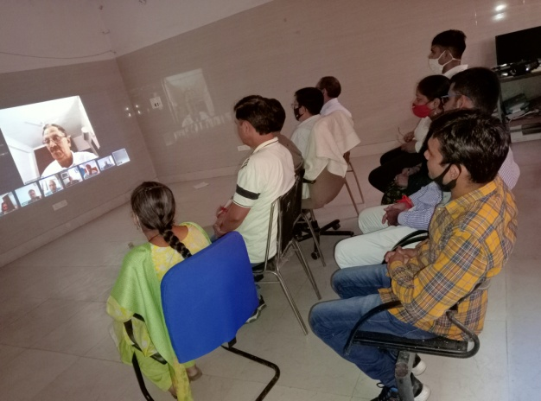
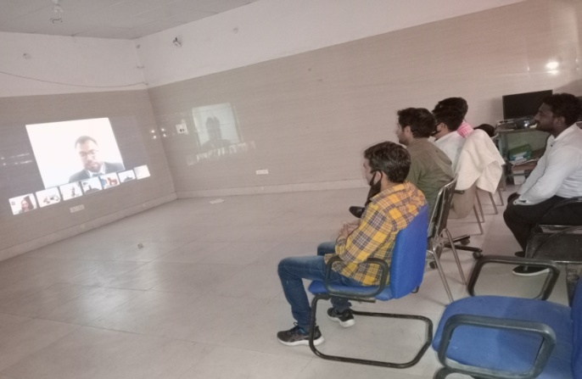
2. Training of Administrators
Another Training program for the sixty Administrators appointed by RCS in different Cooperative Societies in Delhi was conducted on 21st April 2022. The three days Training program was on the subject of “Roles and responsibilities of Administrator for the management of affairs of the cooperative society and conduct of election”. The program was conducted by National Centre for Cooperative Education (NCUI) in collaboration with Delhi State Cooperative Training Centre and office of Registrar Cooperative Societies, GNCT of Delhi.

Slide 7
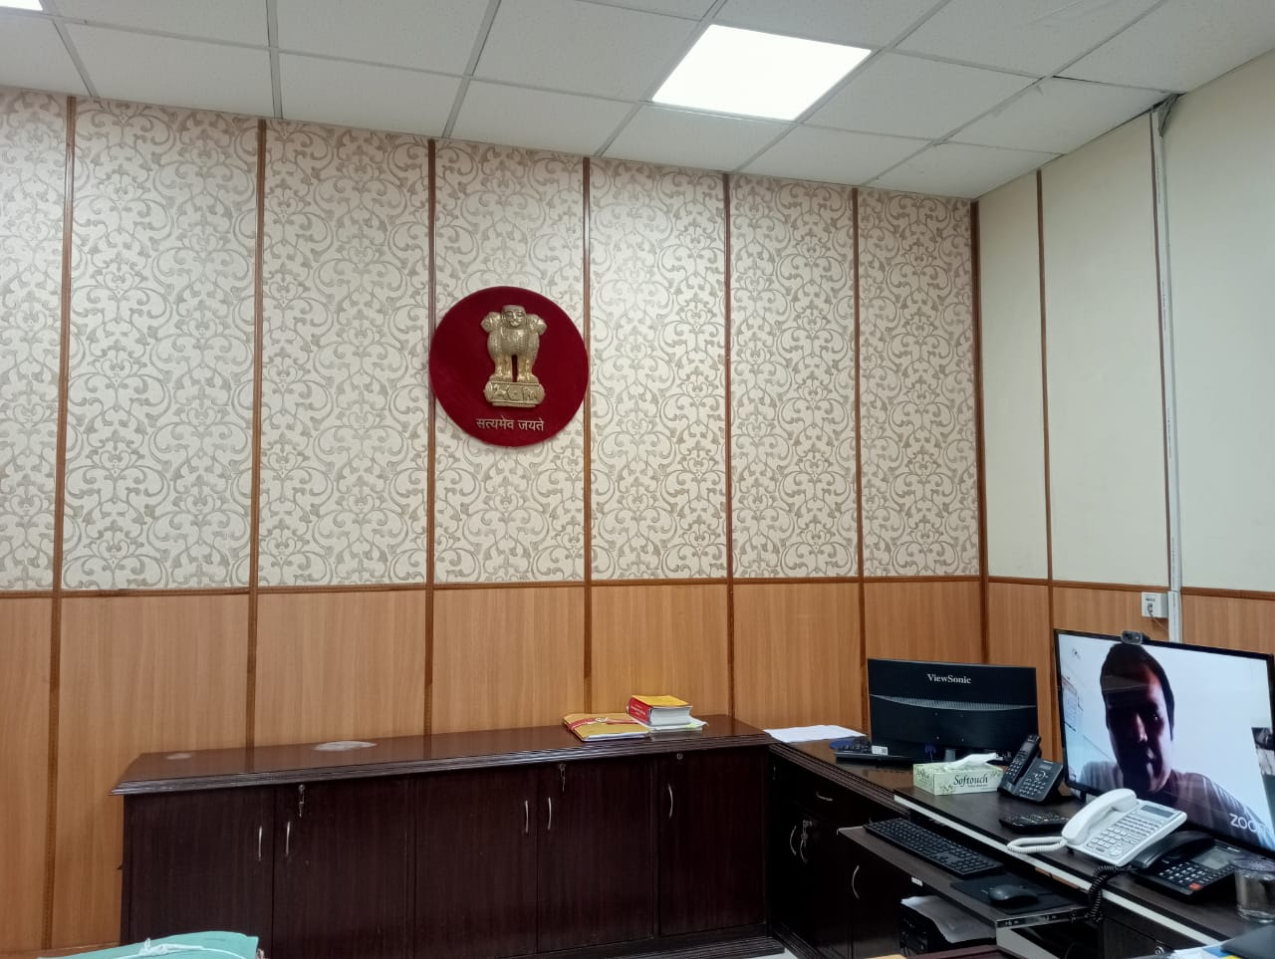
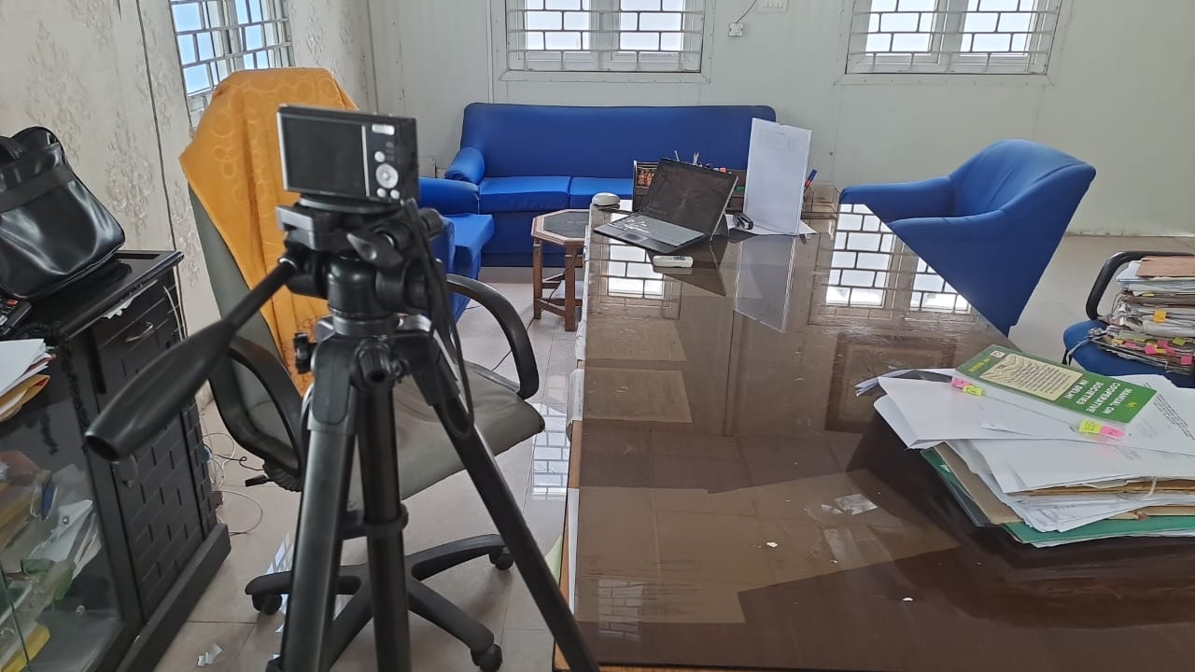
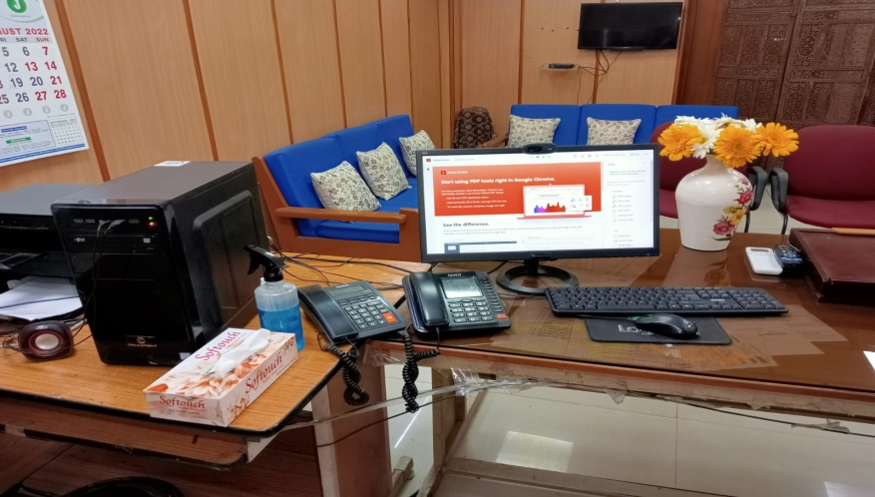
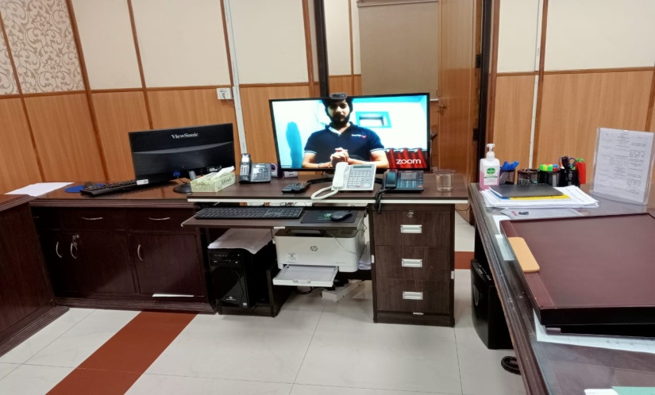
3. Adequate IT setup is available with the officers for virtual meetings and Hearings.
Virtual meetings and hearing by the Senior Officials especially for those petitioners having geriatric issues.

Slide 8
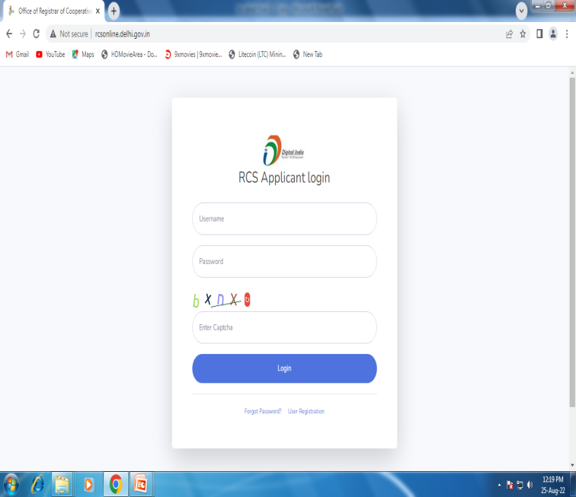
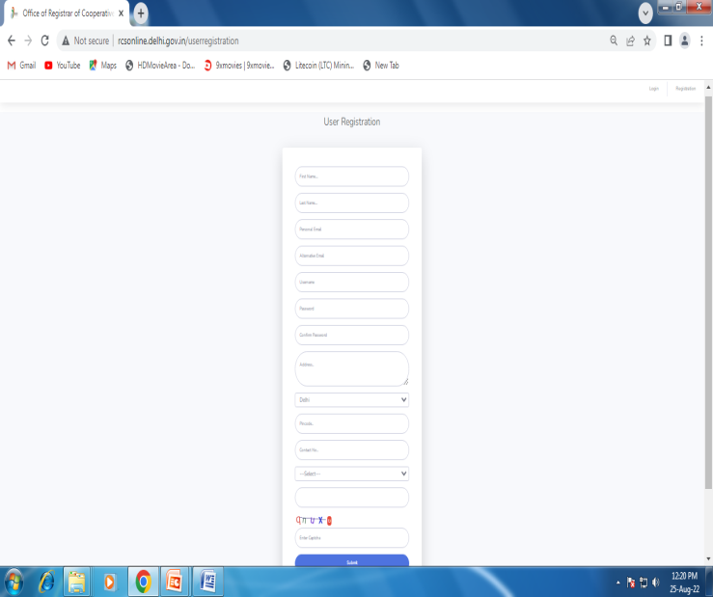
4.Digitalization
The department has implemented online registration of Thrift and Credit Societies and in process to implement other Online Modules with the help of NIC i.e. Grievance Redressal System.
.

Slide 9
5. BRIEF OF AMENDMENT IN OBSOLETE/OUTDATED ACT 2003 AND RULE 2007 TO FACILITATE TO THE ALL STAKE HOLDERS OF COOPERATIVE SOCIETY IN DELHI.
1.An Act Amendment Committee was constituted for suggesting the amendment in Delhi Cooperative Society Act 2003 and DCS Rule 2007 on dated 07.09.2021 after having the approval of Hon’ble Minister Cooperative.
2.The aim of the committee was to suggest appropriate amendments in service rules of employees of Cooperative Banks and Thrift & Credit Societies. Besides this, it will study the functioning of Cooperative Unions and Cooperative Banks in Delhi and suggest the reforms for bringing improvement in the performance, quality of service and their utility in larger public interest.
3.It was also decided that with the passage of time the need has been arisen to amend some of the provisions (particularly of housing societies) of the Delhi Cooperative Society Act 2003 and Delhi Cooperative Rule 2007 through a review committee which will come out with a blue print of the proposed amendments.

Slide 10


