Slide 1
COOPERATION DEPARTMENT
Government of manipur

Slide 2
INTRODUCTION
Co-operative Department is the only sole agency of the Government to deal with the matter of Co-operative Movement in the State. The Co-operative Movement in the State took place as early as in the year 1938 when the Central Co-operative Societies Act, 1912 was adopted by the State Durbar of Sir Churchand Singh His Royal Highness in the year 1938. The first ever Co-operative Society registered under the provisions of the Act of 1912 was “The Manipur Co-operative Bank Ltd.”(now liquidated)
It is a socio - economic Movement of the people to uplift the socio economic status of the people through their Co-operative Societies. It is a movement of the people by the people for the people.

Slide 3
There are as many as 12394 Cooperative Societies with a membership of 667708 as on 31st March, 2022 registered under Manipur Cooperative Societies Act,1976 & Rules 1977.
There are as many as 25457 organizations registered as on 31st March, 2022 registered under Manipur Societies Registration Act,1989 & Rules 2004.

Slide 4
ADMINISTRATIVE SETUP
An IAS Officer is appointed as the Registrar of Cooperative Societies, Manipur and he/she is responsible for the overall promotion and development of the cooperative movement in the State.
There are 16 Districts in the State; each District is under the control & supervision of one Deputy Registrar of Cooperative Societies who is designated as the District Cooperative Officer (DCO). He/She is also delegated with the power and function of the Registrar under Section 3 of the Manipur Cooperative Societies Act, 1976.
The districts are divided into Zones, and Assistant Registrar of Cooperative Societies (ARCS) is in charge of each Zone.
The Department is functioning along with the support from the following District offices and its Zonal offices:

Slide 5
Sl. No. | Name of the District | Name of Office | Remarks
1 | Imphal West | District Cooperative Office, Imphal West | Own Building
i) |  | Office of the ARCS, Mayang Imphal | Rented
ii) |  | Office of the Zonal ARCS, Hiyangthang | Own Building
iii) |  | Office of the Zonal ARCS, Sagoltongba | Rented
2 | Imphal East | District Cooperative Office, Imphal East | Own Building
i |  | Office of the Zonal ARCS, Sawombung | Rented
ii |  | Office of the Zonal ARCS, Irilbung | DCO Imphal East office room Utilized for the Office
3 | Bishnupur | District Cooperative Office, Bishnupur | Own Building
i |  | Office of the Zonal ARCS, Nambol | ICDP Nambol office room is utilized for the Office
ii |  | Office of the Zonal ARCS, Moirang | Own Building
4 | Thoubal | District Cooperative Office, Thoubal | Own Building
i |  | Office of the Zonal ARCS, Lilong | DCO Thoubal Office room Utilized for the Office
5 | Kakching | District Cooperative Office, Kakching | Rented
6 | Chandel | District Cooperative Office, Chandel | Chandel DC Complex
7 | Tengnoupal | District Cooperative Office, Tengnoupal | Rented
8 | Churachandpur | District Cooperative Office, Churachandpur | Own Building
9 | Pherzawl | District Cooperative Office, Pherzawl | DCO Churachandpur office room Utilized for the Office
10 | Senapati | District Cooperative Office, Senapati | Own Building
i) |  | Office of the Zonal ARCS, Mao | DCO Senapati room Utilized for the Office
11 | Kangpokpi | District Cooperative Office, Kangpokpi | Own Building
12 | Jiribam | District Cooperative Office, Jiribam | Rented
13 | Ukhrul | District Cooperative Office, Ukhrul | Mini Secretariat, Ukhrul
14 | Kamjong | District Cooperative Office, Kamjong
15 | Tamenglong | District Cooperative Office, Tamenglong | Own Building
16 | Noney | District Cooperative Office, Noney | Noney DC complex

Slide 6
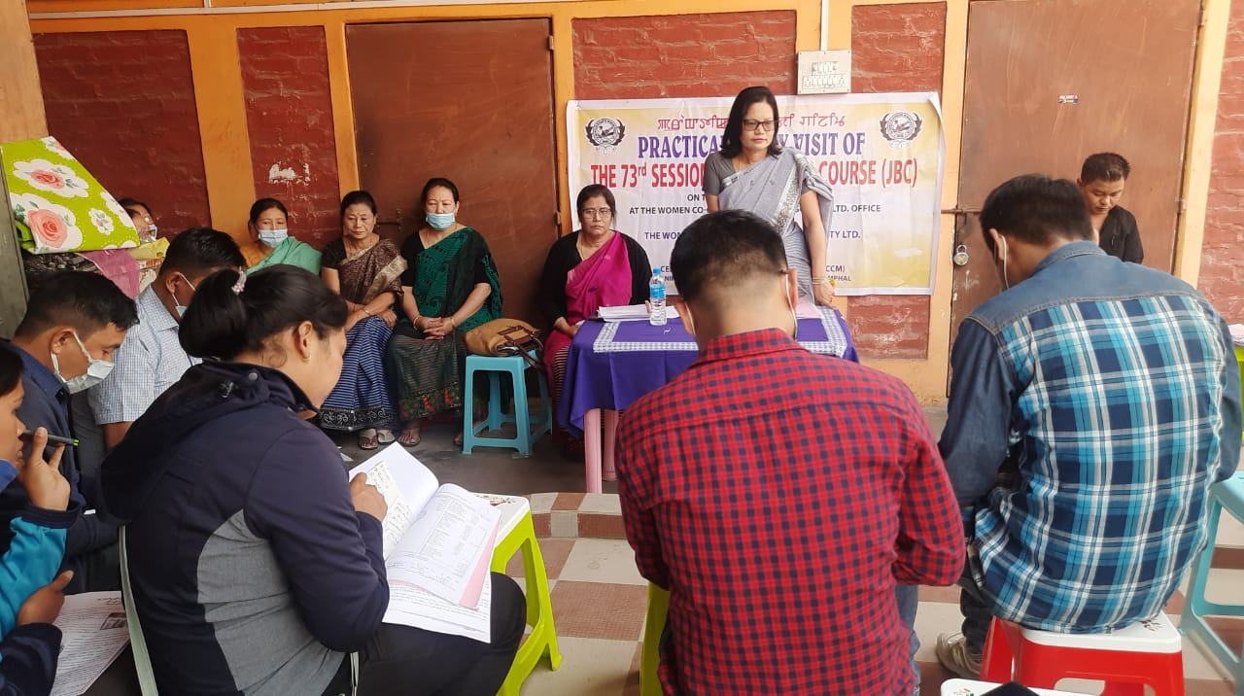
TRAINING
I. Manipur State Cooperative Union (MSCU):
Cooperative education is the best input for the Cooperative Societies. The Manipur State Cooperative Union and the Centre for Cooperative Management sponsored by the MSCU imparted various types of training. It also organizes training for Self Help Groups.
Practical Field Visit of 73rd Session of Junior Basic Course

Slide 7
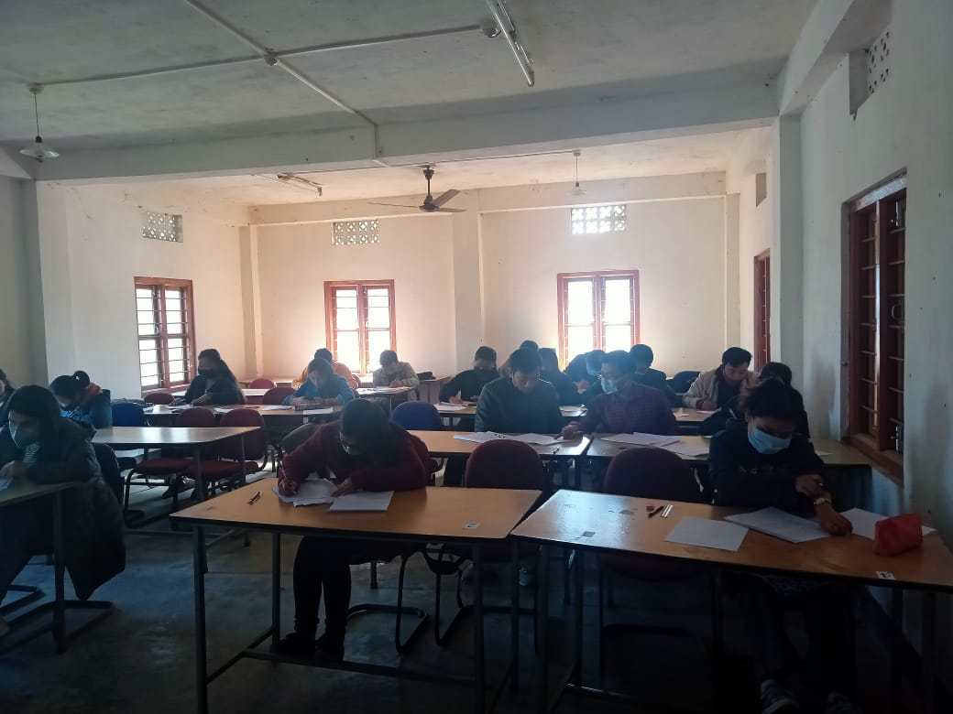
Trainees of Junior Basic Course Conducted by MSCU

Slide 8
II. Institute of Cooperative Management (ICM), Imphal:
The Institute of Cooperative Management Imphal was established in 1988 under the aegis of the National Council for Cooperative Training(NCCT), New Delhi, and it is fully funded by the Ministry of Agriculture, Department of Cooperation , Government of India.
The Institute is catering to the training requirements of the middle level personnel of the Cooperative Department and institutions of Manipur, Nagaland and Mizoram. It is dedicated to the following three functional areas. i)Training, ii) Research and iii) Consultancy.

Slide 9
State and District Wise data:
State/District | No. of Cooperative Societies | No. of NGO/Organisation
State Level | 16 | 2483
Imphal West | 1334 | 5700
Imphal East | 1471 | 2946
Thoubal | 2287 | 2558
Bishnupur | 2430 | 3101
Jiribam | 60 | 347
Kakching | 820 | 1054
Churachandpur | 1093 | 2426
Senapati | 303 | 1210
Ukhrul | 758 | 789
Tamenglong | 328 | 185
Chandel | 275 | 415
Kangpokpi | 454 | 1083
Tengnoupal | 154 | 467
Pherzawl | 106 | 204
Noney | 207 | 264
Kamjong | 296 | 225
TOTAL | 12392 | 25457

Slide 10
E-Office in the Department
GAD have provided 5 (five) computer system, 2 printer and 2 scanner for implementation of e-Office.
The Department has introduced e-Office to the following Section of RCS Office:-
(i)Planning Section, (ii) Store Section, iii) Accounts Section, (iv) Credit and Banking Section, (v) Misc. Section.
Jt. RCS (Audit) and DCO, Imphal West will begin implementing e-Office soon.

Slide 11
EODB/Online Registration:
The Department opened a Web site with license from NIC, Government of India, New Delhi with domain name rcsmanipur.gov.in. in the year 2016.
The Department is in the process of developing Web based software for online registration & monitoring of the activities of registered Voluntary organisations/NGOs & Cooperative Societies in the State under EODB.
Intranet and internet connection is established in all the rooms of RCS Office, DCO Imphal West and Jt. RCS (Audit).

Slide 12
Comprehensive Support Plan Scheme under NABARD & MSCB
60(Sixty) Primary Agricultural Credit Cooperative Societies(PACS) have been selected under Comprehensive Support Plan.
5 (five) PACS have been allotted Computers for computerization of PACS

Slide 13
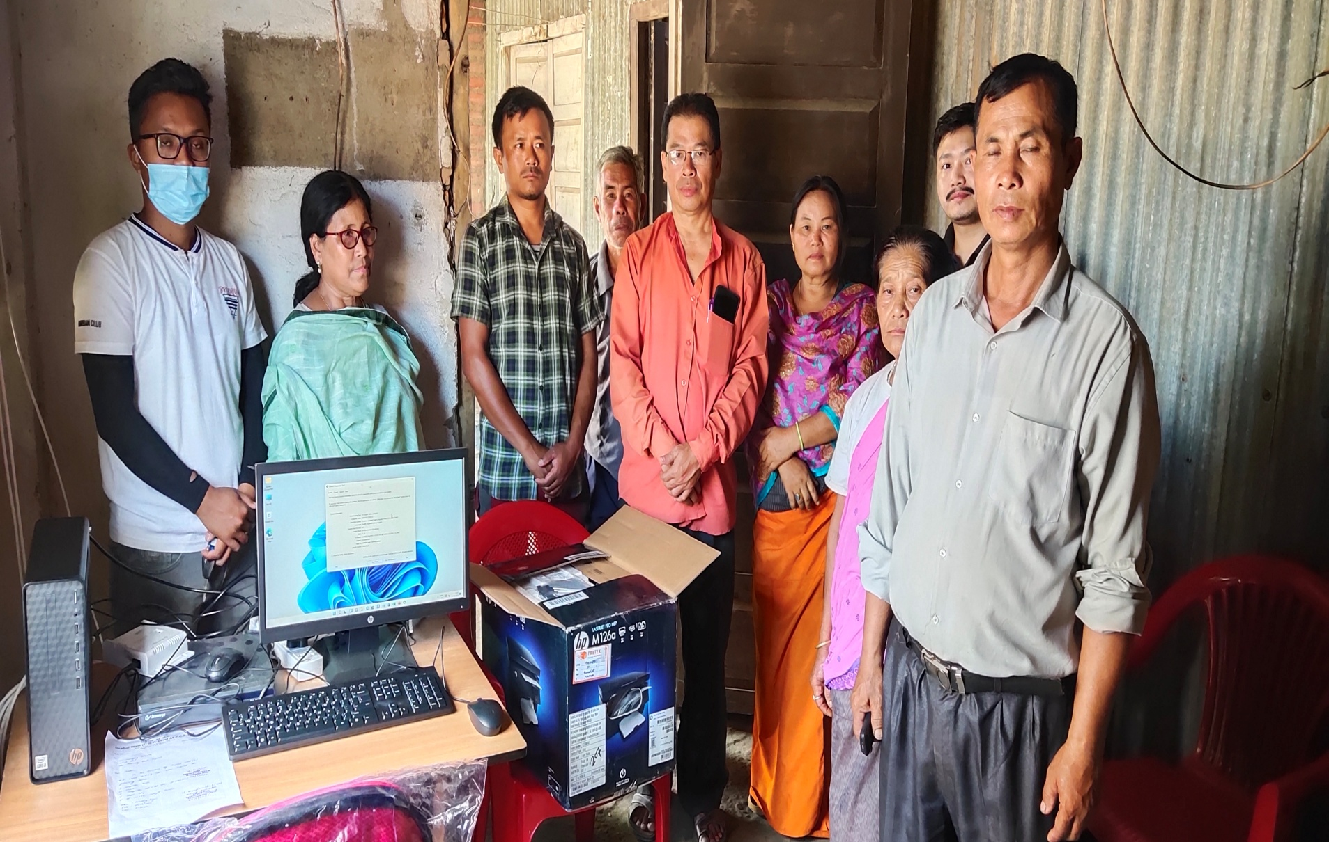
Installation of Computer under Comprehensive Support Plan

Slide 14
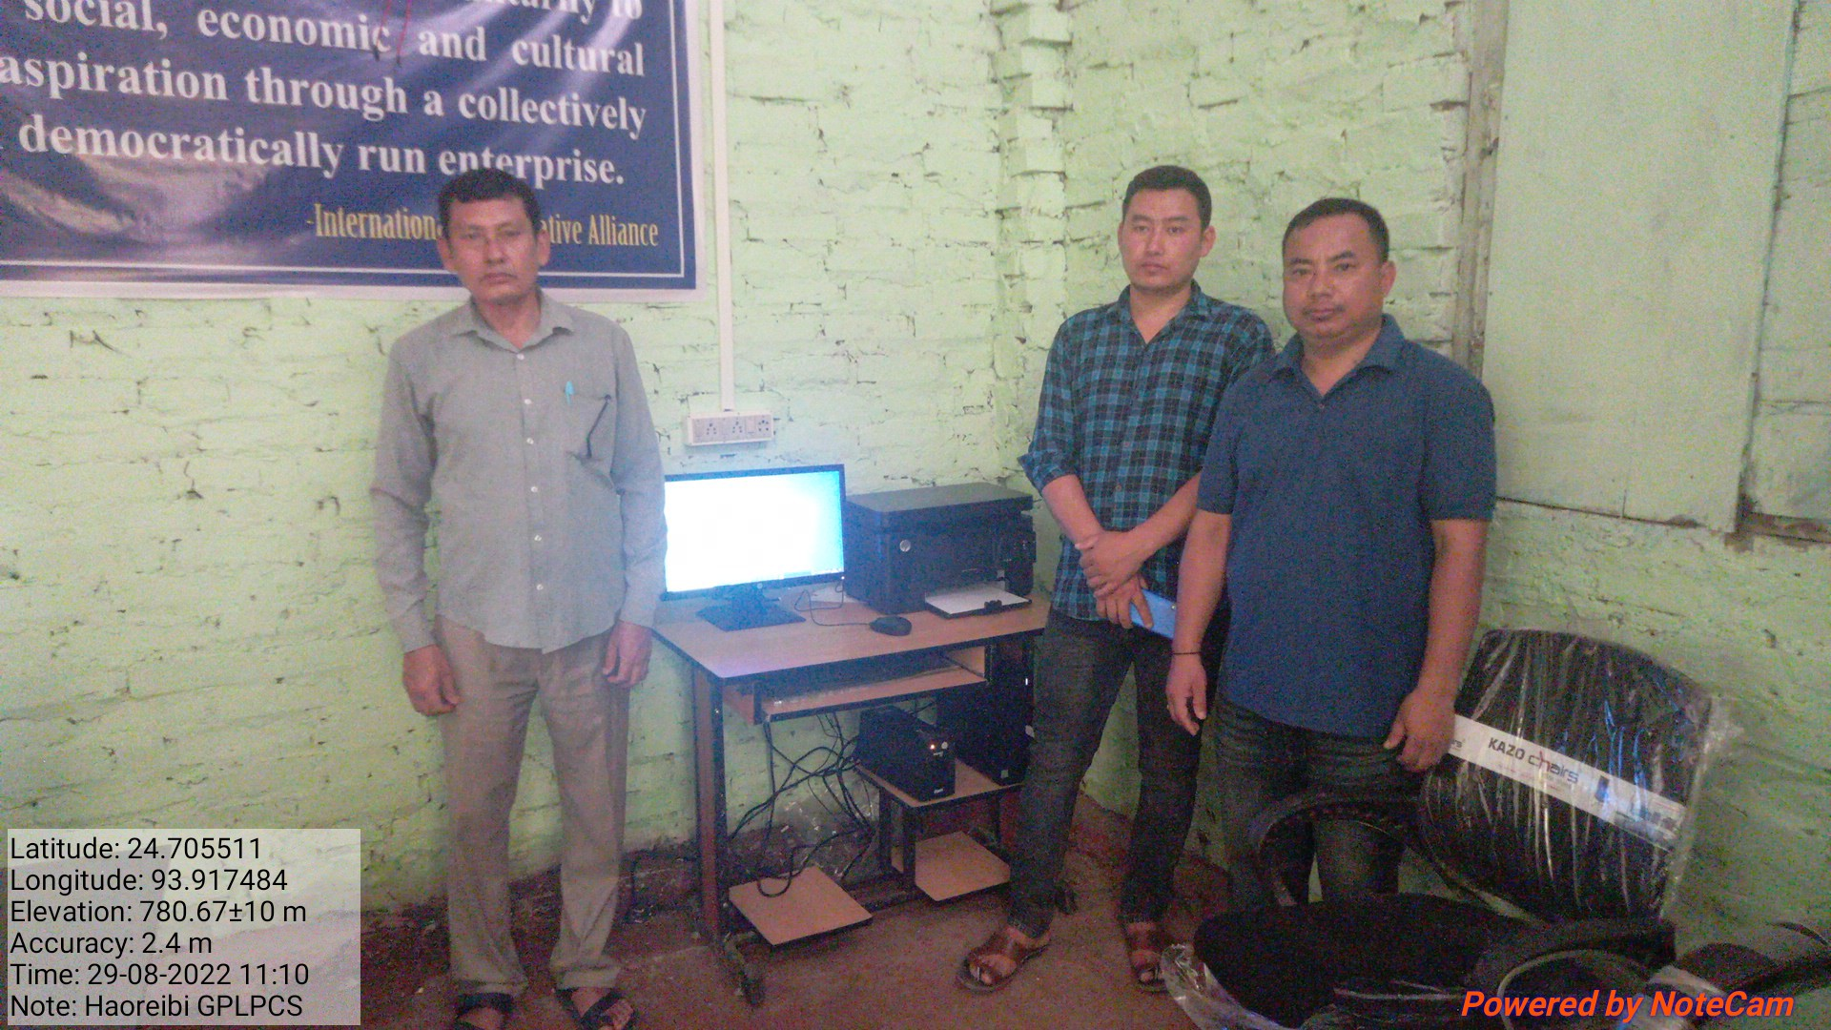
Installation of Computer under Comprehensive Support Plan

Slide 15
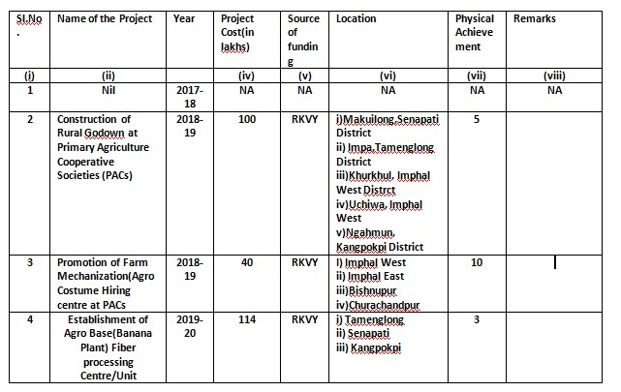
Under RKVY Scheme, the Department have executed the following works/schemes:

Slide 16
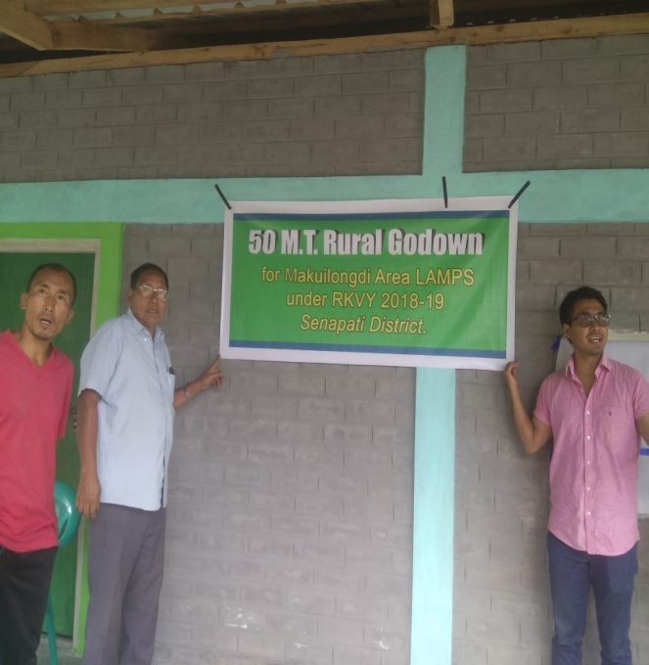
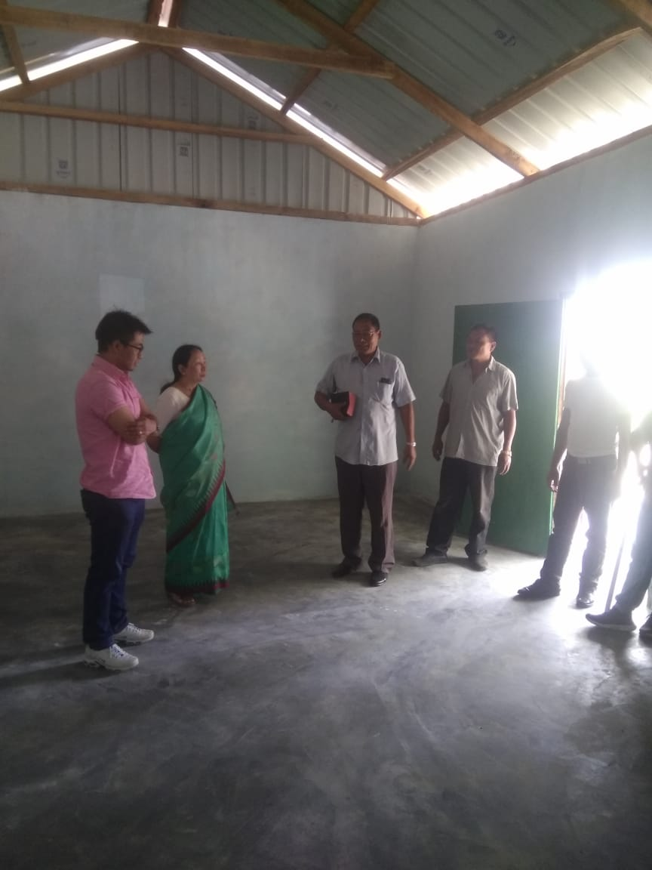
Construction of Rural Godown at Primary Agriculture Cooperative Societies (PACs)
50 MT Rural Godown Constructed at Makuilong, Senapati District under RKVY 2018-19

Slide 17
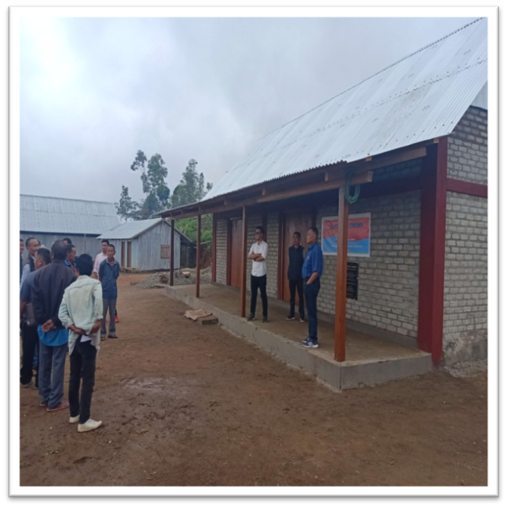
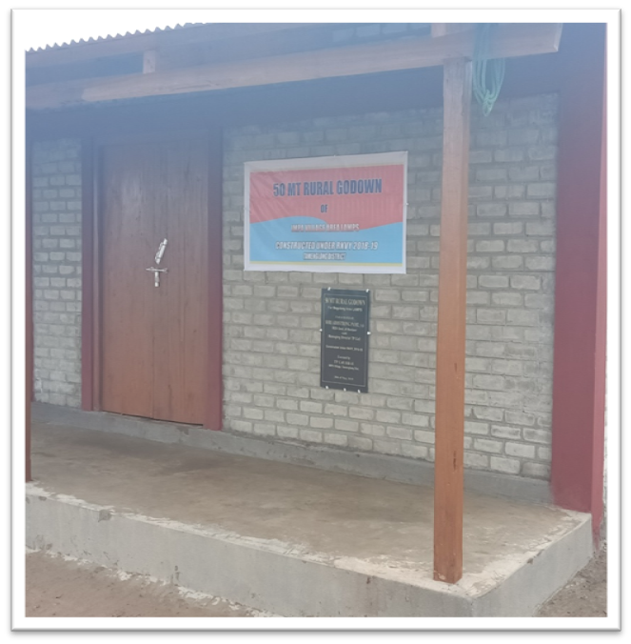
Construction of Rural Godown at Primary Agriculture Cooperative Societies (PACs)
50 MT Rural Godown Constructed at Impa, Tamenglong District under RKVY 2018-19

Slide 18
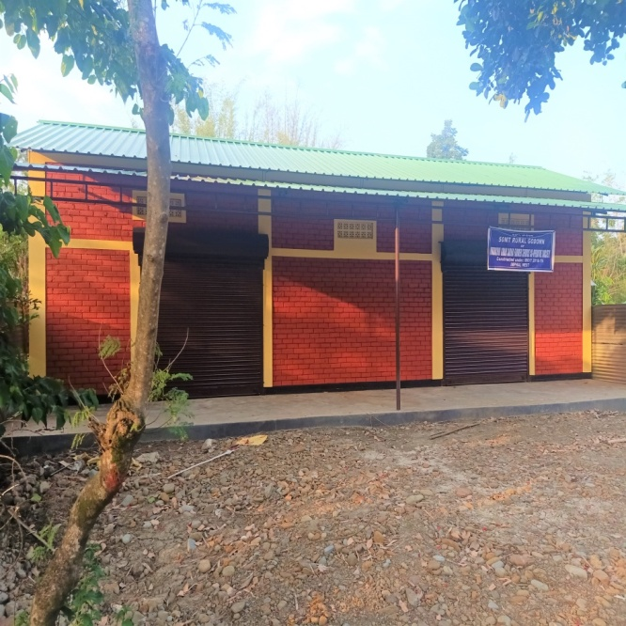
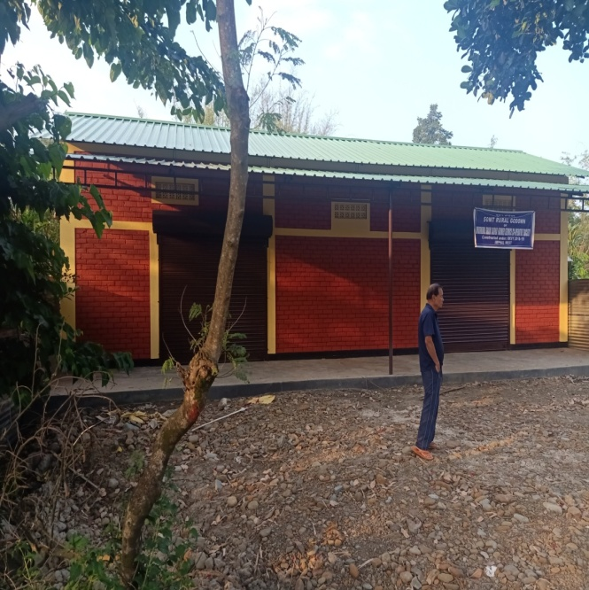
Construction of Rural Godown at Primary Agriculture Cooperative Societies (PACs)
50 MT Rural Godown Constructed at Khurkhul, Imphal West District under RKVY 2018-19

Slide 19
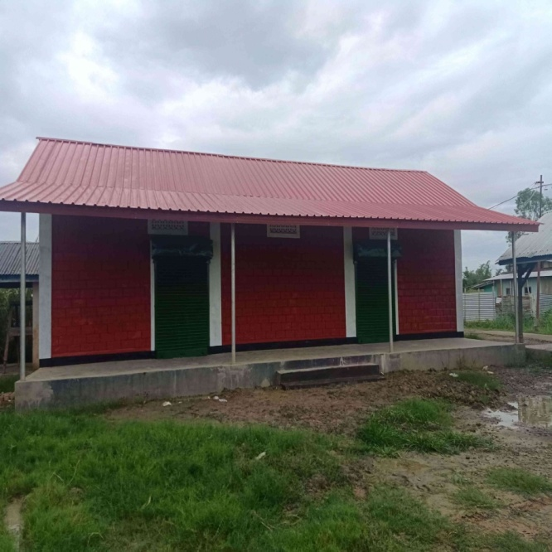
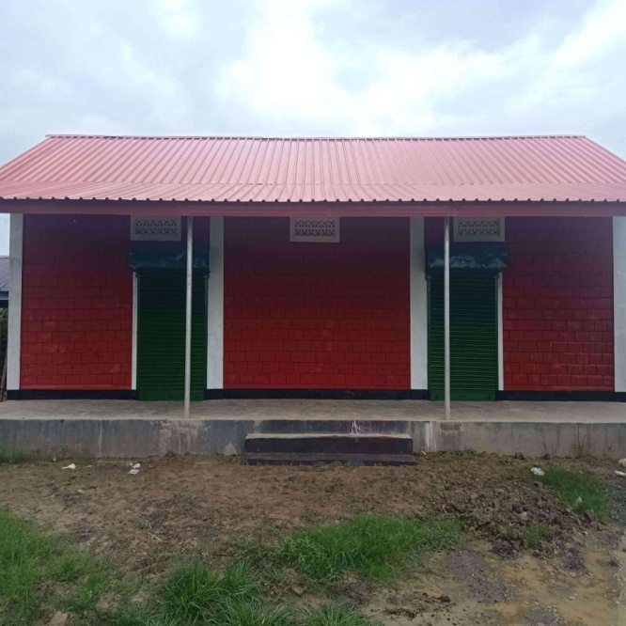
Construction of Rural Godown at Primary Agriculture Cooperative Societies (PACs)
50 MT Rural Godown Constructed at Uchiwa, Imphal West District under RKVY 2018-19

Slide 20
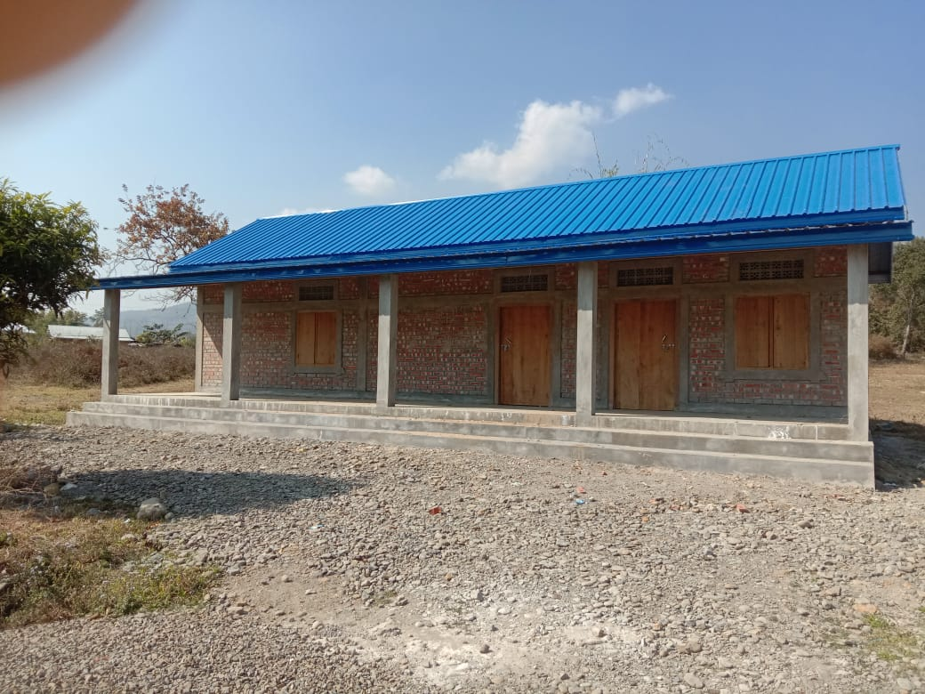
Construction of Rural Godown at Primary Agriculture Cooperative Societies (PACs)
50 MT Rural Godown Constructed at Ngahmun, Kangpokpi District under RKVY 2018-19

Slide 21
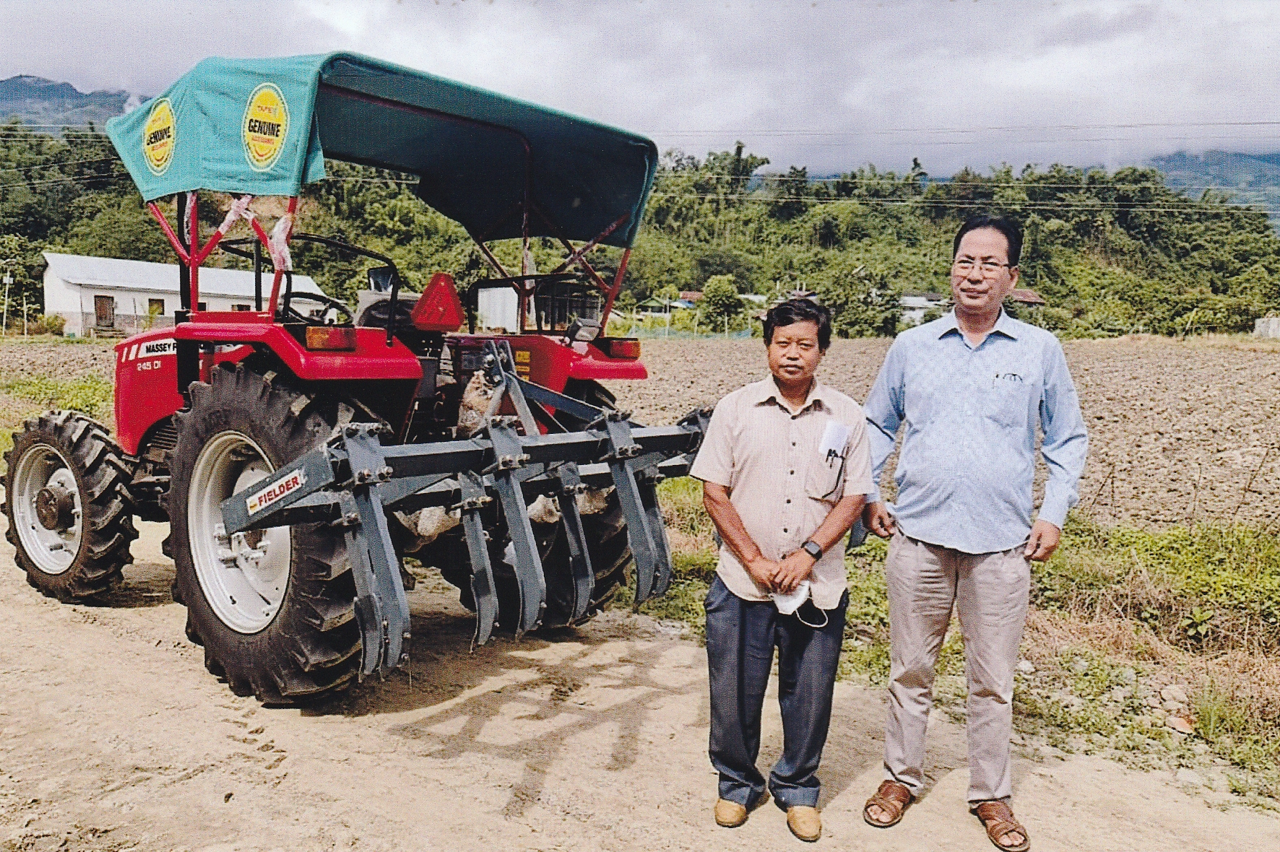
Promotion of Farm Mechanization(Agro Costume Hiring centre at PACs

Slide 22
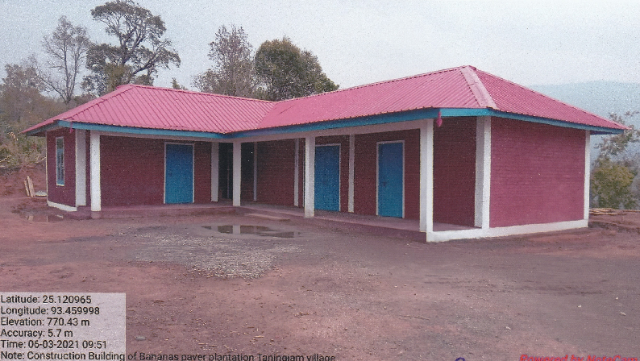
Establishment of Agro Base(Banana Plant) Fiber processing Centre/Unit.
Construction of Banana Fiber processing unit at Impa Village,Tamenglong District.

Slide 23
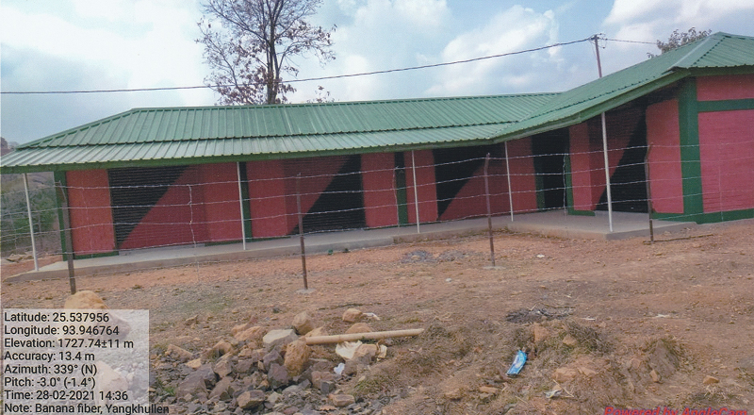
Establishment of Agro Base(Banana Plant) Fiber processing Centre/Unit.
Construction of Banana Fiber processing unit at Yangkhulen, Senapati District.

Slide 24
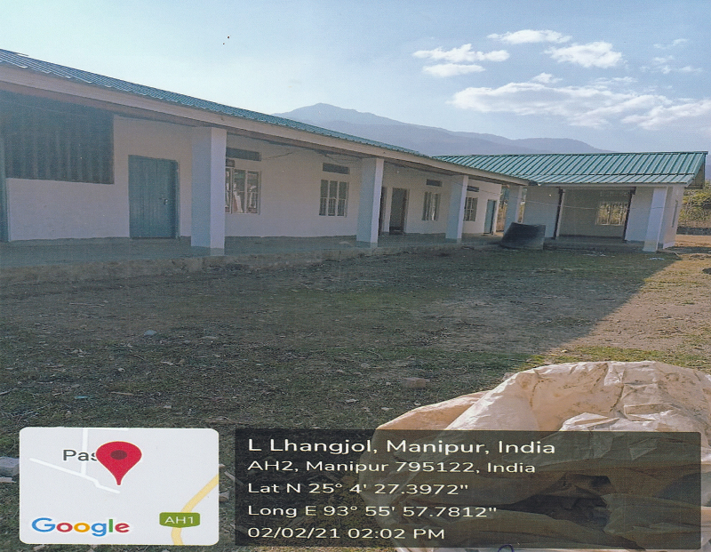
Establishment of Agro Base(Banana Plant) Fiber processing Centre/Unit.
Construction of Banana Fiber processing unit at Ngamung Village, Kangpokpi District.

Slide 25
THANK YOU

