Slide 1




Govt of ut of jammu &kashmir
cooperative department

Slide 2
Revival of Cooperative Sector after abrogation of article 370 in J&K
On-line registration introduced in 2021 improves pace of registration
962 new cooperatives registered & 246 defunct cooperatives revived in 17 months (April 2021 to Aug 2022)
Elections conducted in 89% Cooperatives(824 out of 982) where these were due in 17 months (April 2021 to Aug 2022)
Capital of Rs 366 crore infused in three DCCBs in March 2022

Slide 3
Revival of Cooperative Sector after abrogation of article 370 in J&K
Audit of 83% PACS (494 out of 595) conducted in 5 months of 2022
464 cooperative members registered under Atal Bima Yojana in last 5 months of 2022.
12 DPRs valuing Rs 14.90 crore for setting up Dairy/ Poultry Units submitted to NCDC for sanction/ funding
1 DPR under Ayushman Sahakar and 4 DPRs under Yuva Sahakar got prepared

Slide 4

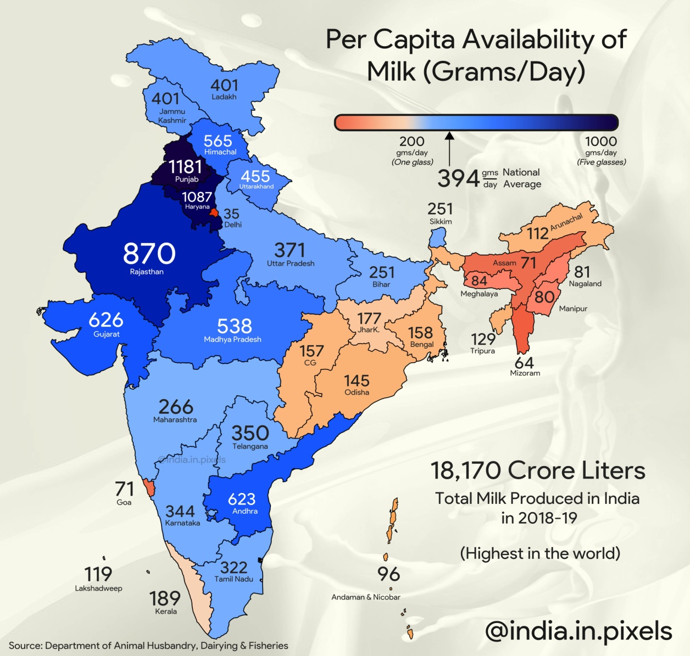
Focus:
Revival of Dairy cooperatives
Farmers of J&K have the third highest per capital income, after Punjab and Haryana.
Milk Production in J&K has increased considerably in the recent past which has given a boost to cooperative movement.
337 dairy cooperatives out of total 752 dairy cooperatives in J&K were registered in last 17 months.
Hardly 5% of milk produced in J&K is processed with ample scope of growth.

Slide 5





approach for:
Revival of Dairy cooperatives
CONVERGANCE and linkages with other departments
TRIBAL AFFAIRS DEPARTMENT.

Slide 6



approach for:
Revival of Dairy cooperatives
Proposal of 09 Cooperatives for setting up dairy units submitted to NCDC for assistance.
JKMPCL is the only apex Cooperative Society processing 1.3 lakh litres of milk per day.
Land and Cooperatives are being identified in 8 districts, to begin with, for setting up milk processing plants.

Slide 7

Banks
There are eight Cooperative Banks– one StCB at Apex level, three DCCBs and four UCBs having 223 branches across J&K.
UCCBs are performing well and pursuing their expansion plan.
Capital of has been infused in the DCCBs in March 2022 Rs. 366.91 crores.
Professional agency is being hired to study and suggest measures for improving the functioning of Cooperative Banks.

Slide 8

Net Banking and advance facilities in Cooperative Banks…
Name of the Bank | No. of Branches | Board of Management | Core Banking System | Payment Gateway | NEFT/ RTGS | ATMs | SMS Alert | Mobile Banking
J&K SCB | 40 | Under process | Yes | Axis Bank | Yes | 19 | Yes | Yes
ACCB | 34 | Under process | Yes | ICICI | Yes | No | Yes | No
BCCB | 35 | Under process | Yes | J&K | Yes | No | Yes | No
KAMCO | 05 | Administrator | Yes | HDFC | Yes | 5 | Yes | Yes
Citizen CBJ | 11 | Yes (Elected) | Yes | Yes Bank | Yes | No | Yes | No
Devika UCB | 04 | Yes (Elected) | Yes | ICICI/YES Bank | Yes | No | Yes | No
UCB Anantnag | 05 | Yes (Elected) | Yes | HDFC Bank | Yes | No | Yes | No

Slide 9
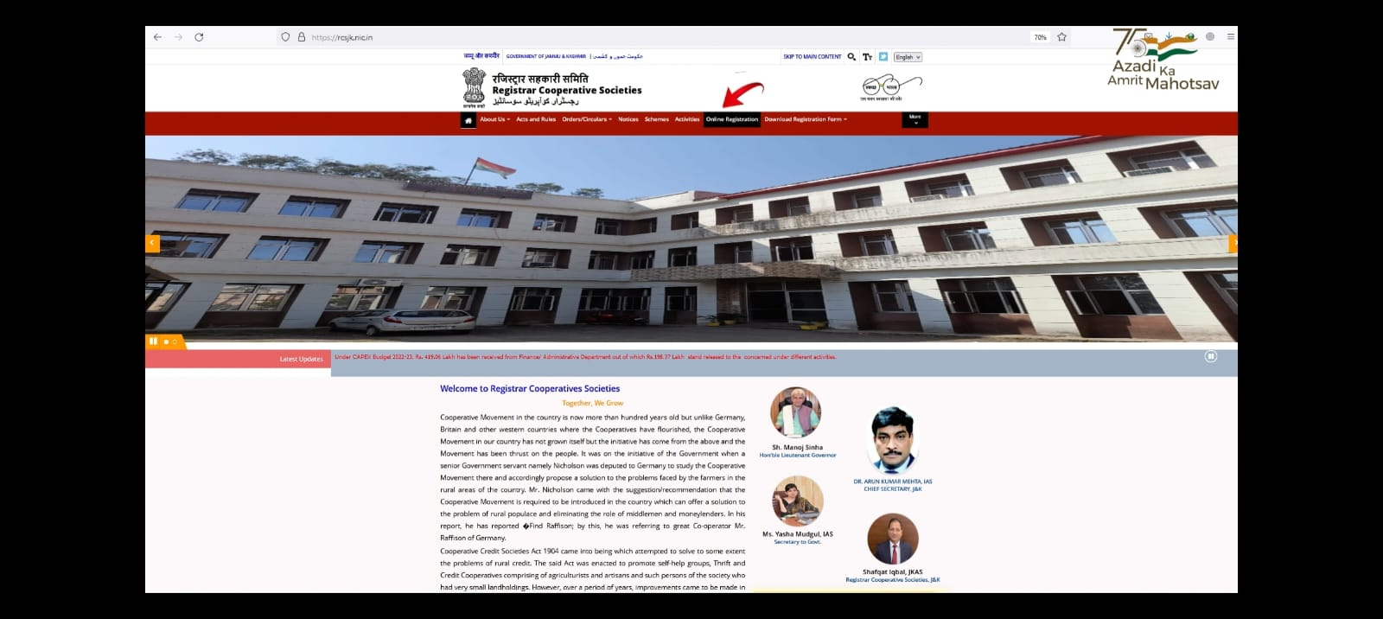
NEW INTERVENTIONS….
Online Registration of Cooperative Societies

Slide 10

Online Registration of Cooperative Societies
For Ease of Doing Business (EoDB) and convenience of general public, a portal has been developed for online registration of Cooperative Societies integrated with payment gateway and launched by Hon’ble LG of UT of J&K on 14th November, 2021.
Online registration service is also integrated with Rapid Assessment System (RAS) while its integration with Digilocker, M-Sewa and e-Unnat is underway.
Officers/ officials/ stakeholders are being trained in collaboration with NIC to manage and operate the online registration portal.

Slide 11

Computerization of PACS & New Registrations…..
In order to implement the new centrally sponsored project Computerization of PACS in J&K as per schedule, audit of PACS has been taken up on fast track basis and out of total 594 PACS in J&K, Audit of 494 PACS has been completed.
UT level and District level Implementation and Monitoring Committees have been constituted by the Government and SNA(Single Nodal Agency ) account opened.
Identification of PACS to be recommended under the centrally sponsored project is underway

Slide 12

Vision…
In order to fulfill the vision of Hon’ble Union Minister for Home and Cooperation for setting up one PAC/ thrift society in every village, the Honorable LG J&K has entrusted the task of registration of one PACS in each Panchayat and accordingly field work has been initiated and awareness camps are being conducted at Block/Panchayat level in collaboration with other line Departments enabling formation of 1850 PACS over a period of 2 years.

Slide 13

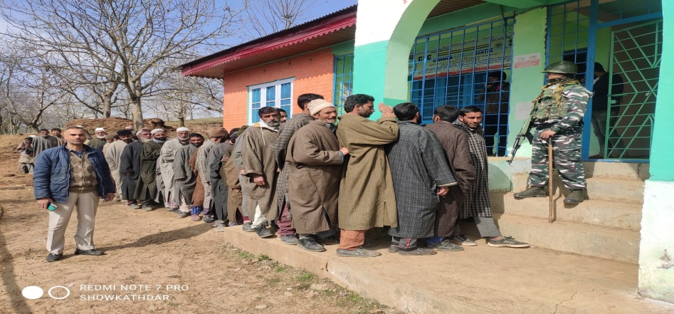
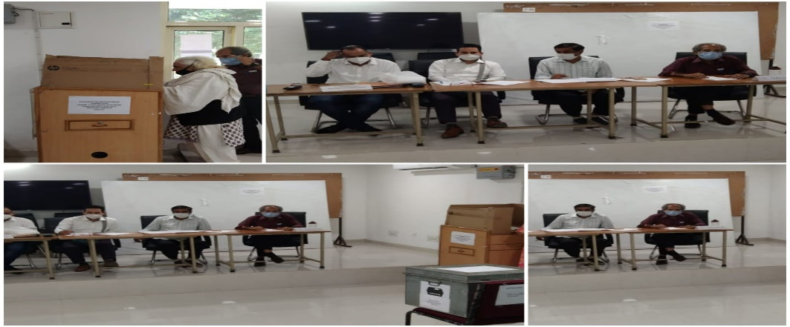
Restoration of democratic character of Cooperative Societies
There were 982 cooperative societies due for election out of which election have been held in 884 Cooperative societies i.e 89% of the Cooperative Societies during A record period of 15 months.
Annual General Board Meetings of the Cooperative Societies with the formation of new Boards have also been held.
Election Notifications for the remaining 98 Cooperative societies stands issued and election shall be held by October 2022

Slide 14

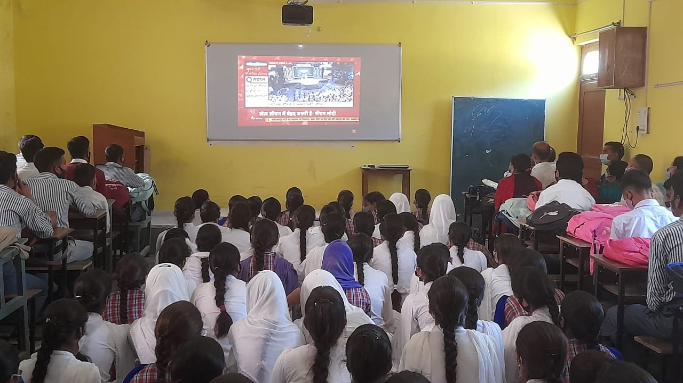
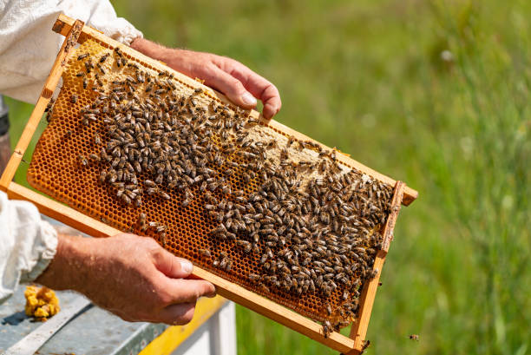


OTHER IMPORTANT INITIATIVES/INTERVENTIONS….

Slide 15

There are Five Cooperative Schools in J&K viz :
Cooperative School Deeli Jammu
Shahisrar Cooperative School Banihal Ramban
Sainik Cooperative School Tikri,Udhampur.
Gousia Cooperative School Budgam
Cooperative Public School Chuntwaliwar, Ganderbal

Slide 16

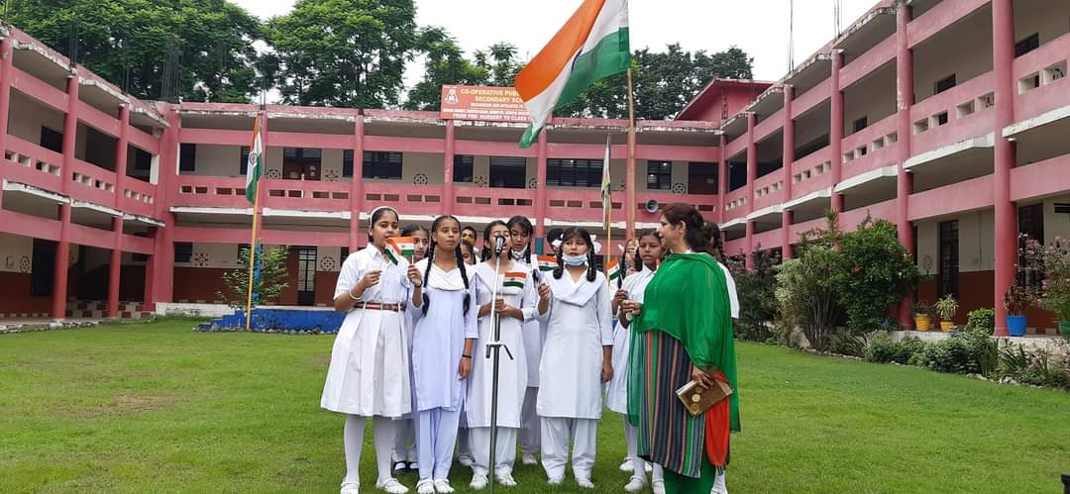
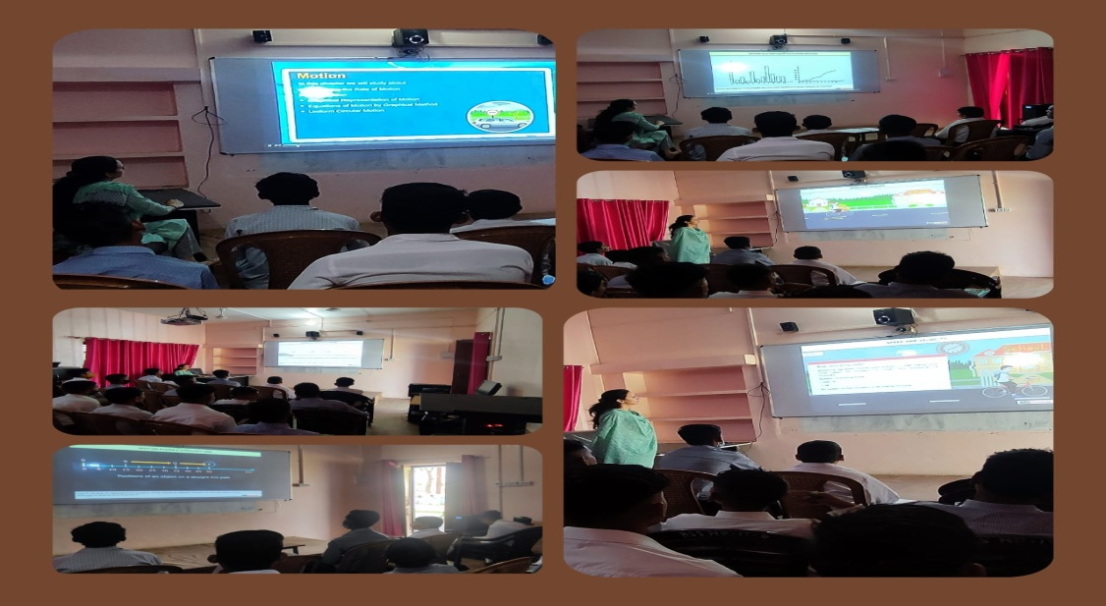
INTERVENTIONS
Assistance of Rs 10.00 lakh is being provided to each Cooperative Schools for strengthening Smart Classrooms and Science Labs.
J&K Government intends to set-up one Cooperative School in each district and accordingly land and Cooperatives are being identified in the remaining 15 districts.
JKSCERT has been requested to introduce a chapter on Cooperatives in the School curriculum.

Slide 17

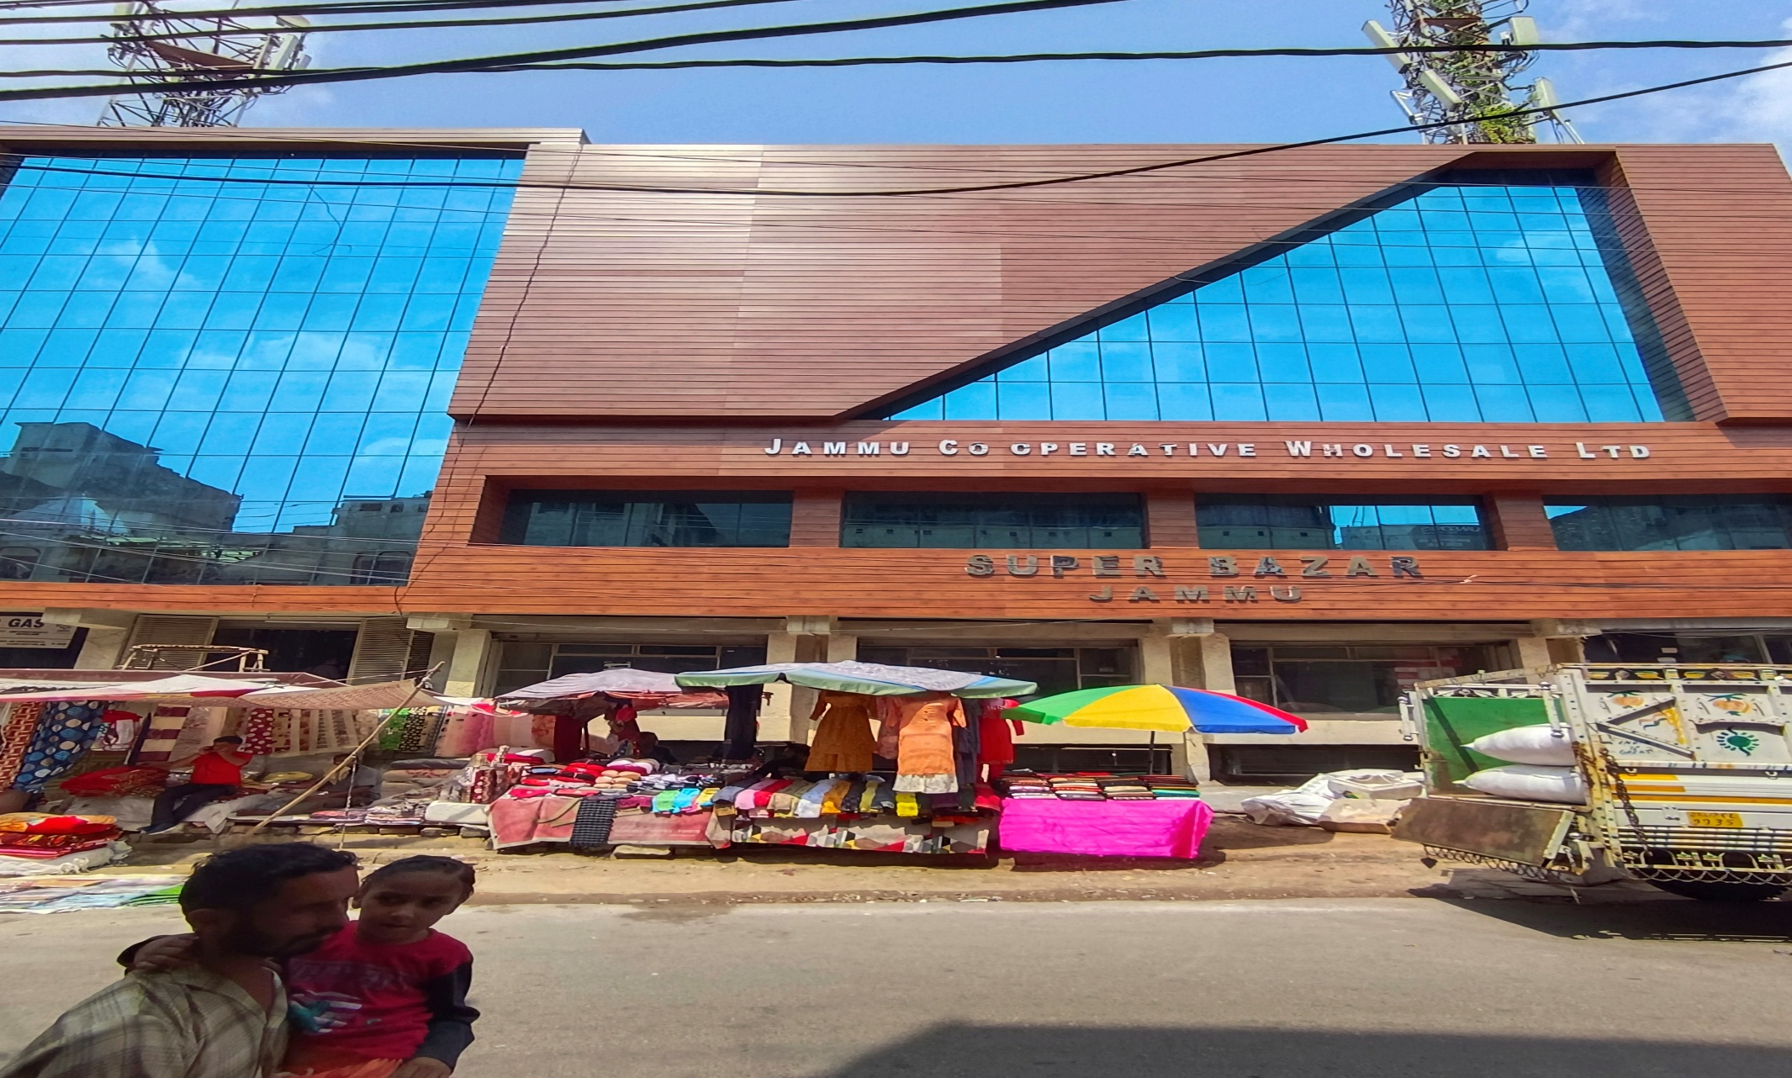

Slide 18
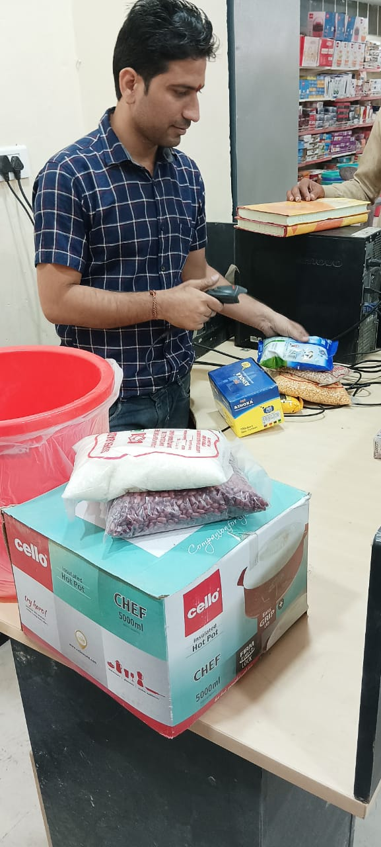
Cooperative SUPER BAZARS
There are Six Cooperative Super Bazars in J&K.
During covid the cooperative super bazaars have played a vital role in supply of essential commodities and medical supplies to the public.
All the 6 Super bazaars have been registered on GEM portal.
Modernization of super bazaars by way face lifting, Bar Coding, Digital Board is underway.
The Department is in process of establishing one Cooperative Super Bazar in each District of UT of J&K and five Districts have been selected in 2022-23 and DPRs are being prepared.
Process for identification of land and cooperative societies for setting up new super bazars in the remaining 9 districts is underway.

Slide 19
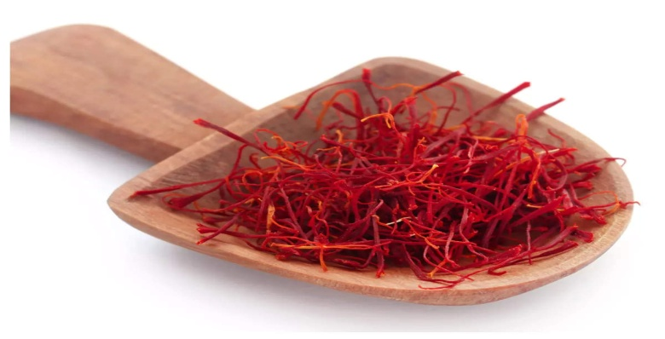
Model Cooperatives with Backward and forward linkages
Cooperative Department has taken an initiative for setting up Models having inter-linkage of Cooperatives in every district.
In Pulwama, JK Kissan Agro Dry Fruit and Spices Marketing Cooperative Ltd. Pampore has been interlinked with seven newly registered cooperatives dealing with cultivation of quality Saffron. The aim is to collect, process, grade, package and market saffron in an organized manner to fetch higher returns. Annual turnover of these cooperatives expected to increase from Rs 3.00 crore to Rs 4.20 crore after the processing plan is established in an year.

Slide 20

Model Cooperatives with Backward and forward linkages
Cooperative Department has taken an initiative for setting up Models having inter-linkage of Cooperatives in every district.
In Budgam, Cooperative Marketing Society Beerwah has been interlinked with nine PACS, 02 Women Consumer Stores and two Specialized Societies for establishment of Food Processing Unit. The interlinked Societies shall produce/ collect the vegetables and process it into Tomato Ketchup, Pickle, Tomato puree to be marketed by Cooperative Super Bazar and through e-marketing platforms. The initiative is expected to enhance the annual turnover of these cooperatives from Rs. 1.63 crore to 2.60 crores.

Slide 21
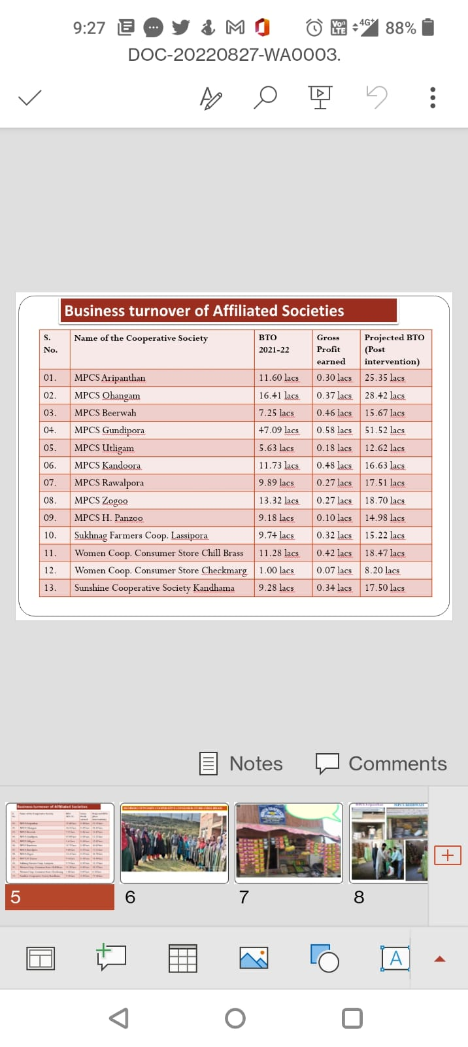
BUSINESS TURNOVER OF BUDGAM MULTIMODAL SOCIETY

Slide 22
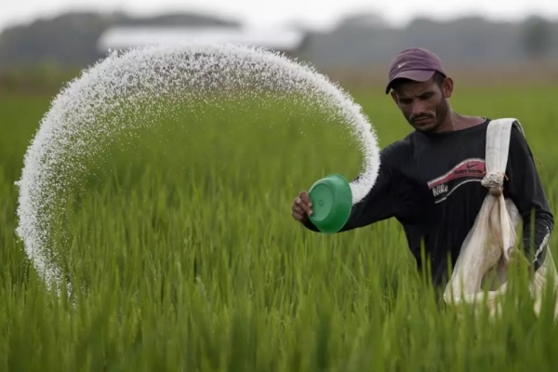
Model Cooperatives with Backward and forward linkages
In Jammu, Kundal Rural Agriculture Cooperative Marketing Ltd. dealing with Sales of Fertilizer and Pesticides has been interlinked with newly registered Transport Cooperatives (Sahakar Parivahan Cooperative Ltd.), one revived Labour Cooperatives (JAK Rural Labour Cooperative Ltd.), and a credit Society. This inter-linkage has benefitted the Labourers and Drivers with a regular wage income. Moreover, annual turnover of these cooperatives is expected to increase from 16 crores to 18 crores.

Slide 23

Model Cooperatives with Backward and forward linkages
In Poonch, a new FPO namely “Poonch Farmer Producer Cooperative Ltd.” has been interlinked with six new Cooperatives dealing with cultivation of Maize. The purpose is setting up Maize Processing Facility by the FPO for supply and marketing of quality by products viz; Pop Corn, Corn Flour and Cattle feed through the Cooperative Super Bazars, CMS/PACS. This processing unit when established will be first of its kind in J&K.

Slide 24
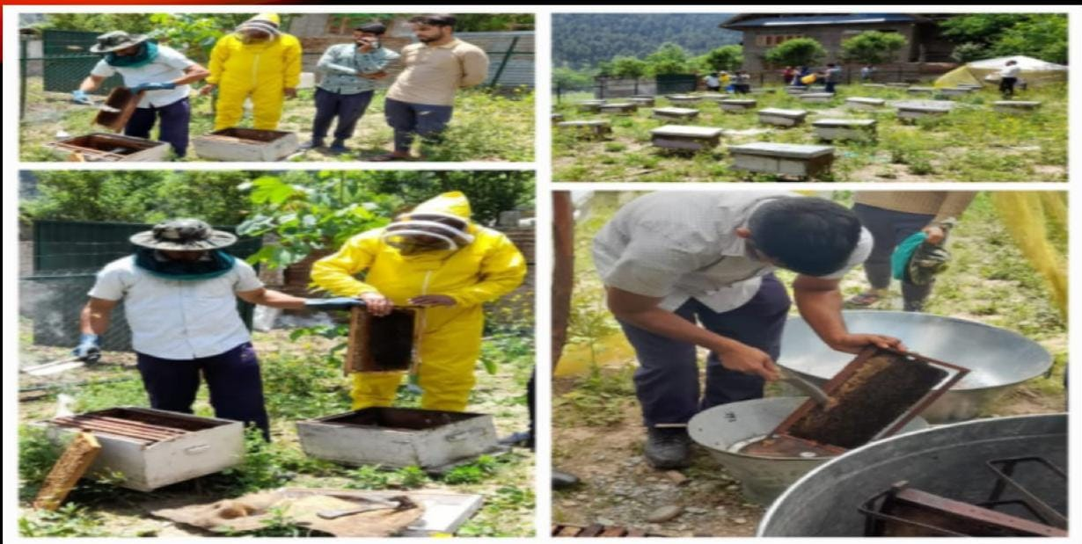
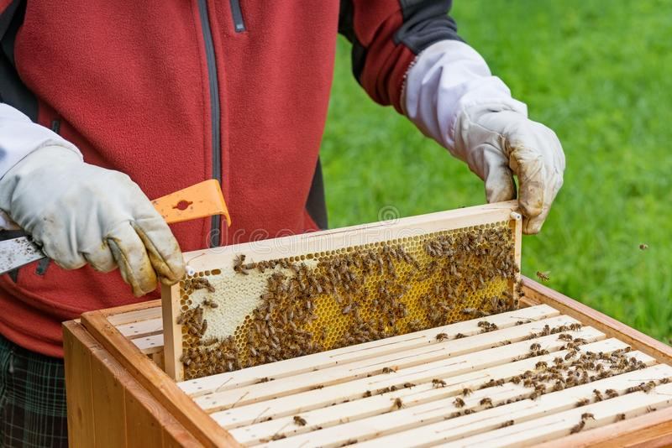
BEE KEEPING BY COOPERATIVES
Financial Assistance given by J&K Government has helped two cooperative Societies viz. “The Gund Hilly Sale and Service Cooperative Society” and “Zazna Multipurpose Cooperative Society” of Ganderbal District in setting up beekeeping units.
The Gund Hilly Sale and Service Cooperative Society has extracted 37 kg Honey valuing to Rs. 0.30 lakh in the last four months.

Slide 25

Thanks….

