Slide 1

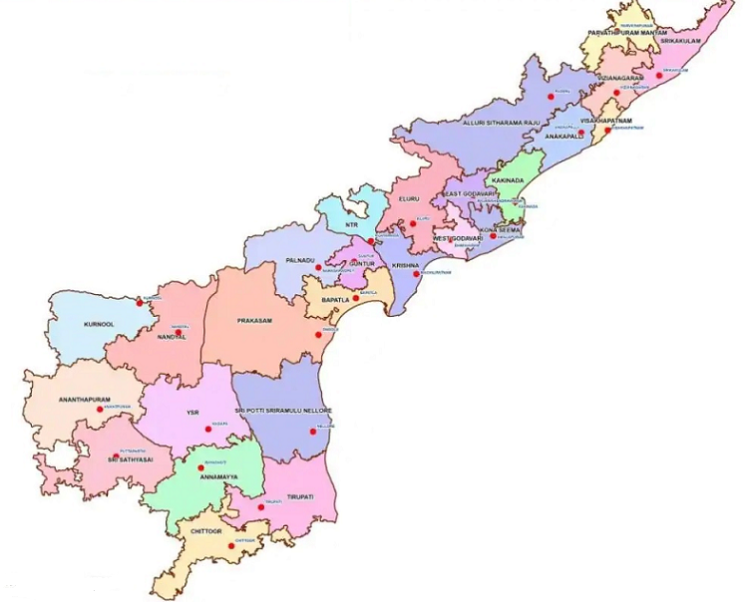
Co-operative Credit Structure
in Andhra Pradesh
Moving Ahead…..

Slide 2
Cooperative Credit Structure
APCOB – A Scheduled Bank
All DCCBs are licensed
Single Window Credit Delivery – Agri (ST & LT), MSME Retail, etc
Professionally managed and all are in profits
Rural Cooperative Banks group is next to UBI, SBI and Canara Bank in credit to Agri & Allied sector.
APCOB
18 Branches
DCCBs
13 DCCBs - 425 Branches
PACSs
2051 PACS
Physiological
Notes:
In Andhra Pradesh, there are a host of co-operatives working in different areas – credit, dairy, fisheries, labour, housing etc., I have focussed on credit co-operatives as it is meeting the largest segment of population in our state. We have an unique single window credit delivery system wherein the short term and long term credit needs of the customers are being met by single entity, be it, PACS or a branch of DCCB. With over 18 lakh active farmer members availing credit, the cooperative credit system in AP is quite vibrant. The CCS includes 2051 PACS at the base level, 13 DCCBs with 425 branches at the mid level and APCOB with 18 branch at the apex level. APCOB is a scheduled bank while all the DCCBs are licensed by RBI. These banks are professionally managed and in terms of business they are next only to UBI, SBI and Cana

Slide 3
Business Parameters
Rs. In Cr
Notes:
With professionalising the managements of AP State Co-operative Banks and 13 DCCBs, the performance of these banks have improved a lot and all are in profits. The total business of the three tier co-operative credit structure is close to Rs. 88,000 crore and we hope to touch Rs. 1 lakh crore this year. We have drawn a perspective plan for the co-operatives in the state with the objective of having atleast 20% of share in total credit in the next five years. Towards this goal, our state government has contributed Rs.295 Crore to APCOB and 9 DCCBs for their strengthening their share capital for meeting regulatory compliances like CRAR.

Slide 4
Business Parameters
Rs. In Cr
In AP, business growth in banking sector stood at 9.08% whereas business growth of APCOB is at 45.31%
Notes:
When it comes to PACS, around 2/3rd are in profits and steps are being initiated to control the losses through increased credit business and diversification into non-credit activities like procurement and sale. Business is primarily increasing due to focus on long term credit and last year APCOB posted a growth of over 45% while the banking sector growth in AP was at around 9%.

Slide 5
Strategy for Development of CCS
The ABCD approach
To promote and diversify business in a farmer centric approach
A
Business development
To adopt technology to bring reforms.
B
Technology
To Collaborate with various stakeholders.
C
Collaborations
To bring in professionalism and impart qualitative methods
D
Human Resources
Notes:
The vibrancy in Credit Co-operatives can be broadly grouped under 4 categories – Business development, Upgradation of technology, right collaboration and focus on Human resources. We worked to promote and diversify business of co-operatives with a farmer centric approach, built on strong technology platform with support coming from State Government under different heads, be it share capital infusion for better mobilisation of resources from lenders or partnering for implementation of large projects. These measures along with transparent HR initiatives helped the credit co-operatives to strengthen further and meet the objectives. I shall be dwelling on each of the above approaches …

Slide 6
Business Development
Thrust
Institutional support
Thrust on SHGs, FPOs and Gold Loans
Establishment of PDCs
Aggregation
Multi-dimensional
Sector Specific project like CHCs, AMUL Project, MFPC, Sthreenidhi.
Started various Non-Fund income businesses like Corporate Insurance, E-Stamping services
Approach
Targets
Farmer Centric approach – ST/LT/PACS as MSC etc.,.
Fixed targets and Development Action plans which changed the business orientation
Notes:
The approach to Business Development for Co-operatives was farmer centric and direction was two fold viz., Thrust on established activities and foray into newer areas through credit aggregation. APCOB played a lead role in credit aggregation at the state level through interaction with various departments of GoAP. This resulted in major projects being implemented by Co-operative banks. APCOB did support district central banks through creation of PACS development cells, disbursing Short term and Long term credit through soft interest rates and providing expert support.
Our focus is not only on credit dispensation, but we also looked into other non fund business areas like Insurance. APCOB has taken the corporate insurance agency with DCCBs as members and are able to provide insurance services to its customers. Another activity we have taken up is E-Stamping business, with APCOB becoming the fee collection agency for Stamps & Registration Dept apart from SBI.
With focussed interventions, we were able to change the business orientation of our DCCBs and PACS.

Slide 7
Focus Areas
SHGs
Cooperatives missed the bus
Less than 1% share (Loan o/s – Rs. 30,000 cr)
Catalystic / Disruptive role by reducing ROI – 9%
Share increased to 5% in one year
AIF – Multi Purpose Facility Centres
Rural Godowns with Primary Processing facility
Projects implemented by PACS
Cost of Project – Rs. 1661 crore
Land, 10% margin and Loan guarantee by GOAP
Streenidhi
A credit co-operative of Women SHGs
Major lendor – Rs. 1500 crore
Consortium of DCCBs & APCOB
Fair Interest rates
CHCs
Custom Hiring Centres through JLGs
Banker to Dept of Agriculture
Over 10,000 CHCs
Subsidy under ISAM
Notes:
I shall dwell a few interventions which have given the co-operatives a major business through convergence approach. In the case of SHGs, the total outstanding credit is around Rs. 30,000 crore and the share of co-operatives is only 1% during the year 2020. We reduced the Rate of Interest to 9% from the prevailing 12-13% and our share improved to over 5% in a year. Our co-operatives were also benefitted with CASA deposits and cross selling of other products. Further, our co-operative banks through a consortium were able to take over 50% of lending portfolio of Streenidhi, a women credit co-operative, amounting to Rs. 1500 crore through competitive interest rates. Similarly, we tied up with GoAP and partnered with them for implementing two major projects viz., Multi Purpose Facility Centres under AIF and Custom Hiring Centres under ISAM. MPFCs are being implemented through PACS with support from GoAP, NABARD under AIF. This has helped the PACS to get loan support at 1% rate of interest with loan being guaranteed by GoAP. Land and Margin is also being provided by GoAP. Further, Co-operatives could also partner with Dept of Agriculture for implementing the CHC project. The cost of each CHC was at Rs, 15 lakhs for purchase of tractor and other implements, with 40% subsidy under ISAM.
The long term lending portfolio of Cooperatives was boosted with the implementation these projects.

Slide 8
Technology
Office Digitization
Core Banking Solution
Implementation of E-Office for movement of Files
Uniform CBS across all banks under the CCS
Mini Branches
Internal Network
Equipping PACS with Micro ATMs for making them Mini Branches
Services
Established COBNET for closing in the gap between Co-Operators
Equipped with IMPS, Mobile Banking, Internet banking, Mobile ATMs on par with Commercial banks
Notes:
With banking becoming technology driven, our State Co-operative Bank along with all the 13 DCCBs have migrated to NABARD supported CBS project within a year. With implementation of TCS Banks24 software and integration of the SCB & DCCBs software, we are able to provide add on services including mobile banking, UPI, IMPS, Internet banking etc., With AePS being enabled shortly, we dream that each and every PACS in our state shall turn into a mini branch thereby improving business of CCS. Further, with the proposed computerisation of PACS, the entire three tier structure shall be integrated and be able to provide customer services on real time.
We have also implemented office digitization (e-office) in APCOB and the same is underway in DCCBs. Further, COBNET was launched for knowledge sharing among the employees of CCS.

Slide 9
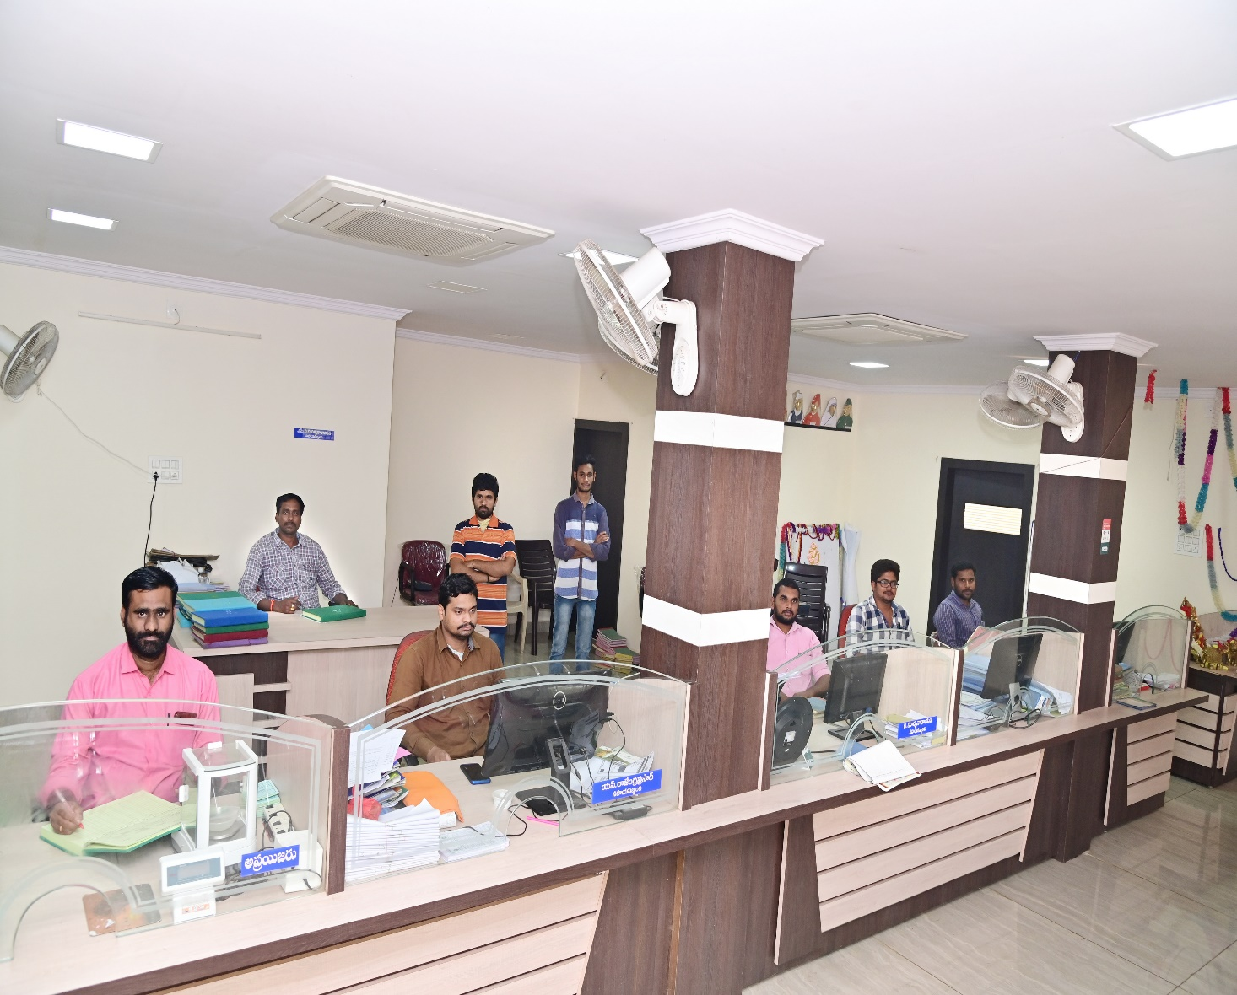
PACS Computerisation - Readiness
Proof of Concept (PoC) done in 38 PACS
Audit for 2021-22 completed in 1874 out of 2051 PACS
Budget provision made for 2022-23
Constituted SLIMC & DLIMC
GoI to permit us to computerise all PACS in a single phase.
Notes:
As regards to readiness of computerization of PACS are concerned, let me inform that we have done a PoC in 38 PACS and the TCS-IPKS software was successful in meeting the requirements of a PACS. Further, Audit has been completed in over 90% of PACS and the rest by this month end. Our state government has already given their concurrence for participation in the project and also made a budget provision during the current year. The State Level and District level Implementation and Monitoring committees have also been constituted and we are ready to launch the computerization in one go.

Slide 10
Collaborations
1st of it’s kind
PACS-RBK
Integration
Tie up with Depts of GoAP
PACS-RBK Integration
Collaborated with Commonwealth of Learning and ANGRAU for COL-L3E and L3F Projects
Collaboration of with Oil Companies & Cement Factories
Collaboration with Digital commerce platforms (Ninjacart)
COL – Interactive knowledge sharing
NABARD
supported in establishment
of BDPIC
HPCL - Setting up of petrol bunks in PACSs
Notes:
I have worked with co-operative institutions for long and noticed that these institutions are far behind in collaborating with other institutions / departments. I had presented in my previous slides the credit increase by collaborating with departments of GoAP. Further, APCOB has tied up with Commonwealth of Learning for imparting continuous education to all the employees of CCS through Mobi-MOOC. We are implementing Life Long Learning for Employees (L3E) through informative audio calls and it has helped in bringing all the employees on one platform. AP Agriculture University is the knowledge partner under the project.
The PACS are also being encouraged to diversify their business into other areas. Last year, we had tied up with oil companies like HPCL and BPCL for setting up of company owned petrol retail outlets in the sites owned by PACS. Around 87 PACS have got letter of intent from these oil companies and are in various stages of implementation. A few PACS have tied up with Ninjacart for banana sale, with cement factories for sale of cement, with Markup for sale of essential items etc., I think in the days to come, collaborations will help the co-operatives in realising higher income streams from their existing networks.

Slide 11
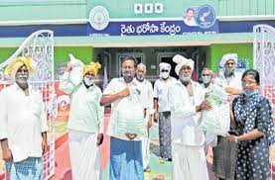
Integration of RBKs - PACS
Rhythu Bharosa Kendras (RBKs), a first of kind initiative in AP
Supporting farmers from “seed to sale”
Every village has one RBK - >10,700 no.
RBKs are geo tagged to PAC
Credit and non credit services.
Notes:
Another far reaching reform being implemented is the integration of Rhythu Bharosa Kendras with PACS. Government of Andhra Pradesh has set up Rhythu Bharosa Kendras (RBK) at village level as first of its kind, wherein farmers are being supported from ‘Seed to Sale’. There are over 10,700 RBKs functioning in the state providing the desired services to the farmers. These RBK’s have been geo tagged with Primary Agriculture Cooperative Credit Societies (PACSs) for providing credit services to farmers in a seamless way. The integration of two grass root level institutions i.e. RBK and PACS will enable greater financial inclusion and also in providing non credit services. During last year, RBKs and PACS through a joint collaboration procured over 50 lakh MTs of paddy from the farmers.

Slide 12
Human Resources
Autonomous Training Institute in Hyderabad. New one proposed in Kadapa
Deputation of Senior Officers of APCOB as GM/OSD to DCCBs for supporting them in statutory aspects
Training
Transparent Career Progression. Amolorpavanathan committee recommendations implemented.
Support
HR Policy
Introduced Test checks methodology for preventing Frauds.
Preventive
measures
Recruitment through IBPS and Common recruitment for all DCCBs
Recruitment
Organization
Development
People
Engagement
Introduced “SANGHAMITRA” - PACS Adoption Policy
Hello Team APCOB, Project Walks
Notes:
Human resources are key for driving the interventions and innovations in the co-operatives. With the implementation of Amalorpavanathan committee recommendations, a transparent recruitment and career progression has been brought in APCOB and DCCBs. The recruitment of employees is only through IBPS and a common recruitment process has been implemented for DCCBs across the state. Further, lot of importance has been given to improve the functional and soft skills among the employees and we have tied up with reputed training institutions like BIRD and IIMs. With average age of employees in co-operative banks being around 30 years, project walks was implemented to give them rural immersion. It was also made mandatory to have ‘All Hands Meet’ in every co-operative on a fortnightly basis to bringin all round transparency. APCOB and DCCB employees were also encouraged to adopt PACS under our sanghamitra policy.

Slide 13
PACS - HR Policy
Pay & Allowances
Career Progression
District Level Support Fund
Transfer Policy
Common Recruitment
Notes:
Realising the need for structured HR intervention, we have framed the Human Resource Policy for PACS employees, a first of its kind in India. Revised Pay & Allowances, Transparent Transfer Policy, Common Recruitment, Career Progression and training are salient features of the HR Policy. A district level support fund has been created for meeting the revised pay and allowances for the PACS employees. DCCBs and APCOB are bearing the cost of DLSF. With implementation of HR policy, it has created a job security for PACS employees with well defined working conditions.

Slide 14
Road map – Futuristic Approach
PACS
Computerization
Brand Image
Completion of Computerization of PACS by the end of FY 2022-23
Target
Build a common brand for all institutions under the umbrella of CCS
Aiming to reach the top w.r.t lending to Agriculture sector in Andhra Pradesh
Business
1.5 Lakh cr. combined business by end of FY 2024-25
Notes:
While the co-operatives slowly regaining the lost ground, we have further plans for strengthening the initiatives taken by us in the last few years. A brand consultant who has earlier worked with Andhra Bank has been employed to build a common brand for all the three tiers of the CCS and the work is underway. Further, long term perspective plans are being prepared for every entity to meet the goal of reaching atleast 20% share in total credit in the next 5 years. Our ultimate goal is to be the number one lending institution for farmers in our state.

Slide 15
A few challenges..
Separate Refinance Exposure Policy by NABARD for SCBs with single window credit delivery (ST & LT)
Membership in National Credit Guarantee Trustee Company (NCGTC) for providing credit guarantee for education loans
Clearance for computerization of all PACS in one go
Regulatory compliances – Need for developmental approach
Strengthening share capital of cooperatives through an appropriate mechanism by Government of India as grant in the days to come.
Notes:
Cooperative banks in AP are meeting the short and long term credit needs of the farmers under single window system. Due to bifurcation of the state, the AP State Co-operative Bank (APCOB) lost its branch network in Hyderabad, loosing its huge deposit base and is totally dependent on borrowings from NABARD. I request that NABARD may redefine its exposure norms to State Co-operative Banks which are under single window credit delivery system and increase the support so that there is no strain towards extending credit to farmers.
We thank GOI for upward revision in norms for housing finance by cooperative banks as well as extending CGTMSE facility. On the same lines, I request for support for education loans sector. The membership extended to commercial banks in National Credit Guarantee Trustee Company (NCGTC) for providing credit guarantee for education loans may also be extended to cooperative banks.
We also request clearance for computerization of all PACS in the state in one go, instead of phases as we have almost completed audit for the year 2021-22 and complied to all the instructions of GOI. This will help us in furthering the initiatives which we are taking at state level.
A recent phenomenon is imposing of penalties by RBI on Co-operative Banks for failing to meet regulatory compliances. Over 145 banks have been penalized with over Rs. 12 crore. Its not the penalty but the loss of image to the cooperatives, which have a very limited operational area. With co-operatives embrassing technology in a big way, we need a developmental approach by RBI for another 5 years before taking stricter measures.
I close my presentation with a request for strengthening share capital of co-operatives through an appropriate mechanism by GoI, similar to commercial banks. This shall help many of the co-operatives to meet regulatory compliances like CRAR and also will be able mobilise resources from a basket of lenders.

Slide 16


Thank You

