Slide 1



Cooperative Department
Andaman & Nicobar Administration
Sahkar-se-Samriddhi

Slide 2
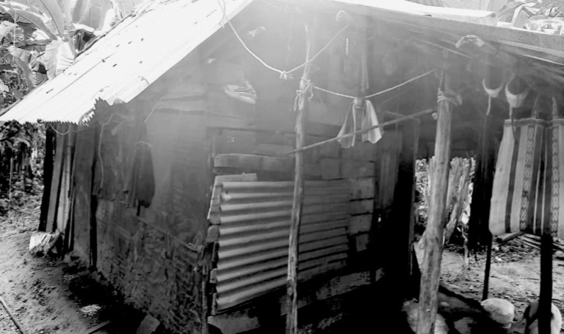
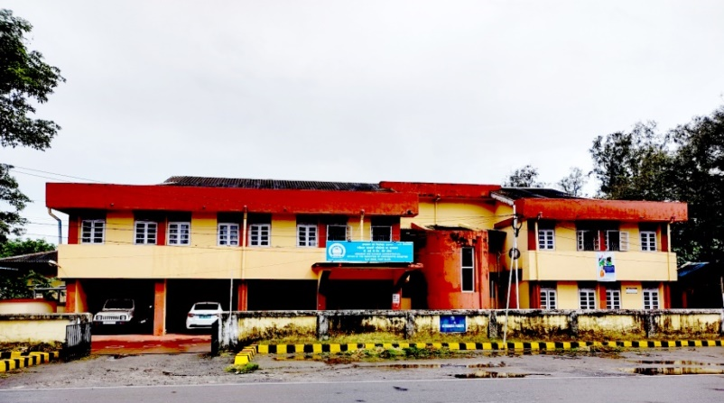
The Background
First Society
History of cooperative movement in Andaman & Nicobar Islands started in the year 1946 with registration of the first cooperative society “Rangachang Cooperative Land Syndicate” on 04th Dec, 1946 under Cooperative Societies Act, 1912.
Cooperative Department started functioning independently from Dec, 1962. Prior to that, the powers of RCS was delegated to the Director of Industries/Fisheries/Revenue Department.
Cooperative Deptt. Office

Slide 3
Growth of Cooperative Societies in A&N Islands
2260
1682
856
422
269
121
175
01
34
Number of registered cooperative societies

Slide 4














Major Sectors in A & N Islands
Construction - 1161
Primary Agricultural Credit Societies - 46
Fisheries - 132
Tourism - 45
Labour Contract - 131
Non-Agricultural Credit Societies - 37
Housing - 93
Canteen - 33
Marketing - 79
Services - 28
Dairy/Poultry/Livestock - 77
Plantation - 26
Consumer Store - 70
Banking - 1
Total cooperative societies - 2260

Slide 5

Achievements
Employment
Annual employment to more than 36,000 persons.
Rs 62.26 crores loan provided by 46 PACS to 8,698 members/farmers from 1965 to 2022.
Agriculture loan
Rs 787.98 crores loan disbursed by 01 cooperative bank/37 thrift & credit cooperative societies to 7,911 members from 1965 to 2022.
Non-agriculture loan
Cooperative societies running 63 consumer stores catering 4.34 lacs population from north (Diglipur) to southernmost tip of India (Campbell Bay).
Fulfilling daily needs

Slide 6
Achievements
03 Tribal cooperative societies for Onges, Nicobarese and Great Andamanese cater daily needs of PVTGs/aborginal tribes and procures local produces such as copra, coconut, arecanut from its members/tribals.
Social inclusion - tribal welfare
and development
Development of fisheries sector
132 Fisheries cooperative societies undertake various activities - catching and sale of fish, loan disbursements for boat purchases and other equipments.
Security & Healthcare services
28 Cooperative societies fulfilling the local requirement of security guards and health care workers.

Slide 7
Achievements
Affordable housing solutions
93 Housing cooperative societies provided affordable housing solutions to 1,706 people.
Total volume of activities of all cooperative societies in FY 2021-22 was Rs 131.39 crores.
Total deposits of 01 cooperative bank as on 30.06.2022
Rs 1206.77 crores.
Total turnover of
all coop. societies
Rs 15.07 crores financial assistance given to 869 cooperative societies[ Govt share capital, managerial subsidy, reimbursement of establishment charge, grant-in-aid to cooperative unions, working capital loan ].
Financial assistance by
A & N Administration
Training &
Capacity building
585 training programmes conducted for cooperative societies directors/members/employees.
13,977 members trained during last 23 years.

Slide 8
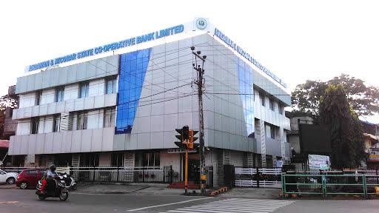
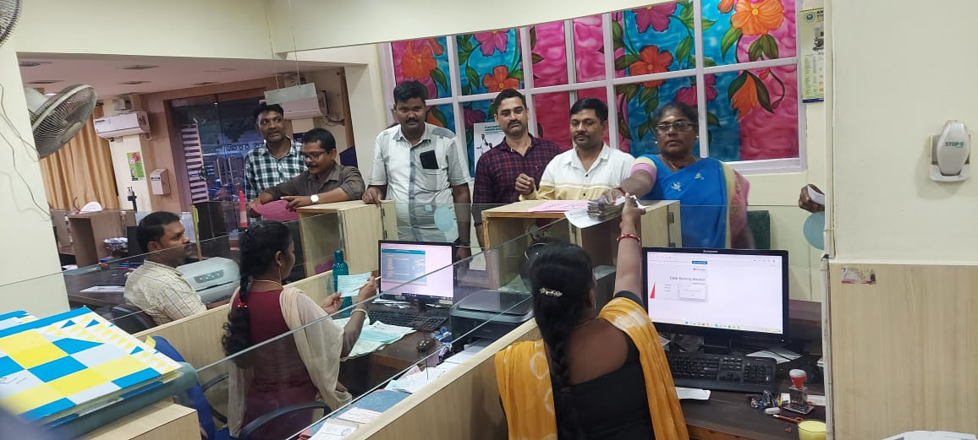
Success Stories - Financial Inclusion
Andaman & Nicobar State Cooperative Bank Ltd.
Largest bank of territory with 41 branches at 14 Islands from north (Diglipur) to southernmost tip of India (Campbell Bay).
Established on 6th Jan, 1965.
Provides agricultural loans to farmers through 46 Primary Agricultural Credit Societies (PACS).
Total employees - 334
Total bank accounts – 4,06,334
Total deposits - 1206.77 crores
Total Agriculture loans disbursed - 62.26 crores
Total Non-Agriculture loans disbursed - 785.44 crores

Slide 9

Success Stories - Complete tribal society
Ellon Hinengo Limited (EHL) – Car Nicobar
A Central tribal cooperative society formed by a group of 15 primary cooperative societies.
Established on 04th May, 1977.
13 retail outlets.
Nature of activities – 02 cargo ships, 01 petrol pump, civil engineering works, stevedoring activities, procurement & sale of copra, coconut and arecanut.
Total employees - 224
Annual turnover - 36.05 crores (FY- 2021-22).

Slide 10
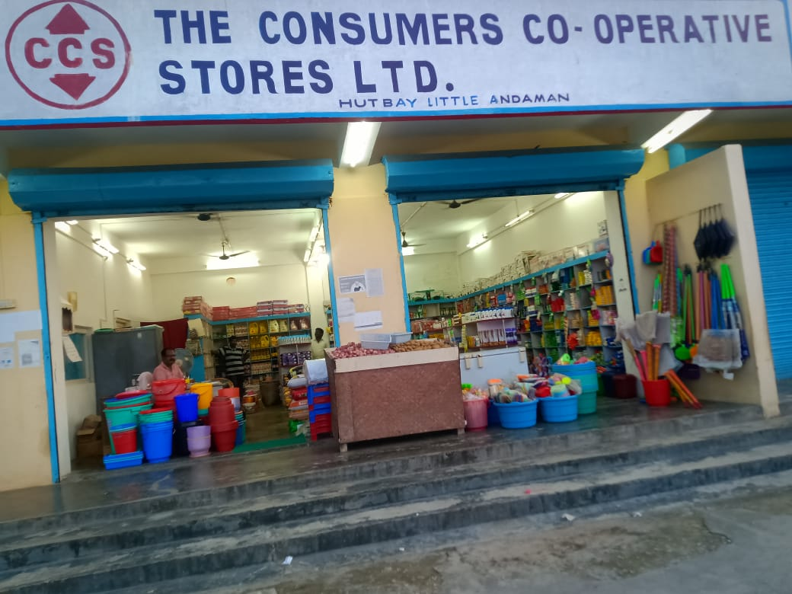
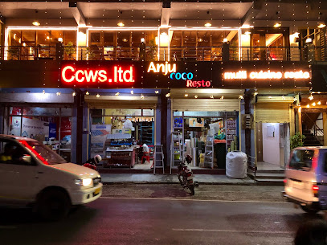
Success Stories - Catering daily needs of people of farflung areas
Consumer Cooperative Stores Ltd. (CCS)
Established on 15th Dec, 1962.
28 consumer stores
Nature of activities – sale of consumer goods, fair price shops, LPG distribution.
170 employees
Annual turnover - Rs 42.24 crores (FY 2021-22).
Central Cooperative Welfare Society Ltd. (CCWS)
Established on 1st Dec, 1948.
12 branches
Nature of activities - sale of hardware items, paints, construction material, crackers.
52 employees
Annual turnover - Rs 16 crores (FY-2021-22).

Slide 11
Constraints and Challenges
Geographical remoteness - lack of accessibility to mainland markets.
Sparse population (4.34 lacs).
Scarcity of land and other resources.
High transportation & labour cost results into costlier inputs, higher project costs and incompetitive sales.
Members lack adequate & latest knowledge/techniques/practices.
Shortage of funds & working capital to run & expand activities.
Difficulty in getting buyers.
Lack of branding of local produce.

Slide 12
Initiatives/Future Plans
A web based portal being developed for facilitating online registration, amendment, election etc, to be started from 1st Nov, 2022.
Computerisation of all 46 PACS with assistance of GOI.
01 Cooperative bank (1,206.77 Cr deposits) already on-board on GeM on 9th Aug, 2022.
Digitalization
Organizing sectorwise training-cum-seminar - fisheries, plantation, tourism, civil construction, labour contract, PACS sector etc.
Setting up of new projects in coconut, arecanut, fisheries, tourism.
Food processing activities for local consumption - pickle, mineral water, dry fish, coconut dessicated powder, coconut oil & coir products.
Skilling & Entrepreneurship
Assistance in getting new buyers from mainland.
Expanding financial assistance.
Diversification of PACS - fair price shops, common service center, agriculture inputs to fulfill local needs.
Business Assistance

Slide 13




