Slide 1
National Database of
Cooperatives
Ministry of Cooperation
1

Slide 2
Current Scenario
At present,
there is no cooperatives
comprehensive
available with the Ministry of
and authentic
database on
Cooperation.
The Ministry of Cooperation has initiated process for creating a National Database on Cooperatives.
Ministry has already started consultations with stakeholders on finalization and inclusion of various parameters, procedures and processes for the database;
  23rd December, 2021
  5th January, 2022
  7th February, 2022
1

Slide 3
Introduction and Objectives of the Database
The objective of developing National Database on Cooperatives is to provide a single point access to information on cooperatives of different sectors and develop a process for better understanding of cooperatives.
The proposed database may function as the main planning tool for Central Ministries, State Governments, Cooperative Federations, Cooperators and Sectoral Institutions like NABARD, etc. for cooperative sector.
It is envisaged to facilitate in policy making, improve governance and improve transparency. It may also help the cooperative sector for its better positioning in the business environment.
The proposed database intends to bring synergy among line ministries and state governments.
1

Slide 4
Functioning and Workflow of the Database
The system would be made available as a platform and can easily be adopted for various activities over a period of time.
The filing of data may be kept voluntary for the cooperatives.
The platform of database would be available on 24*7 bases using internet in a faster and secure environment adopting standard open technologies.
There are two components of the database: static and dynamic. The dynamic database components (financial details) need to be updated on annual basis as on the closure of financial year.
In order to populate the data and understand the ground realities, it is proposed that we may request the cooperatives to fill up the additional data for previous two years (2019-20 and 2020-21).
4

Slide 5
Data Dissemination and Report Generation
Central Ministries, NABARD, State Authorities, National Federations and other stakeholders may be provided access to data as per the Open Data Policy of Government of India.
Quarterly bulletin may be issued giving significant insight to the data. A dash board/ analytics of information would be made available to public.
There shall be a dedicated help desk and toll free number to assist Cooperatives/Federations.
5

Slide 6
Work Done by the Ministry
At present Data Analytics Division, M/o Cooperation is working on the prototype of the National Cooperative Database in the MS Access database.
The Division has already finalized various parameters or fields to be incorporated in the proposed database.
The structure and design of the data collection template of proposed database is in the finalization stage.
Different tables/blocks/forms/reports of the database has been created in MS Access for demonstration purpose and may be communicated to the software developer.
5

Slide 7
Static Blocks of the Database
The proposed database has been divided in the static and dynamic blocks.
The static blocks will contain the fields which remain unchanged for a comparatively longer period of time.
The outline of the Static block is listed detailed fields will be shown in further slides.
Identification Block
Particular Block
Operative Detail Block
Details of Board of Director’ Block
Use of ICT Block
below and
5

Slide 8
Dynamic Blocks of the Database
The dynamic blocks may have fields that may be updated annually after the closure of the financial year.
The outline of the Dynamic blocks is listed below and the detailed fields will be shown in further slides.
  Employment and Labour Cost Block
  Income and Expenditure Block
  Asset and Liability Block
  Products, Services and Schemes Block
  Verification and Submission Block
5

Slide 9
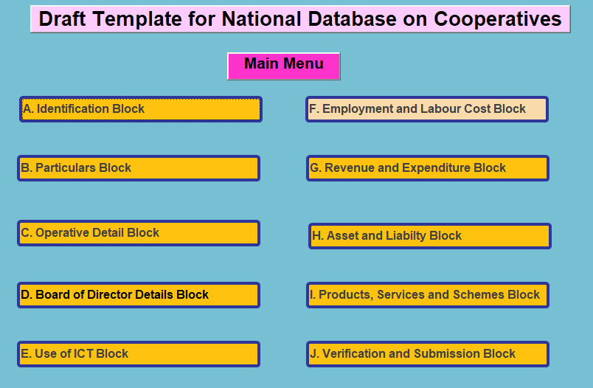
Screen Shot of Template of the Database
9

Slide 10
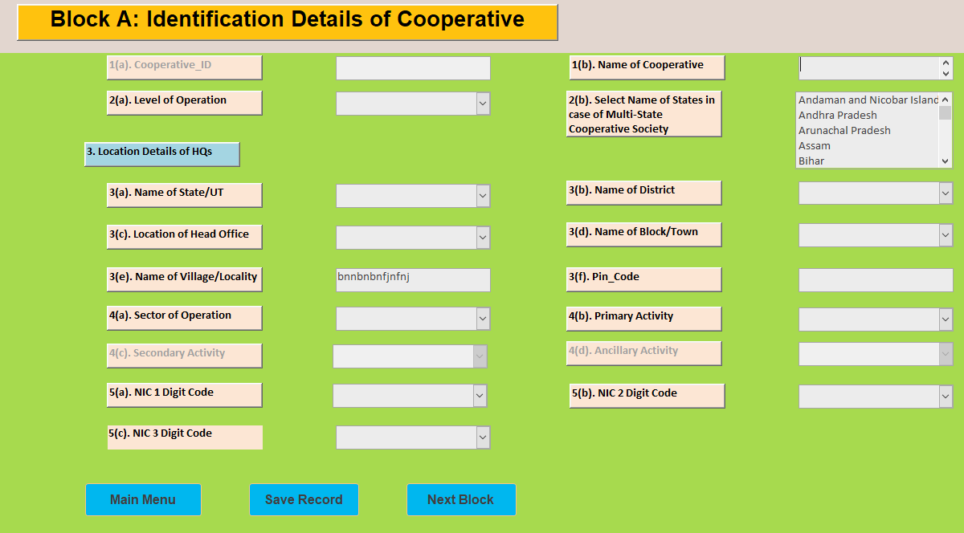
Screen Shot of Block A in the Database

Slide 11
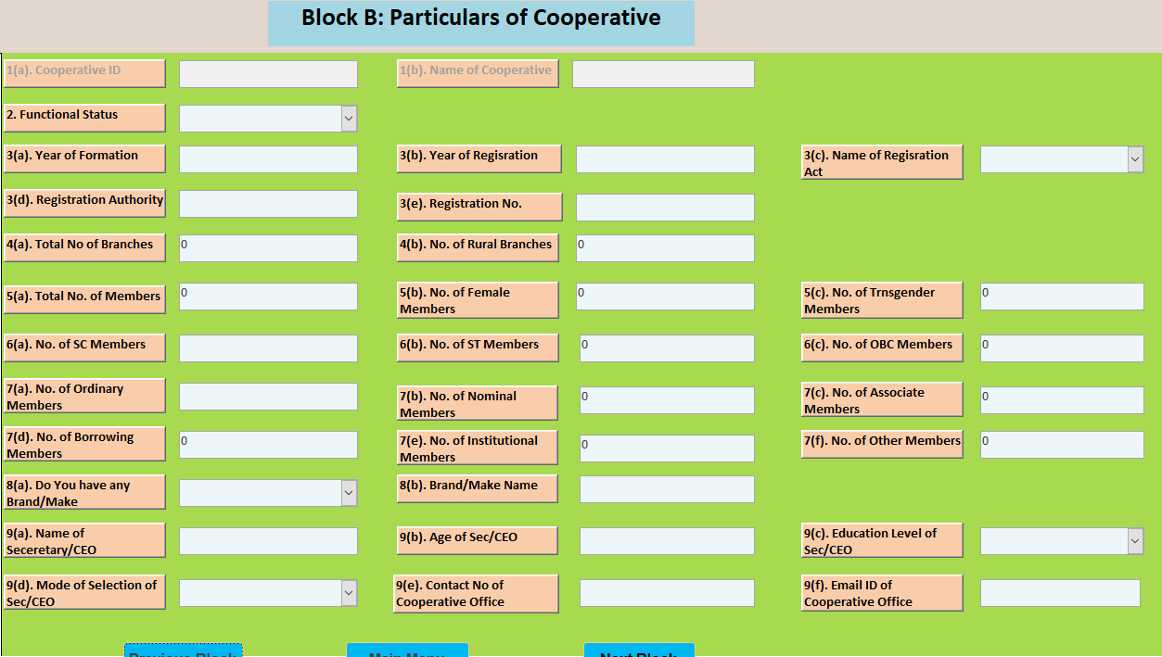
Screen Shot of Block B in the Database

Slide 12
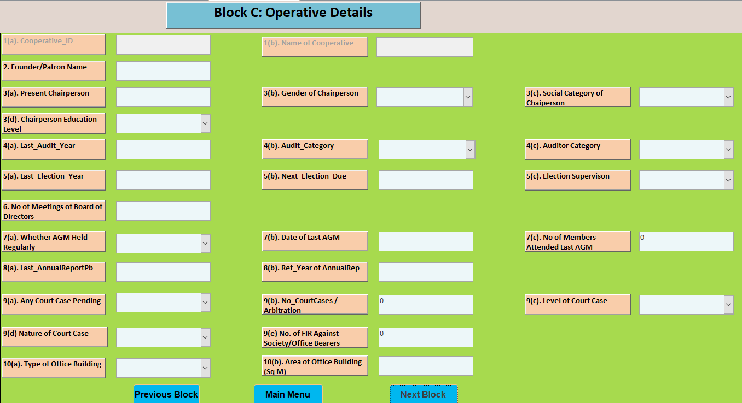
Screen Shot of Block C in the Database

Slide 13
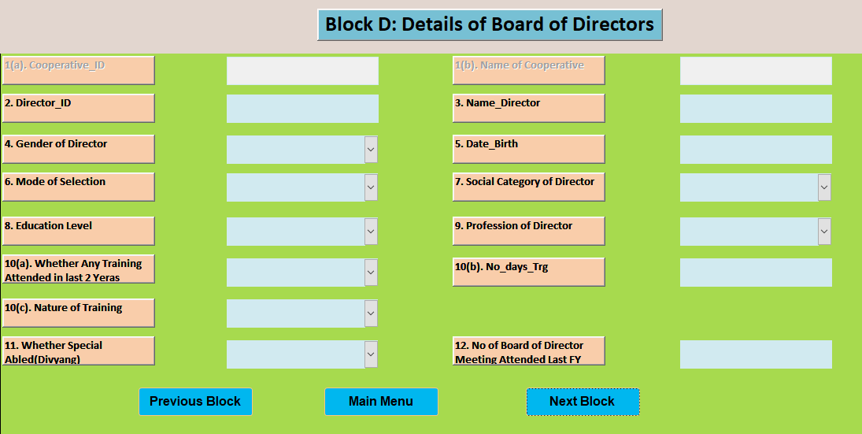
Screen Shot of Block D in the Database

Slide 14
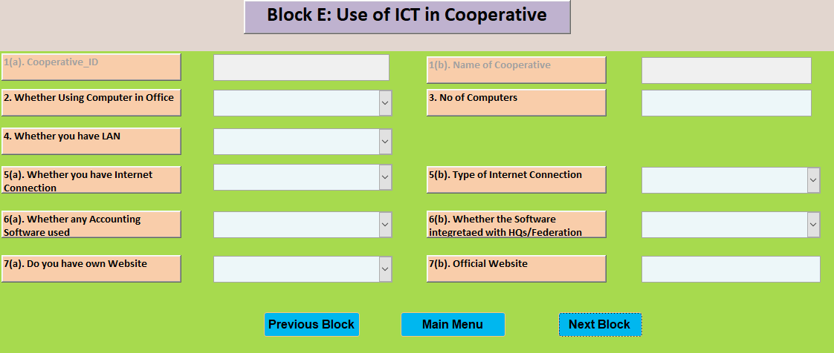
Screen Shot of Block E in the Database

Slide 15
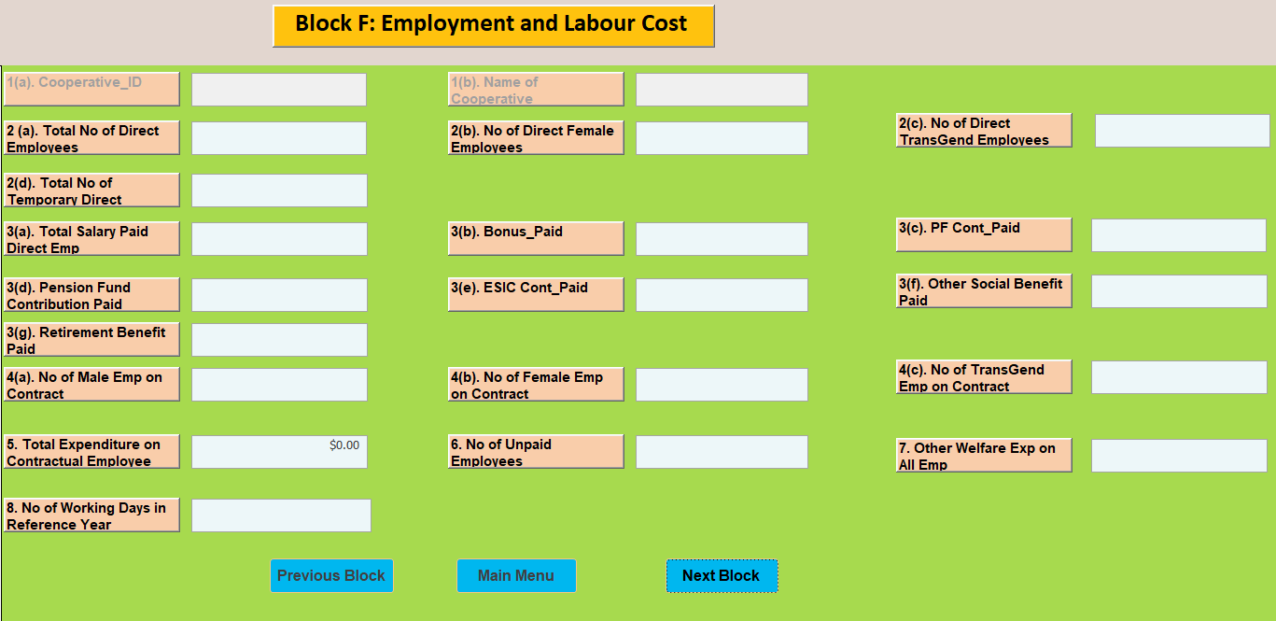
Screen Shot of Block F in the Database

Slide 16
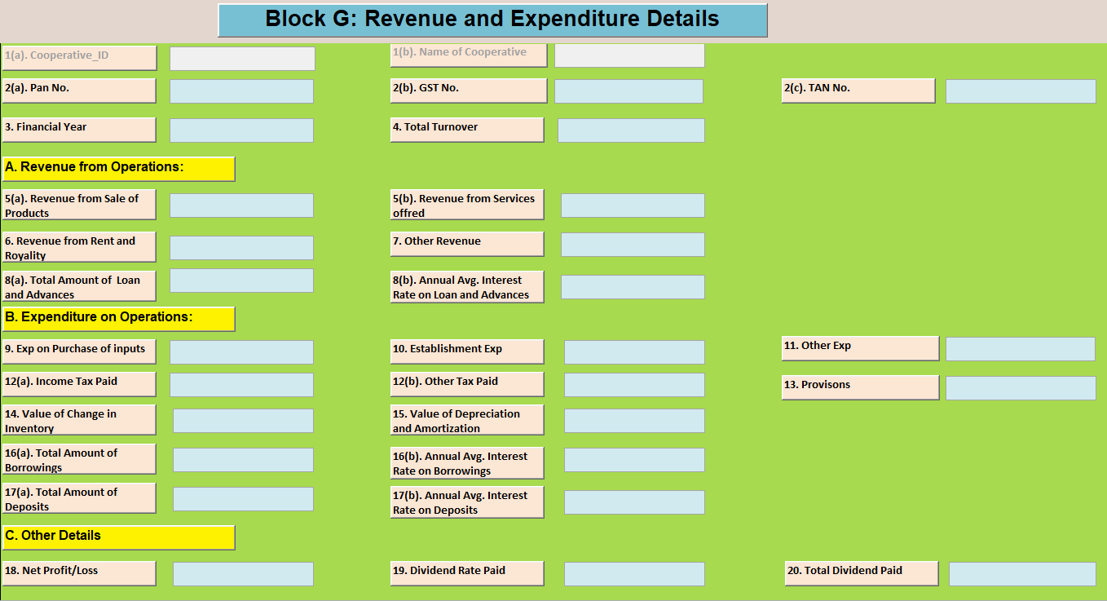
Screen Shot of Block G in the Database

Slide 17
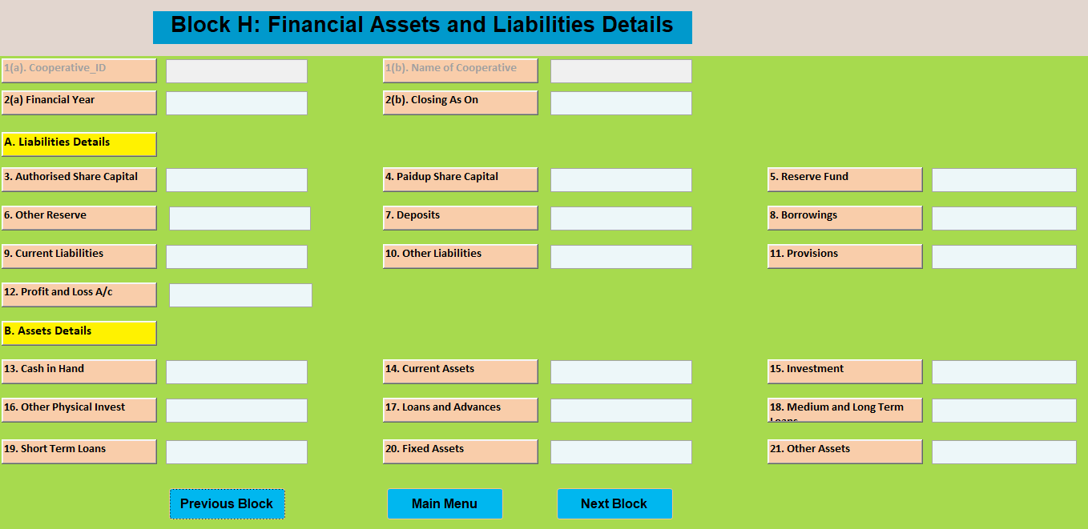
Screen Shot of Block H in the Database

Slide 18
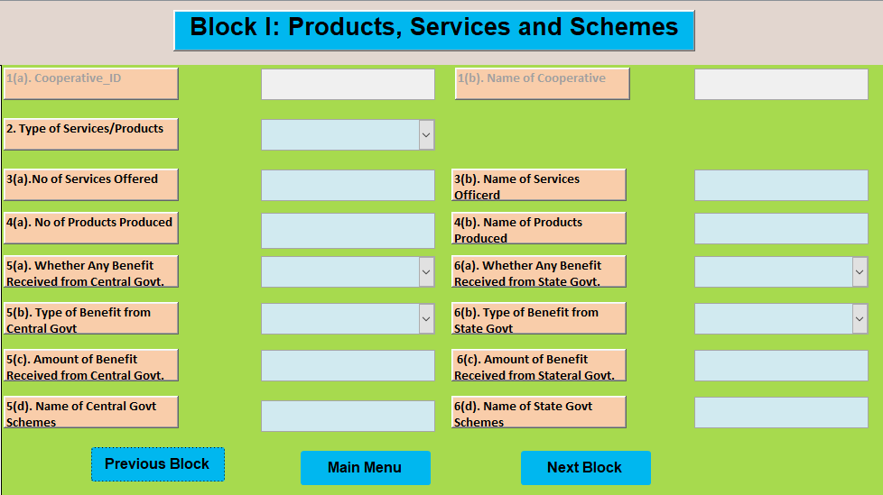
Screen Shot of Block I in the Database

Slide 19
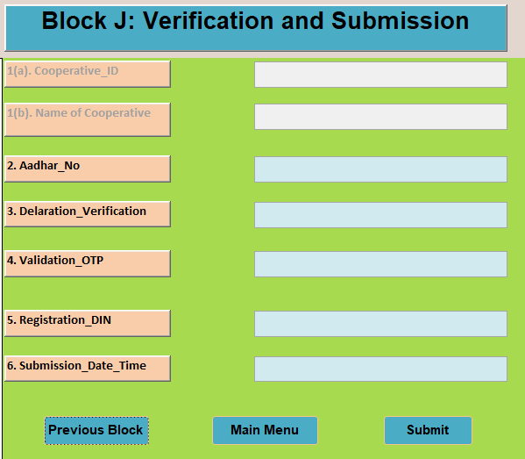
Screen Shot of Block J in the Database

Slide 20
Proposals of Ministry
The Ministry is planning to held a Workshop with State Registrar of Cooperative Societies (RCS), Cooperative Federations, NCCT, Training Institutes, NABARD for finalisation of Sector-Specific Fields of the proposed Database.
The Ministry may facilitate State Governments, Cooperative Federations to organise awareness campaign about the importance of proposed National Database for policy making at grass root level and encouraged them to enter requisite data at Cooperative level itself.
Keeping in view of workload involved and practices followed for data collection in similar Census/Surveys, like Economic Census, NSS Surveys, the Ministry may keep Budgetary provisions of honorarium to meet data entry related expenditure.

Slide 21
Way Forward
The database may be prepared in such a way that it may help the State Governments for registration of the new cooperatives.
The portal may turn into a national portal of registration of cooperatives. However, it would depend on further customisation as per the needs of the registering authorities in State Government and on boarding of State Governments.
The portal may be linked to GEM (Government E Market) platform so that cooperatives can sell their products and services at that platform.

Slide 22
Thank You

