Slide 1

Ministry of Cooperation
National Cooperative Development Corporation

Slide 2
Introduction
NCDC was established by the Parliament under NCDC Act, 1962.
Advance loans and grant subsidies to State Governments for financing co-
operative societies and also direct lending to co-operative societies.
Aims to provide assistance to all the bankable projects across States through its
18 Regional Offices.
Disbursements have risen steadily from Rs 5700 Crore (2014-15) to Rs 34200 Crore (2021-22). Cumulative financial assistance so far is Rs. 2.15 lakh crore.
Implements flagship GoI schemes such as erstwhile CSISAC, FPO, PMMSY, FFPO, DIDF, FIDF, PM FME, AMI, National Livestock Mission, etc.
Timeline: Working Capital Loan in 15 days and Term Loan in 30 days.

Slide 3
Regional Office wise Equivalent Penetration Targets (EPT) for FY 2022-23
S.No. | Regional Office | Covered States/UTs | EPT (Population * 500) (Rs. in Crore) | Mobile No of Regional Directors
1 | Bengaluru | Karnataka | 3000 | 9311765334
2 | Bhopal | Madhya Pradesh | 3600 | 9311765335
3 | Bhubaneswar | Odisha | 2100 | 9311765336
4 | Chandigarh | Punjab, Haryana, Jammu & Kashmir, Chandigarh | 6600 | 9311765337
5 | Chennai | Tamil Nadu, Puducherry | 3600 | 9311765338
6 | Dehradun | Uttarakhand | 500 | 9311765339
7 | Gandhinagar | Gujarat, Daman & Diu | 3200 | 9311765340
8 | Guwahati | Assam, Arunachal Pradesh, Mizoram, Tripura, Nagaland, Manipur, Meghalaya | 2100 | 9311765341
9 | Hyderabad | Andhra Pradesh, Telangana | 4600 | 9311765342
10 | Jaipur | Rajasthan | 3400 | 9311765343
11 | Kolkata | West Bengal, Sikkim, Andaman & Nicobar Islands | 4600 | 9311765344
12 | Lucknow | Uttar Pradesh | 10000 | 9311765345
13 | Patna | Bihar | 5000 | 9311765346
14 | Pune | Maharashtra, Goa, Dadra & Nagar Haveli | 5500 | 9311765347
15 | Raipur | Chhattisgarh | 12000 | 9311765348
16 | Ranchi | Jharkhand | 1600 | 9311765349
17 | Shimla | Himachal Pradesh | 300 | 9311765350
18 | Thiruvananthapuram | Kerala, Lakshadweep | 1700 | 9311765351
Total |  |  | 73400

Slide 4


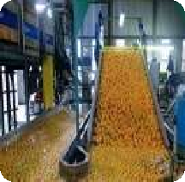

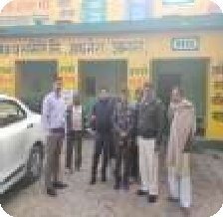
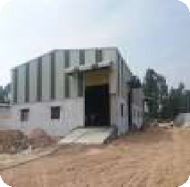







Activities Funded by NCDC
Marketing & Inputs
Assistance for MSP operations, Farm Service Centres, Agri-infrastructure, Custom Hiring Centres
Industrial ,Credit ,Service Coops. & Yuva
Sahakar
Agro-Processing
Sugar, Textile, Oilseed, Food grains, Fruit and Vegetables and other processing.
Weaker Sections
Dairy and Livestock, Fishery &TD Handloom, Coir, Jute, Sericulture, SC/ST and Women Cooperatives .
Erstwhile ICDP
It is an integrated area-based approach taking into account the local needs and resources.
Supply Chain, Computerisation etc.
Storage, Cold Chain, Supply Chain Consumer, Computerization and Promotional and Development
TERM LOAN
WORKING CAPITAL LOAN
Rate of Interest
10.10% to 10.57%
6.82% to 9.16%

Slide 5
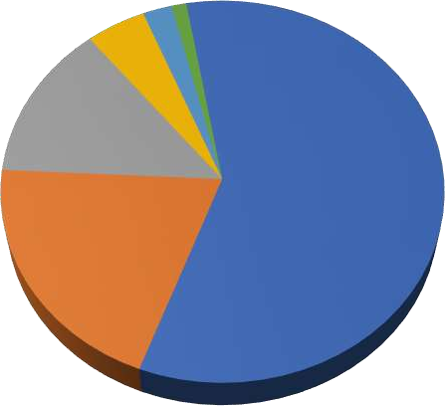
Activity Wise Exposure of NCDC
SN | Activity | Cumulative disbursements (Rs. In Crore)
 |  | Amount | %
(i) | Marketing & Inputs | 126142.29 | 58.49
(ii) | Industrial & Service Coops. | 43270.4 | 20.06
(iii) | Agro-Processing | 28807.42 | 13.36
(iv) | Weaker Sections | 10068.02 | 4.67
(v) | ICDP | 4875.33 | 2.26
Others
(vi) | Computerisation of Cooperatives | 608.25 | 0.28
(vii) | Storage and Coldchain | 1384.19 | 0.64
(viii) | Consumer | 349.03 | 0.16
(ix) | Promotional & Developmental Activities | 148.06 | 0.07
(x) | Yuva Sahakar | 0.32 | 0.00
(x) | FPO | 16.37 | 0.01
Total |  | 215669.68 | 100
^{ICDP} Others
Weaker ^{2%} Sections
5%
1%
Agro- Processing 13%
Marketing & Inputs 59%
Industrial & Service Coops.
20%

Slide 6
Livestock Programme Telangana
Special scheme of livestock, assistance to Telangana State Sheep and Goat Development Cooperative Federation Ltd. of ₹ 8600 crore for a period of 8 year.
Project aims at grounding of 7.5 lakh sheep rearing units(20 Ewes and 1 Ram-
cost ₹1.50 lakh) benefitting 7.5 lakh cooperative members in 32 districts of
Telangana.
Repayment of loan spreads over a period of 8 year. Year wise repayment provision is made in state budget by Government of Telangana.
Other States may follow the similar model of staggering the budgetary allocation for repayment throughout the loan period .

Slide 7
STREE NIDHI
Jointly promoted by Community & Govt. of Andhra Pradesh and Telangana
NCDC has provided loan to
Telangana:
  Andhra Pradesh: Rs.3100.00 crore benefitting 9.46 lakh SHGs (7.66 lakh in rural & 1.80 in urban)
  Telangana: Rs.1200.00 crore benefitting 6.26 lakh SHGs (4.45 lakh in rural & 1.81 in urban)
Stree Nidhi Credit Co-operative Federation Ltd. of Andhra Pradesh and
Stree Nidhi
(Federation of MSs and TLFs)
Mandal Samakhyas (MS)
(Federation of VOs)
Town Level Federations (TLFs)
Federation of SLFs
Village Organization (VOs)
(Federation of SHGs)
Slum Level Federations (SLFs)
(Federation of SHGs)
SHGs in Villages
SHGs in Urban areas

Slide 8
Working Capital for Procurement
NCDC provides credit for short term MSP and non MSP procurement with or without Government Guarantees and through State Government also.
In last financial year, NCDC has disbursed Rs.30,000 crore for MSP operations.
In case of non- availability of Government guarantees, hypothecation of receivables and escrow mechanism of receipt of sale proceeds are accepted as security.
PACS having storage facilities can avail assistance from NCDC on the hypothecation/pledge of stocks available in the godowns.

Slide 9
Exposure to Apex Banks and DCCBs
NCDC finances cooperative banks of some States for their short term credit requirement every year.
Total StCBs : 34, DCCBs : 352, SCARDBs : 13
In last financial year, NCDC has disbursed ₹ 3300 crore to 16 cooperative banks.
NABARD does not provide assistance directly to PACS.
NCDC is offering competitive rate of interest and it is willing to fulfil the credit
requirements of Coop banks and PACS, which is not being met through NABARD.

Slide 10
Special Schemes
Yuva Sahakar (New Cooperative): Start-up support, Rate of Interest @ 2 % less than
applicable rate of interest on term loan.
Ayushman Sahakar (Health Cooperative): Healthcare support, Rate of Interest @ 1% less than applicable rate of interest on term loan, where women members are in majority.
Nandini Sahakar (Women Cooperative): Women support , Rate of Interest @ 1% to 2% less than applicable rate of interest on term loan for all types of cooperatives, where women members are in majority.

Slide 11
Thank You

